Slide 1
2024-2029 Mid-term
Financial Plan (MTFP)
Doug MacLeod, Chief Financial Officer
Todd Nikkel, Senior Manager, Budget
1

Slide 2
2024-2029 MTFP
Six-year forecast
Strategic financial planning
Establishes 2024 Budget baseline
Not an appropriation

Slide 3
2024-2029 MTFP (cont’d)
Fare revenue lower than previous forecasts
Sales and use taxes slightly lower
Sustainable service levels
Asset maintenance fully funded
Fund balances maintained

Slide 4
2024-2029 MTFP (cont’d)
Strategic plan implementation
TABOR limits
Economic volatility

Slide 5
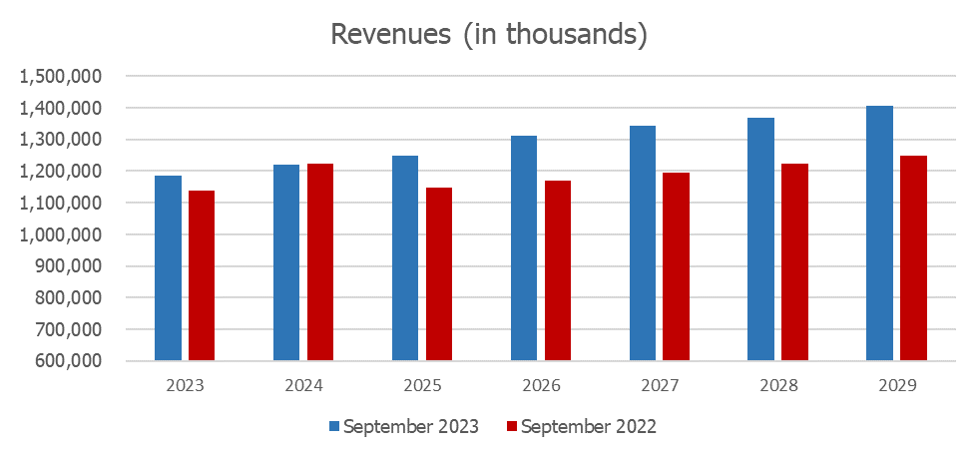
Revenue – Sept. 2023 vs. Sept. 2022

Slide 6
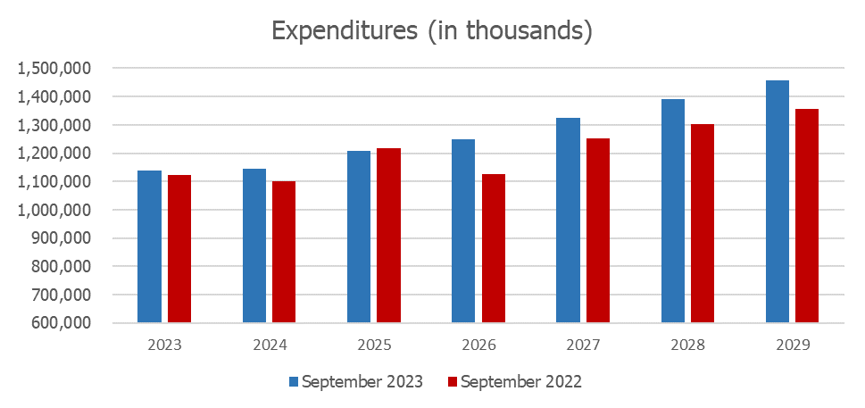
Expenditures – Sept. 2023 vs. Sept. 2022

Slide 7
2024-2029 MTFP Base System ($ in thousands)

Slide 8
2024-2029 MTFP FasTracks ($ in thousands)

Slide 9
2024-2029 MTFP Total ($ in thousands)

Slide 10
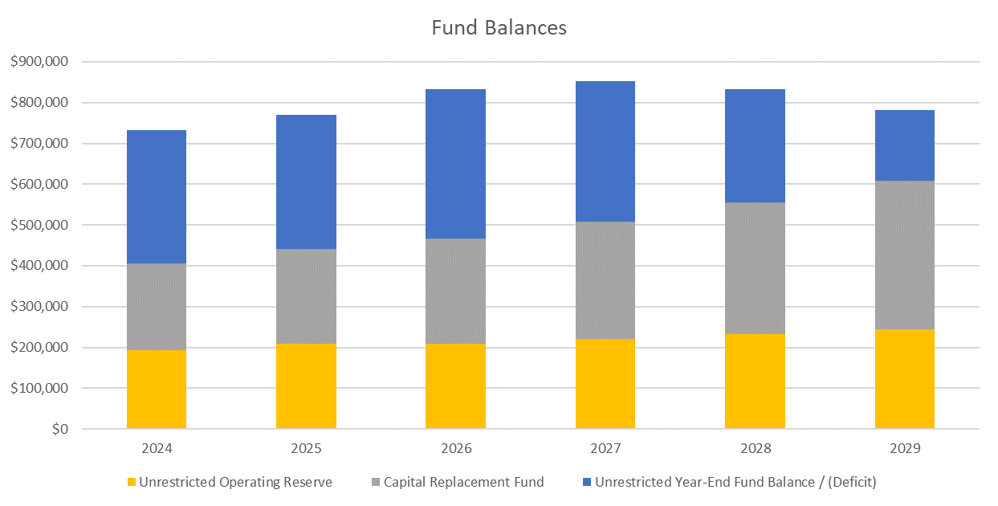
2024-2029 MTFP Total ($ in thousands)

