Slide 1
OpenGov System Training
Role: Public Users

Slide 2
Session Overview
How to request access to Public User from the RTD Website
How to view projects/procurements

Slide 3
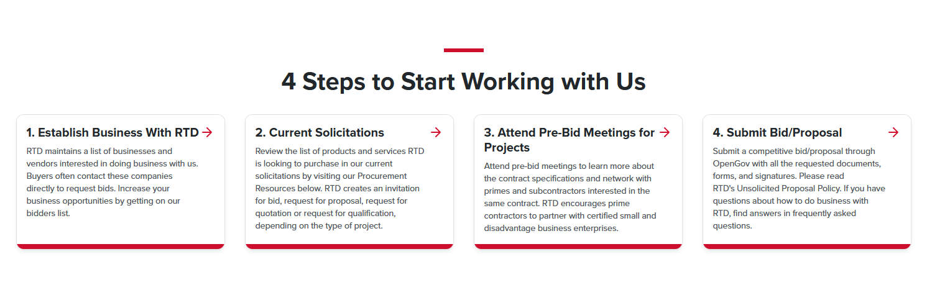
OpenGov: Public User Training
How to access the RTD website
  Go to https://www.rtd-denver.com/doing-business-with-rtd
  Scroll down to Establish business with RTD

Slide 4
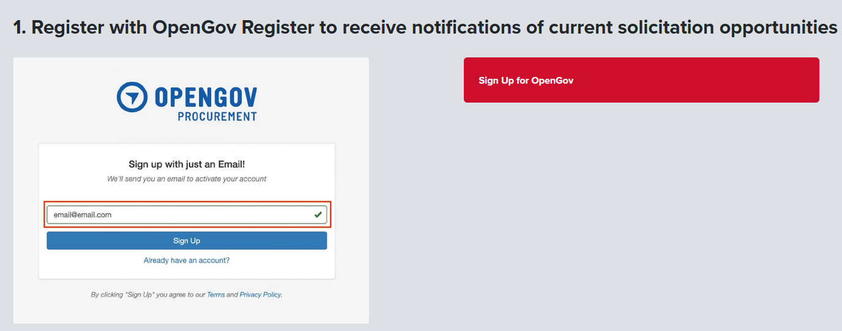
OpenGov: Public User Training
How to Register as an RTD Vendor using the RTD website
  Enter a valid email address
  Click Sign up for OpenGov

Slide 5
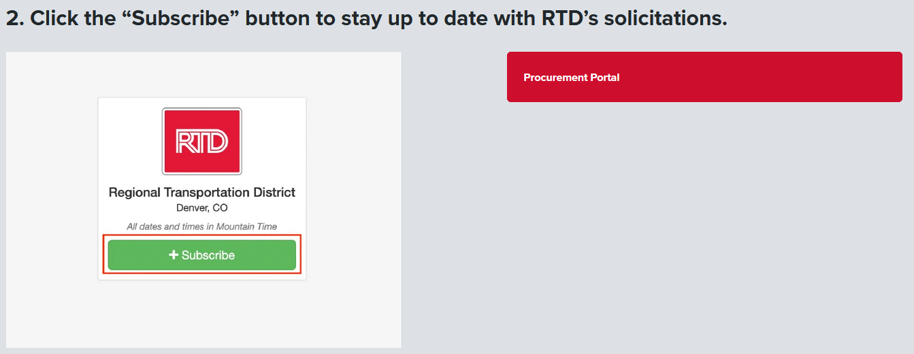
OpenGov: Public User Training
How to Subscribe to RTD solicitations using the RTD website
  Click Subscribe
  Use the Procurement portal to view RTD solicitations

Slide 6
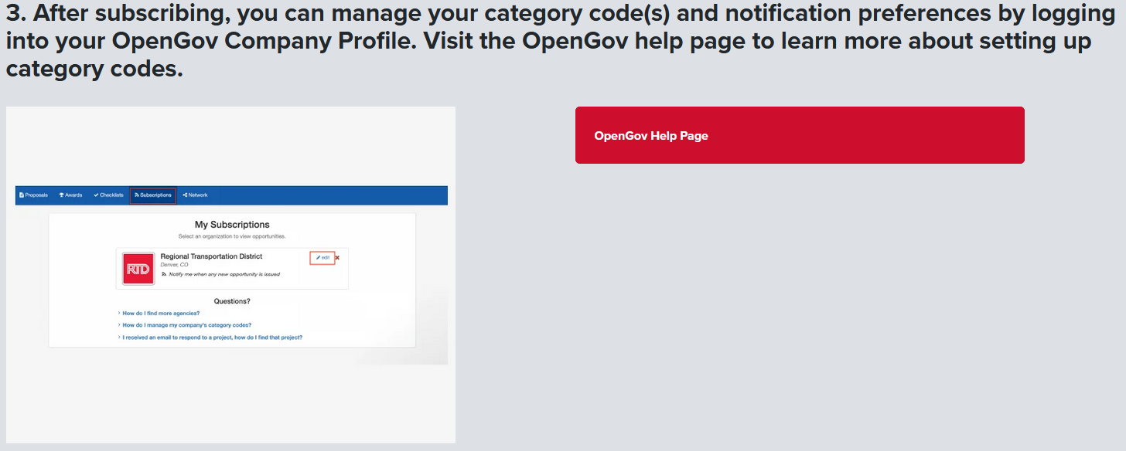
OpenGov: Public User Training
How to Get Help with OpenGov
  Click OpenGov help page link (External Site)
  OR
  Click one of the links under questions in My Subscriptions

Slide 7
OpenGov: Public User Training
How to View Current Solicitations from the RTD website
  Go to https://www.rtd-denver.com/doing-business-with-rtd
  Scroll down to Current Solicitations

Slide 8
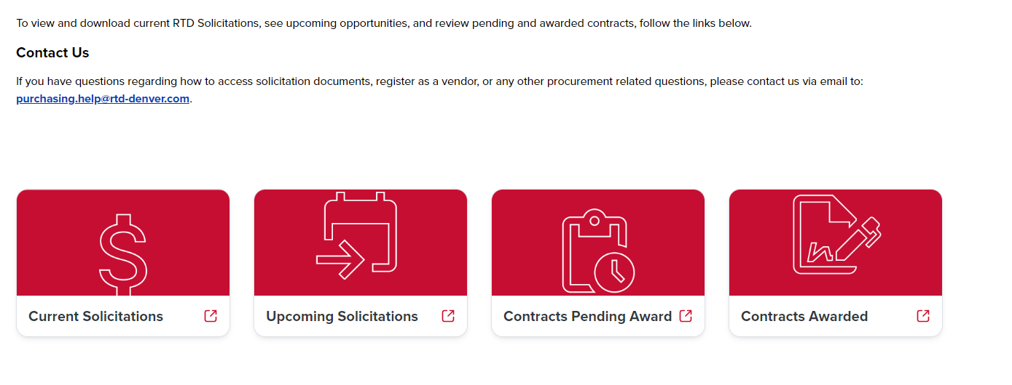
OpenGov Public User Training
Next: Click on Current Solicitations to review Open Projects

Slide 9
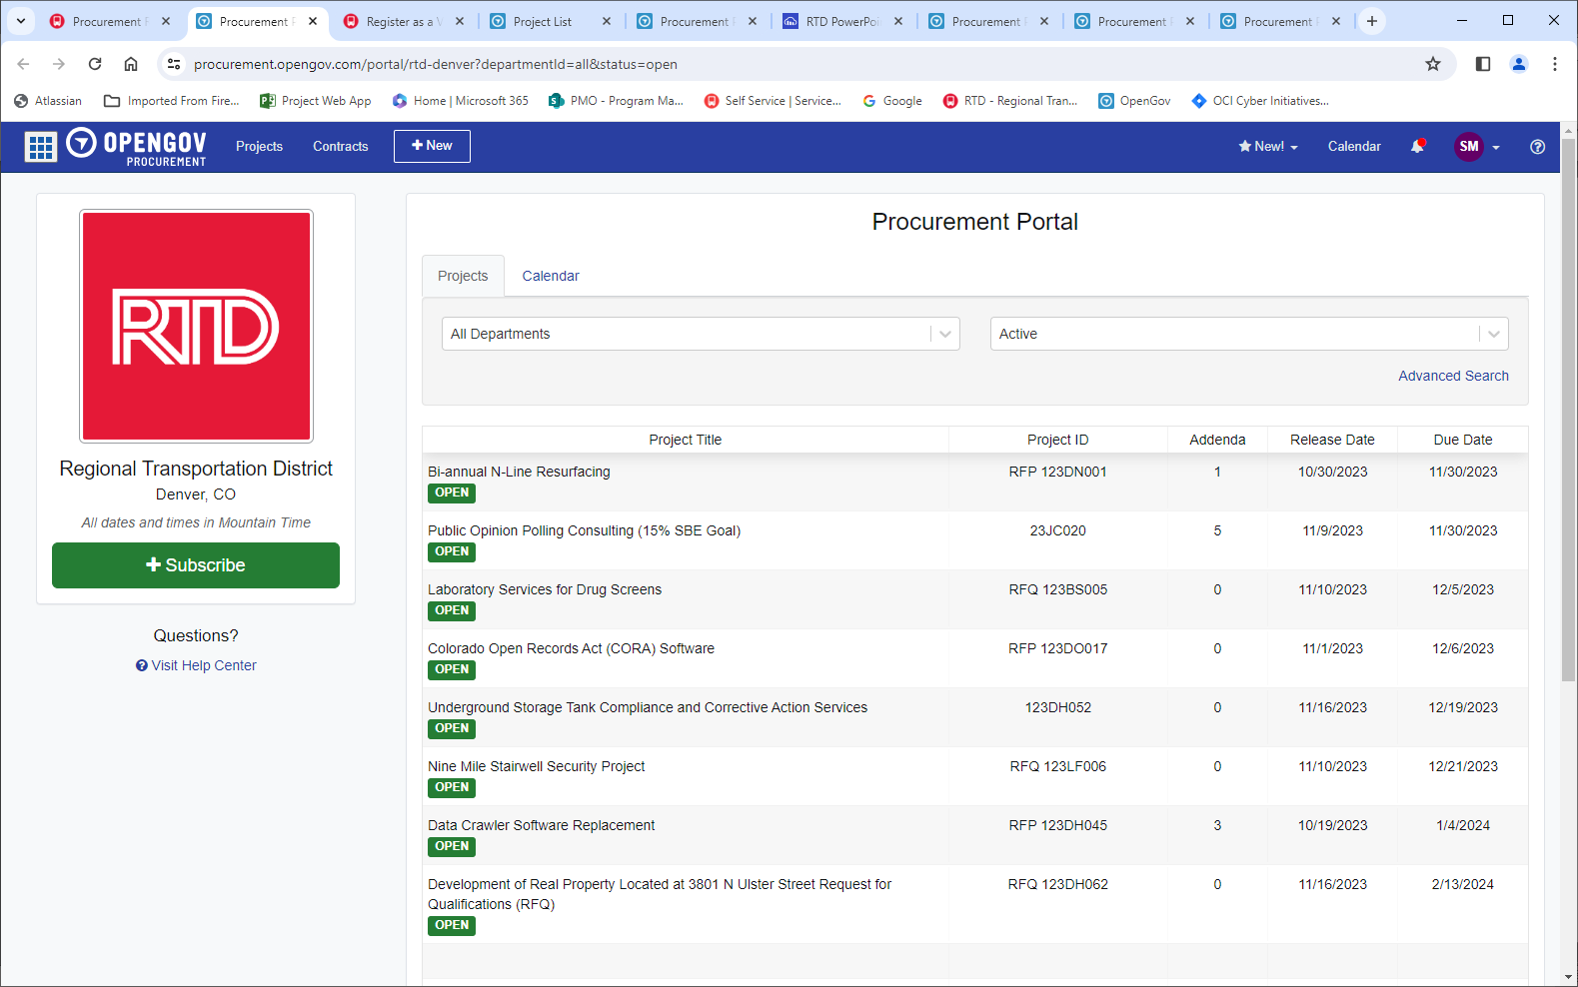
OpenGov Public User Training
Current Solicitations view:
Click on “Open” to open a procurement
Click on “Subscribe” to register to RTD’s procurement postings in the future

Slide 10
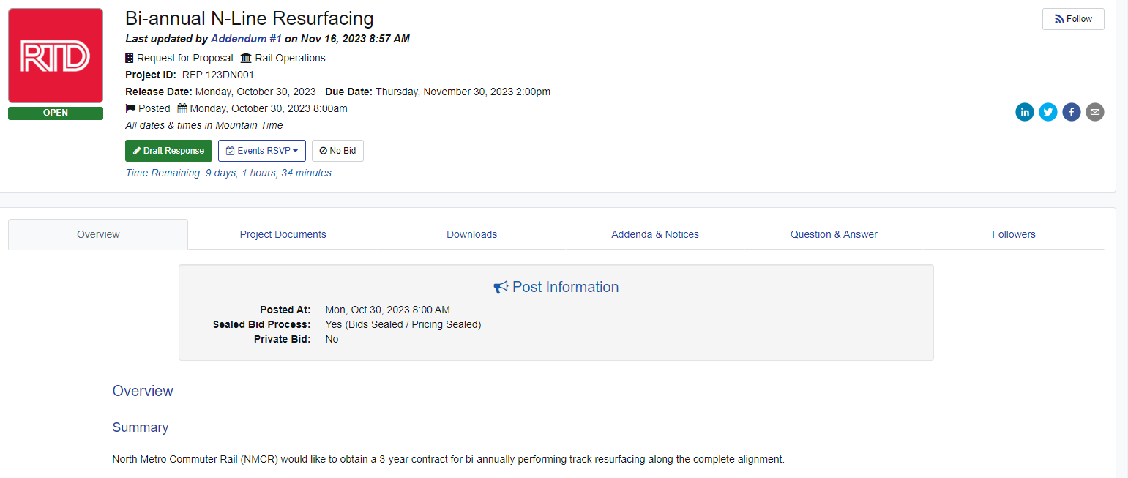
OpenGov Public User Training - Andrea Sucherman
Current Solicitations view:
When user is in a specific Procurement user can select to view the procurement Overview, view Project Documents, download Documents, see Addenda & Notices, see Questions & Answers, and see who is Following the procurement

Slide 11
OpenGov Public User Training
Next: Click on Current Solicitations to review Open Projects

Slide 12
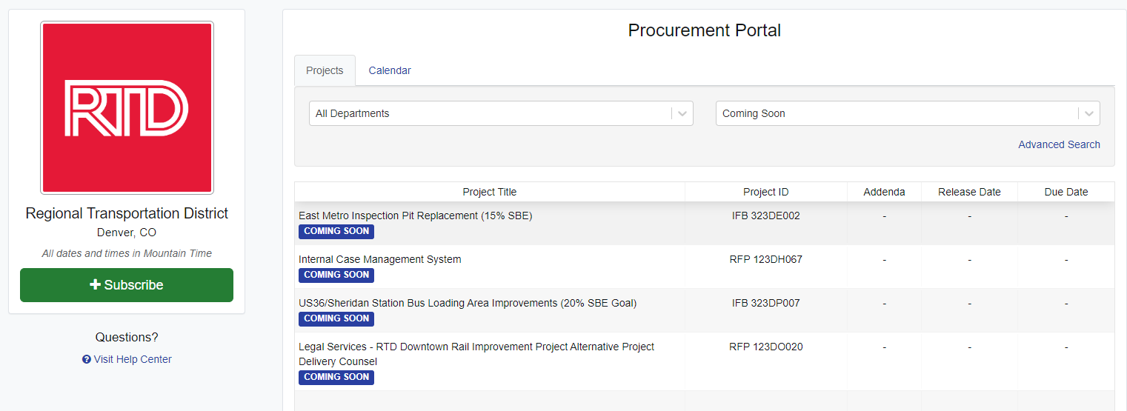
OpenGov Public User Training
Upcoming Solicitations view:
This is an informational screen, there is no additional information available to the Procurement
Click on “Subscribe” to register to RTD’s procurement postings in the future

Slide 13
OpenGov Public User Training
Next: Click on Current Solicitations to review Open Projects

Slide 14
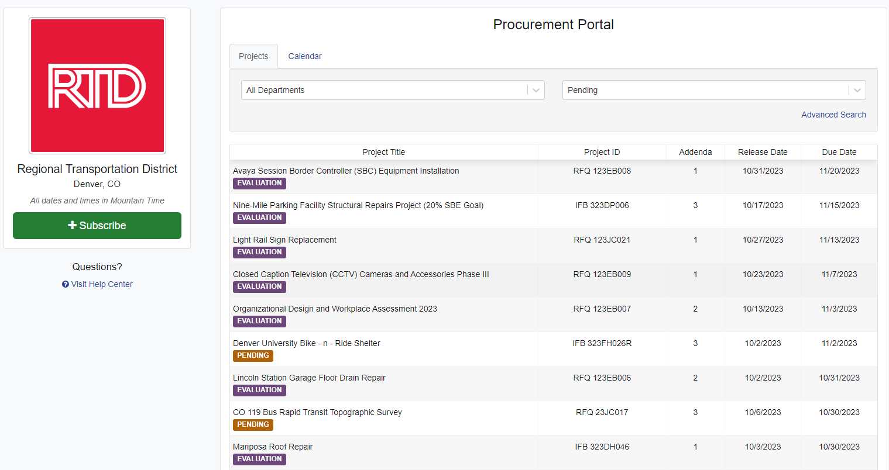
OpenGov Public User Training
Contracts Pending Awards view:
Click on “Pending or Evaluation” to open that procurement
Click on “Subscribe” to register to RTD’s procurement postings in the future

Slide 15
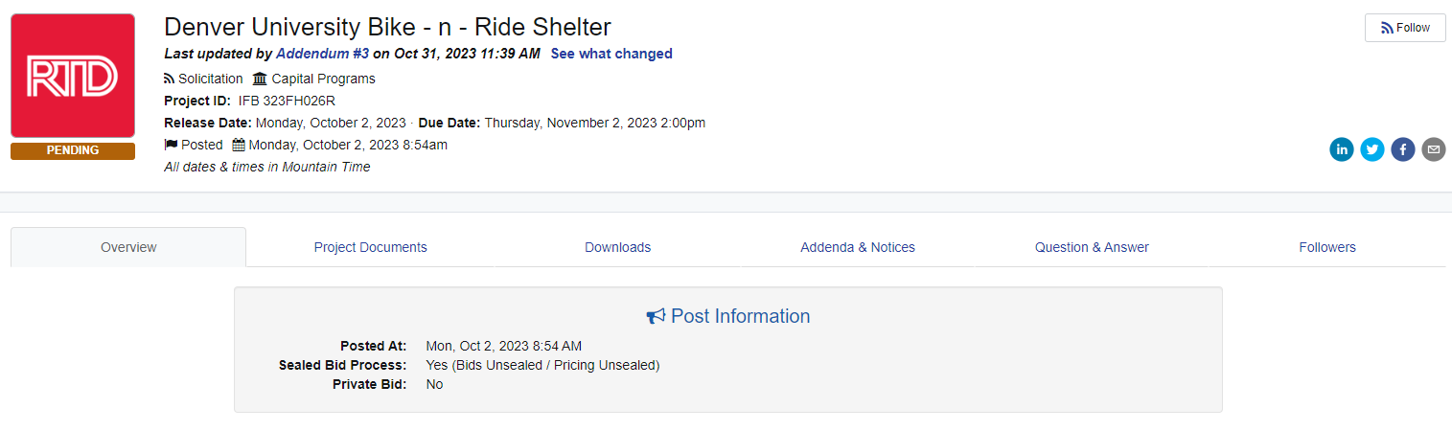
OpenGov Public User Training
Contracts Pending Awards view:
Now that you are in a specific Procurement you can select to view the procurement Overview, view Project Documents, download Documents, see Addenda & Notices, see Questions & Answers, and see who is Following the procurement

Slide 16
OpenGov Public User Training
Next: Click on Current Solicitations to review Open Projects

Slide 17
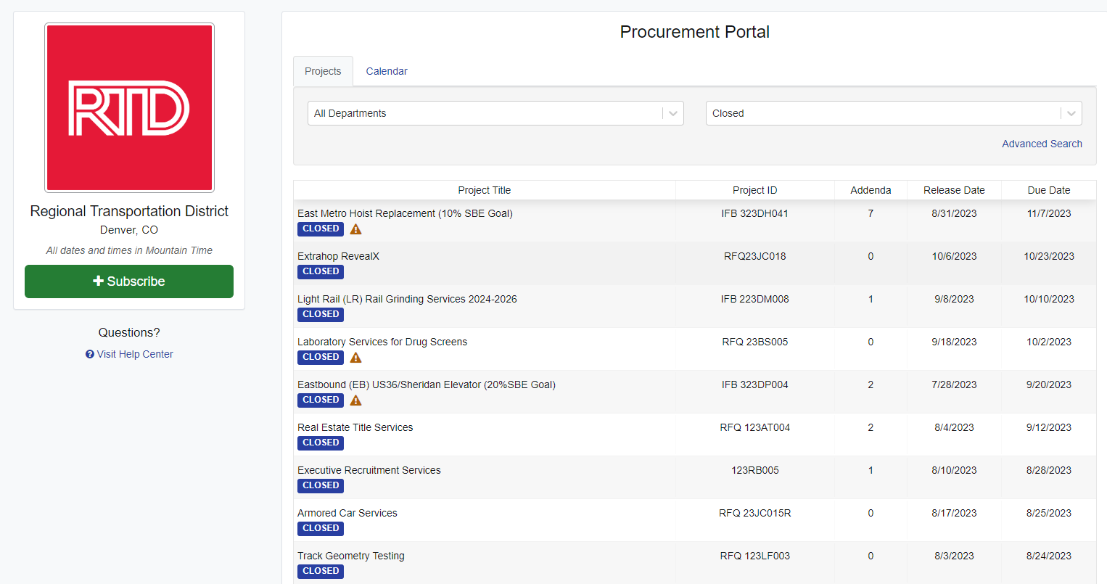
OpenGov Public User Training
Contracts Awarded view:
Click on “Closed” to open that procurement
Click on “Subscribe” to register to RTD’s procurement postings in the future

Slide 18
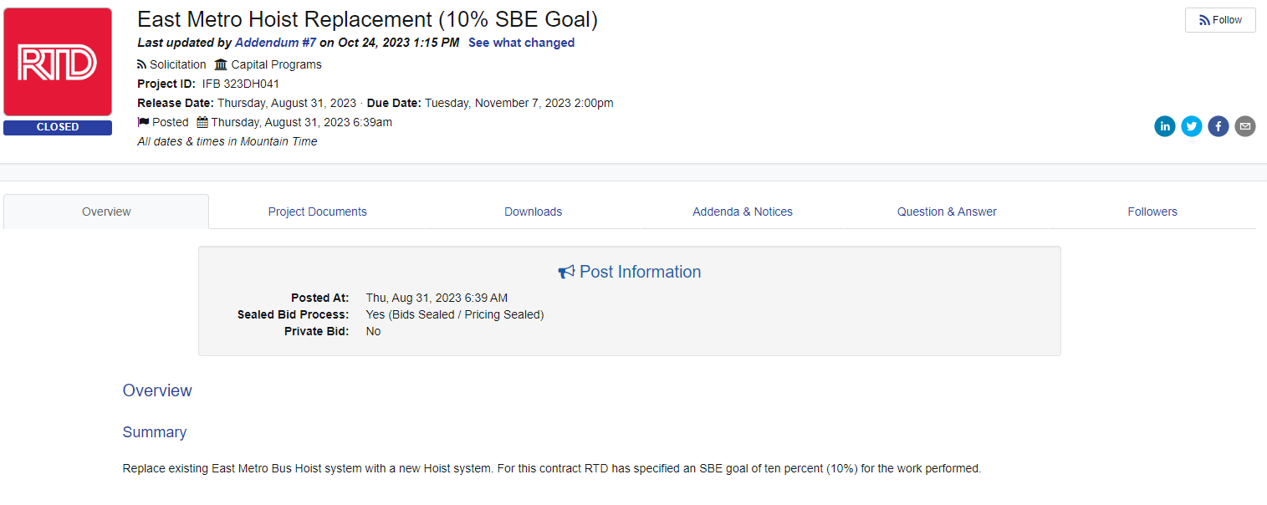
OpenGov Public User Training
Contracts Awarded view:
Now that you are in a specific Procurement you can select to view the procurement Overview, view Project Documents, download Documents, see Addenda & Notices, see Questions & Answers, and see who is Following the procurement

Slide 19
OpenGov Public User Training
Overall Procurement Process Flow

Slide 21
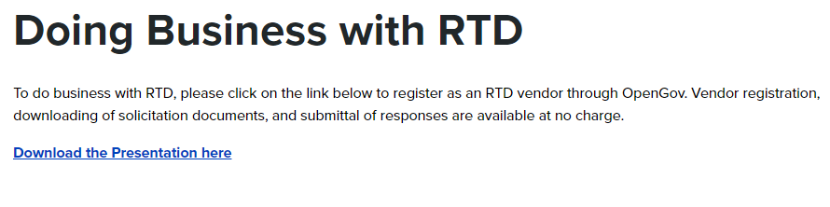
OpenGov Public User Training
How to access the RTD website
  Go to https://www.rtd-denver.com/doing-business-with-rtd
Remove from web page

