Slide 1
OpenGov Overview, Vendor Registration and Procurement Advice
Brenda Leo, CPPO, CPPB, Contract Manager
Contracting and Procurement
This presentation is the property of RTD and is being provided for informational purposes only. Nothing in this presentation is being offered as legal advice, nor does it create any form of agreement between RTD and the recipient. Further, this document and RTD’s procurement policies are subject to change at any time and without notice.

Slide 2
OpenGov Vendor Training
OpenGov Overview
Vendor Registration
OpenGov Procurement Resources
Follow a Solicitation in OpenGov
Advice from Procurement Staff

Slide 3
Overview

Slide 4
OpenGov Overview
OpenGov is an award-winning cloud-based Contract Lifecycle Management (CLM) tool with end-to-end workflow automation that encourages collaboration and accelerates procurement processes for compliant solicitation development, evaluation, contract creation, award and management
RTD advertises solicitations and receive vendor proposals and bids through the OpenGov secure web portal
Suppliers utilize the OpenGov to complete compliant solicitation responses and offer RTD a more sustainable vendor network
Vendors can download and monitor solicitations at no cost
Proactive Contract Management Software - track milestones and set automatic notifications for upcoming deadlines (future)
Public facing contract database (future)

Slide 5
Vendor Registration

Slide 6

Register as a Vendor on OpenGov
Registration is easy and gives you access to OpenGov and RTD Solicitations within minutes!

Slide 7
Why Should You Register as a Vendor on OpenGov?
Automatic Notifications
Receive notifications of advertised solicitations
Instant Access
Ability to access and download all solicitation documents at no charge
Ask Questions
Ask any questions you have about a solicitation online through OpenGov
Submit Solicitation Responses
Submit responses to solicitations through a secure online process
See Solicitation “Followers”
View Vendor Analytics to see contractors that have “followed” a solicitation

Slide 8
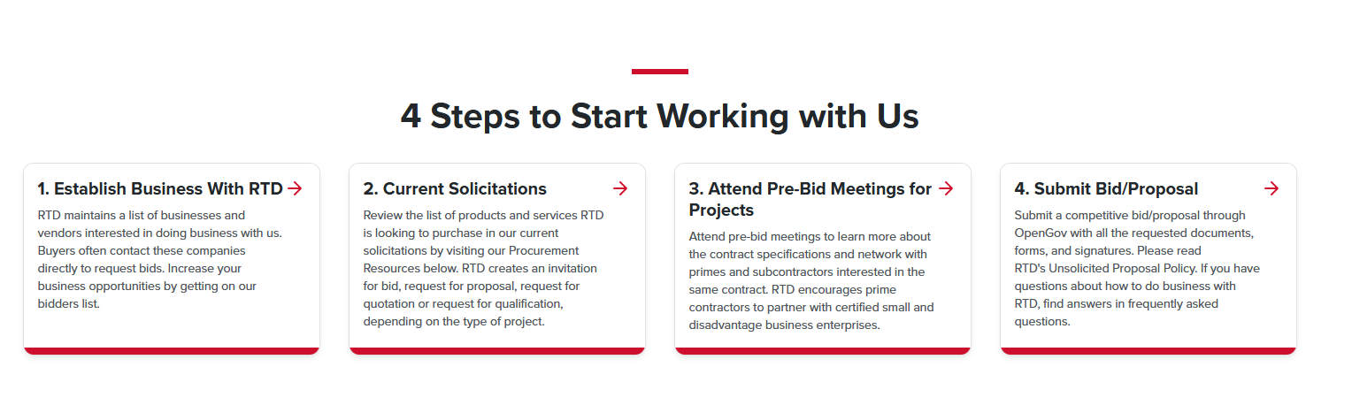
OpenGov: Public User Training
How to access the RTD website
  Go to https://www.rtd-denver.com/doing-business-with-rtd
  Scroll down to Establish business with RTD

Slide 9
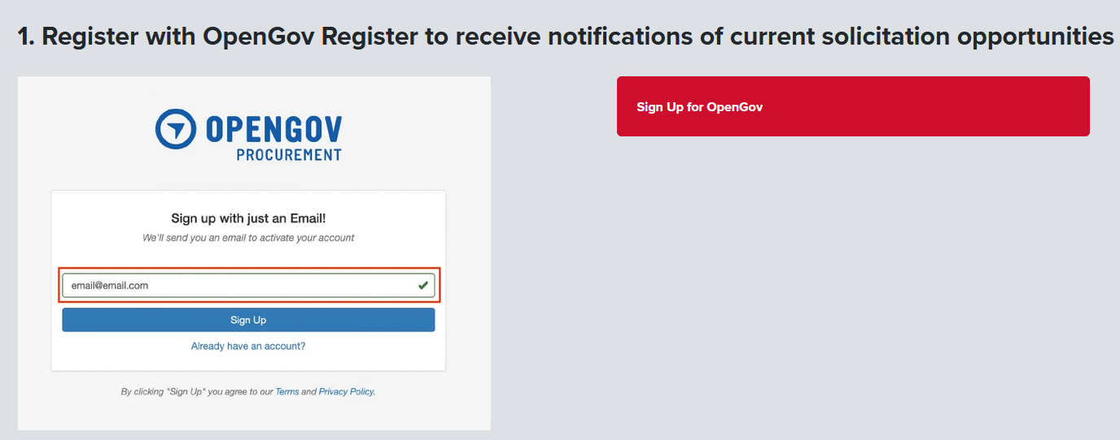
OpenGov: Public User Training
How to Register as an RTD Vendor using the RTD website
  Enter a valid email address
  Click Sign up for OpenGov

Slide 10

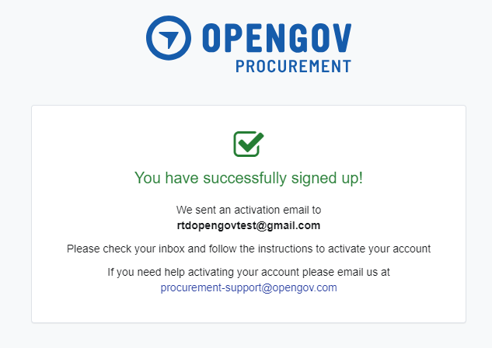
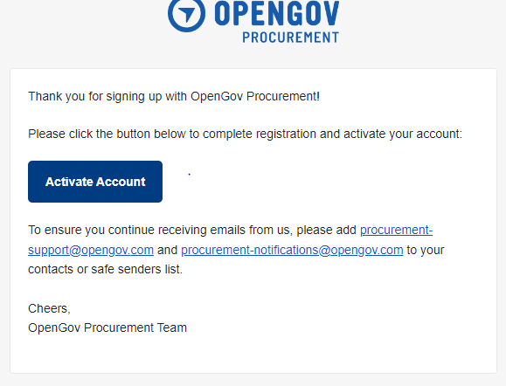
7. Confirmation of sign-up screen appears and OpenGov also sends an activation email.
8. Open the OpenGov email and click on “Activate Account”.

Slide 11
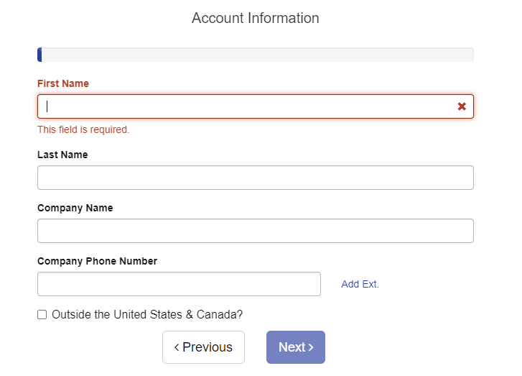
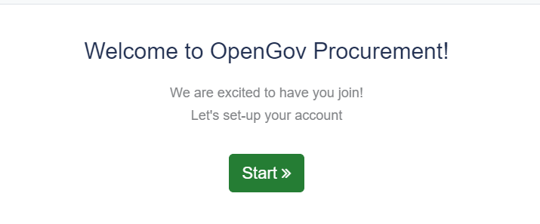
9. Click on “Start” to set up an account.
10. Enter your information for all fields, then click on “next”:

Slide 12
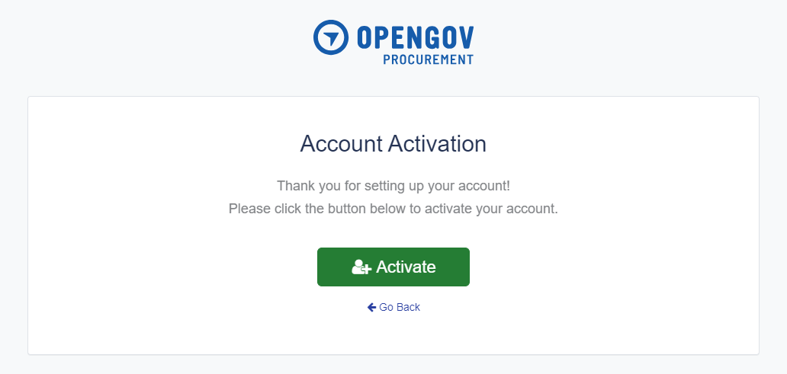
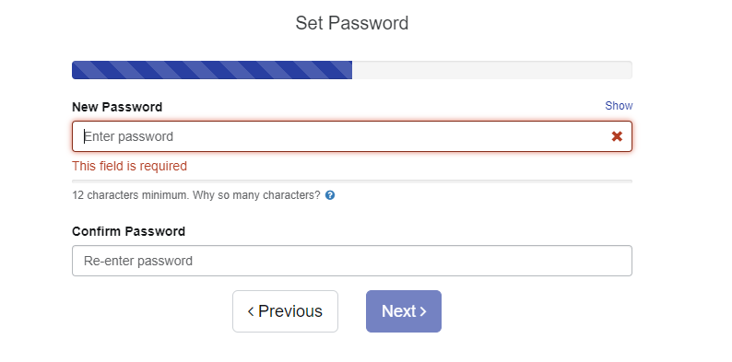
11. Enter a password with at least 12 characters, then enter password again to confirm.
12. You will need to activate your account. Click on “Activate”.

Slide 13
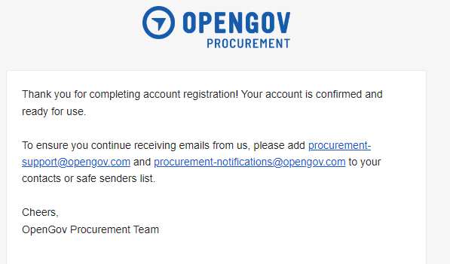
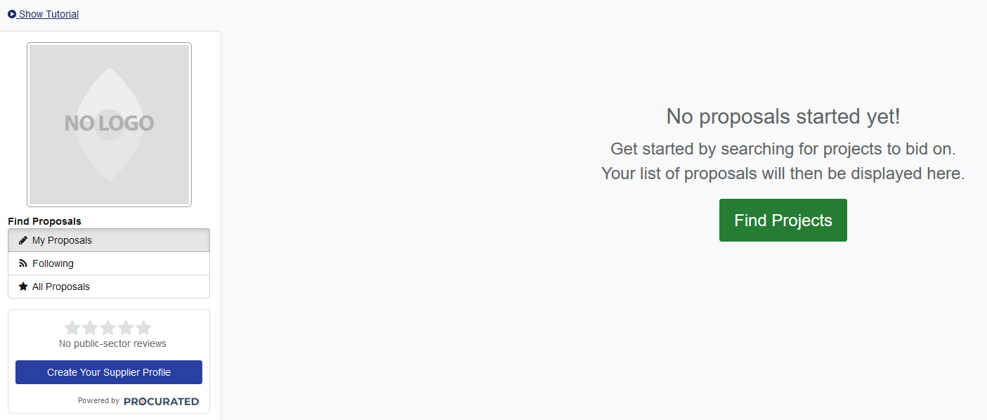
14. When opening OpenGov a screen to add Logo will appear.
15. This screen will enable the user to find projects
13. OpenGov will send you an email confirmation that you have completed your account registration. Follow the instructions to add OpenGov email addresses to your contacts or safe senders list

Slide 14
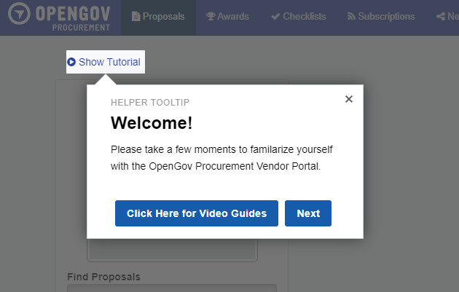
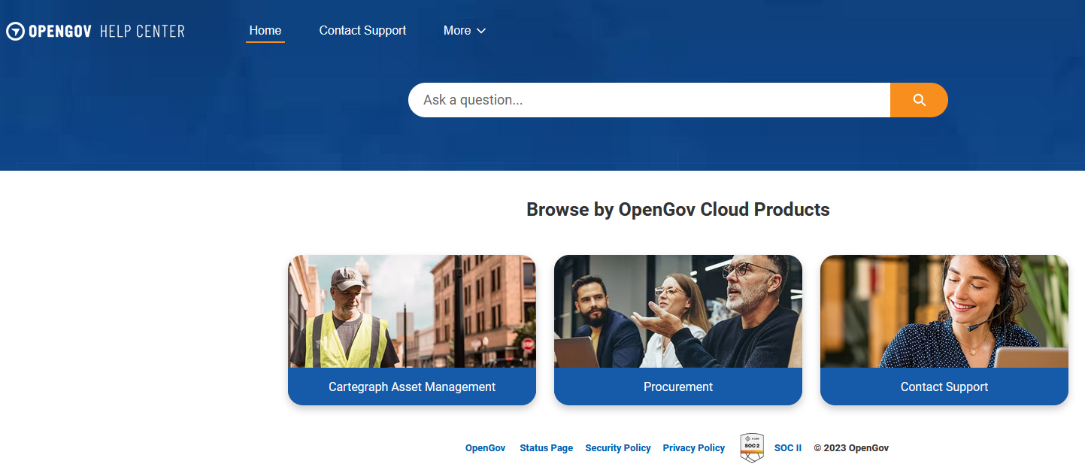
16. When you login to OpenGov, a tutorial screen will pop up. Watch the Video Guides to learn about the OpenGov Procurement Vendor Portal.
17. User will be directed to the OpenGov website

Slide 15
RTD Procurement
Resources Page

Slide 16
OpenGov: Public User Training
How to access the RTD website
  Go to https://www.rtd-denver.com/doing-business-with-rtd
  Scroll down to Establish business with RTD

Slide 17
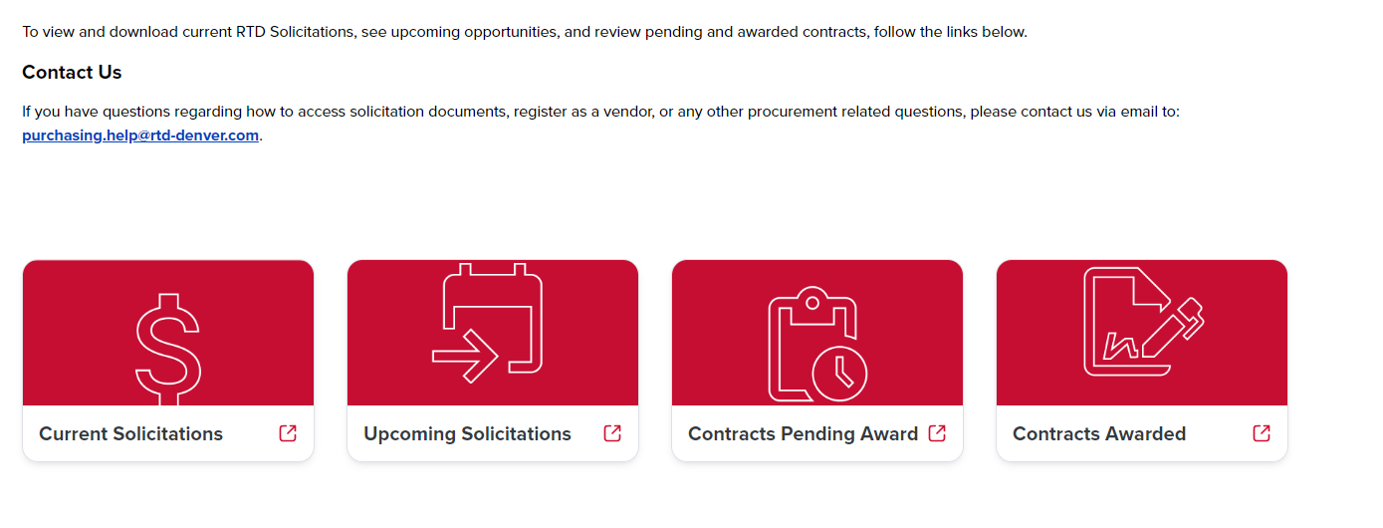
OpenGov Public User Training
Next: Click on Current Solicitations to review Open Projects

Slide 18
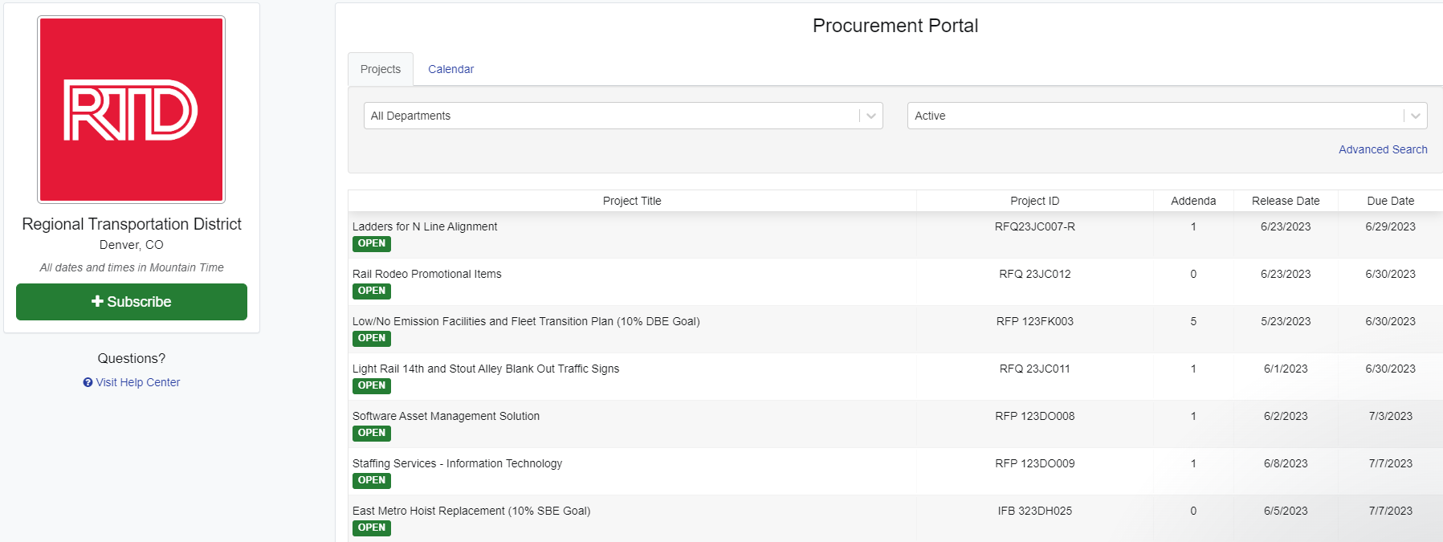
Current Solicitations

Slide 19
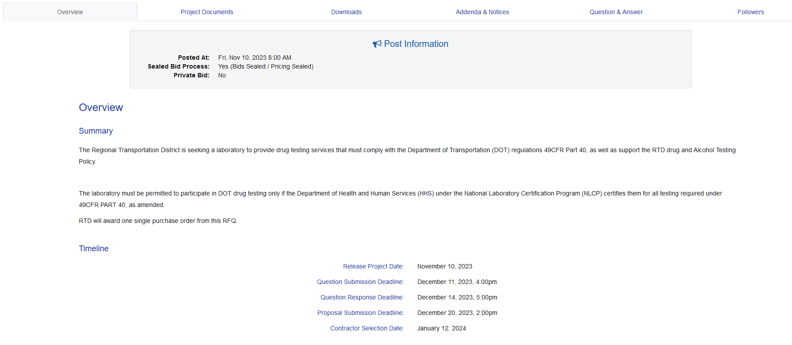
OpenGov: Current Solicitations
Once user is in the Current solicitations the overview tab will show project information
Project Summary information will be here

Slide 20
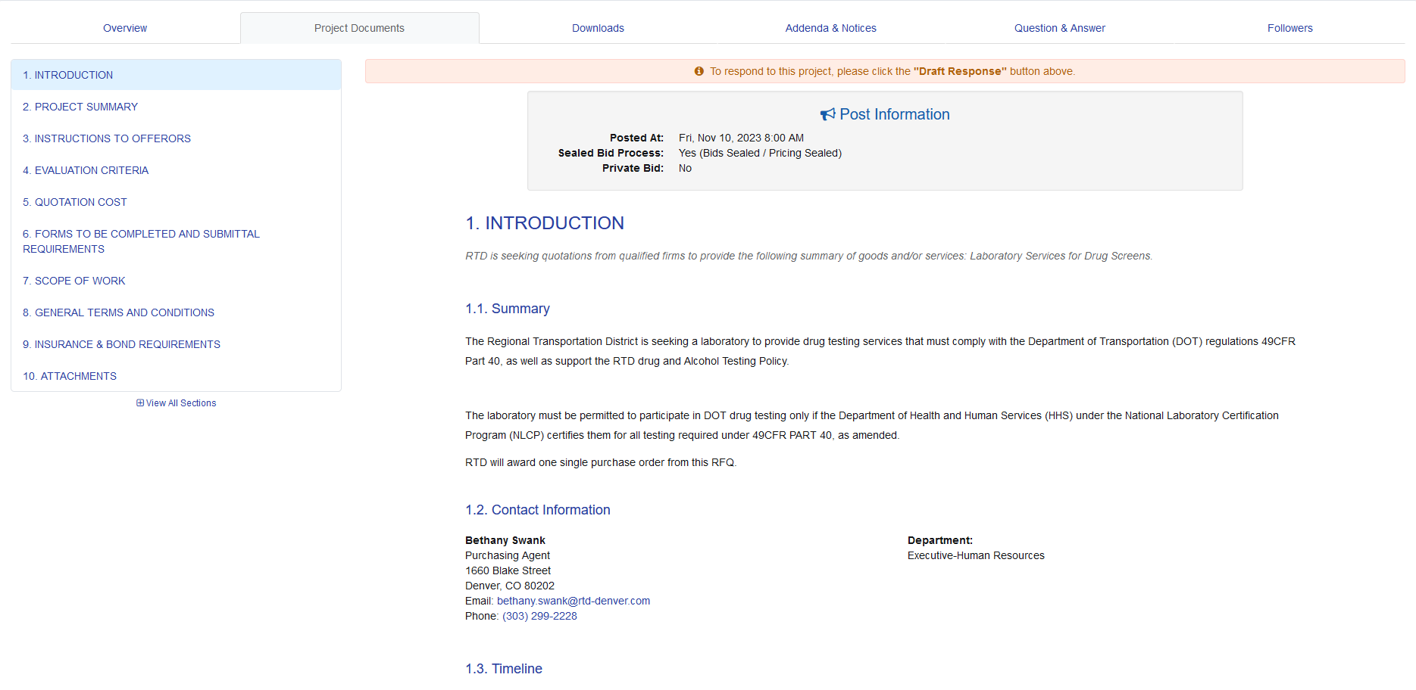
OpenGov: Current Solicitations
Procurement Documents tab provides all documents required for the solicitation

Slide 21
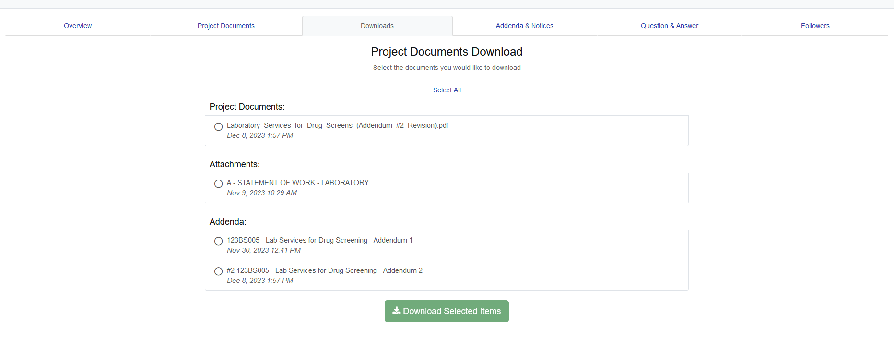
OpenGov: Current Solicitations
Downloads will include all documents the user is able to download
  Select documents to download
  Click download selected items

Slide 22
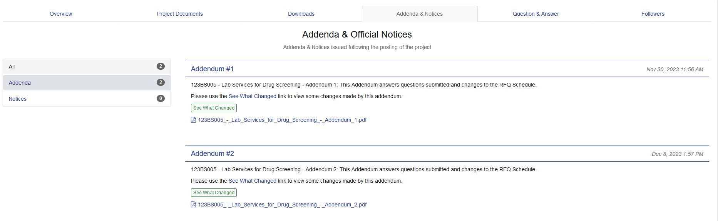
OpenGov: Current Solicitations
Addenda and Notices will will include addendums and notes available for review by the
  Select addendums to review
  Left side column identifies the number of available document by category

Slide 23
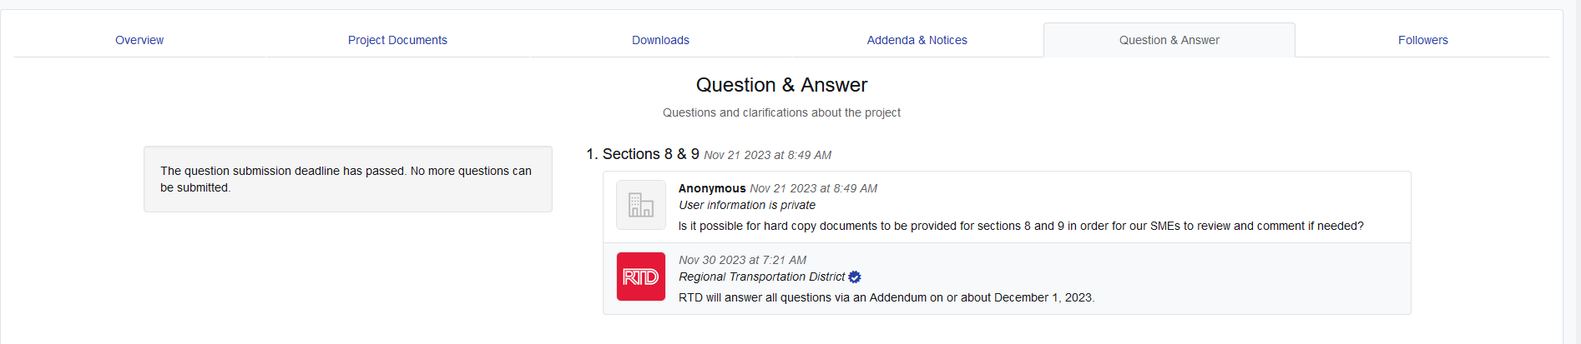
OpenGov: Current Solicitations
Questions and Answer includes all questions by vendor and responses from
  User can view all questions and answers

Slide 24
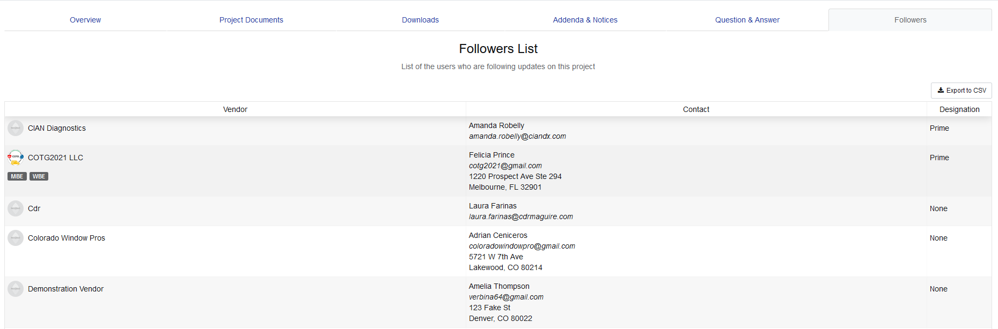
OpenGov: Current Solicitations
Follows reflects vendors who have solicited for the project

Slide 25
OpenGov Public User Training
Next: Click on Upcoming Solicitations to view projects that have not yet been opened

Slide 26
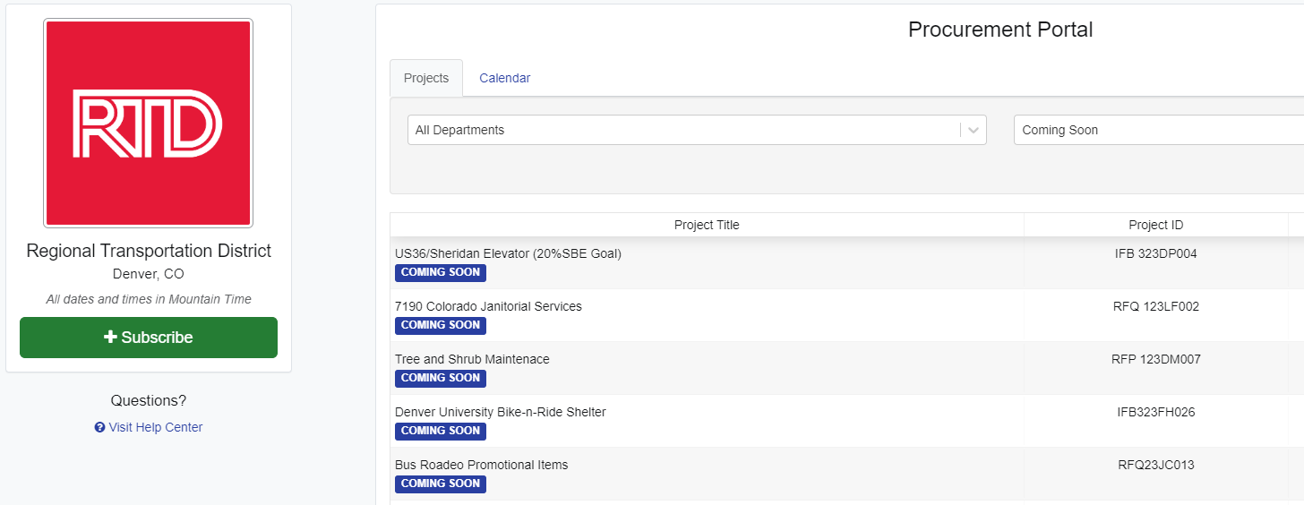
OpenGov: Upcoming Solicitations
Coming Soon: User will not have access to open upcoming projects in OpenGov

Slide 27
OpenGov Public User Training
Next: Contracts Pending will provide the same project information as Current Solicitations (pages 19 – 24)

Slide 28
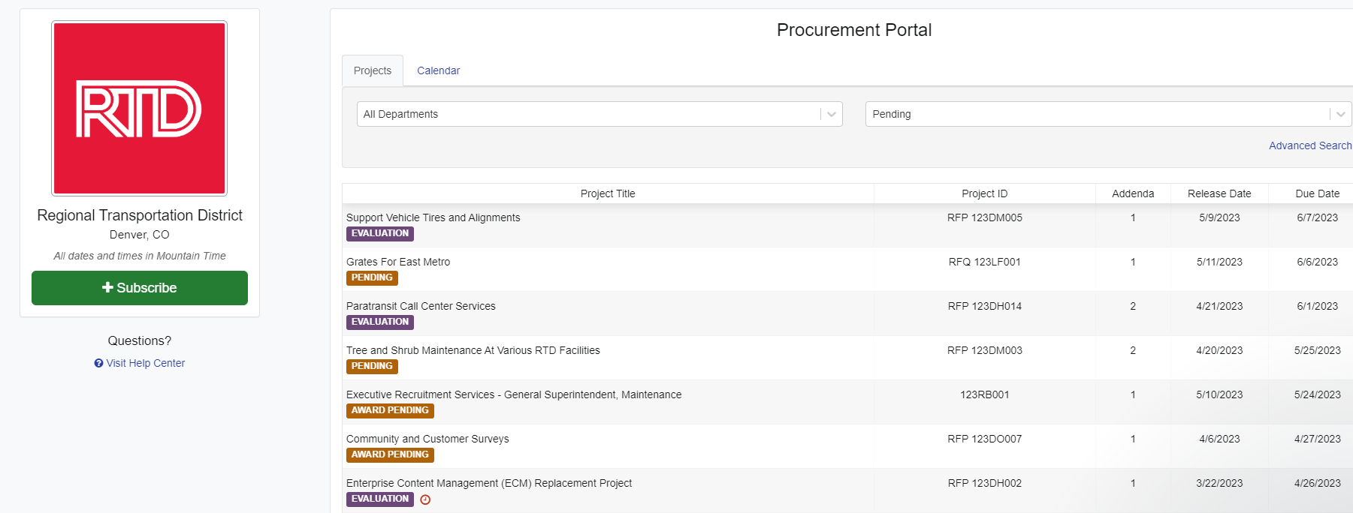
Contracts Pending Award

Slide 29
OpenGov Public User Training
Next: Contracts Pending will provide the same project information as Current Solicitations (pages 19 – 24)

Slide 30
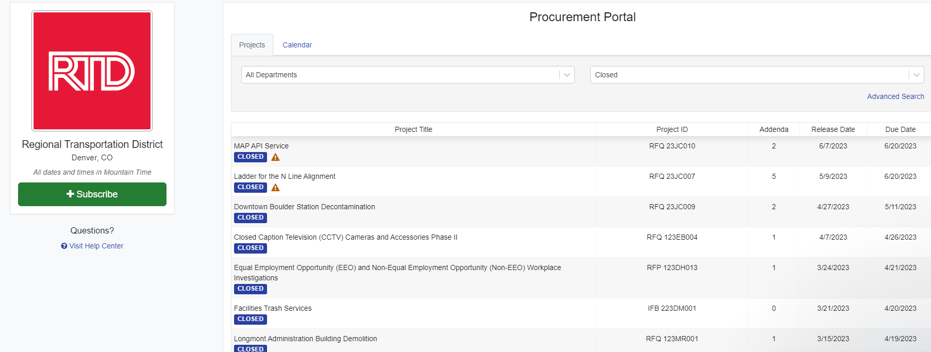
Contracts Awarded

Slide 31
Follow OpenGov Solicitation

Slide 32
Follow Solicitations in OpenGov
Remember to follow all solicitations that you may be interested in and that your company can provide goods or services to help complete the work identified in the SOW
When you follow a solicitation your company name, your name, and email address will then be shown on the “Follower’s” list
Appearing on the list will make it easy for prime contractors to contact you
When you follow a solicitation, you will receive all notifications regarding that solicitation

Slide 33
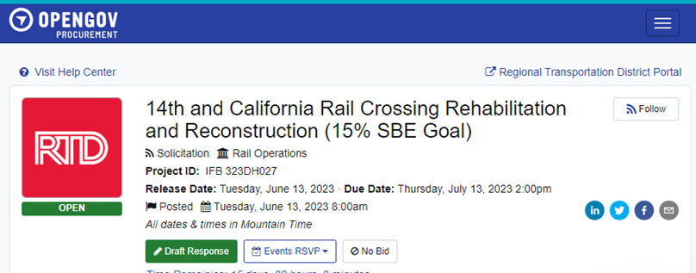
How to Follow a Solicitation
Click on a solicitation
On the top right side of the screen, click on “Follow”

Slide 34
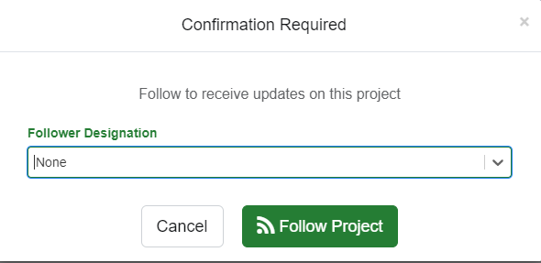
How to Follow a Solicitation
Select Follow Designation from drop down menu (Prime Contractor or Subcontractor)
Then click on Follow Project
A box will pop up on the bottom left screen that says “Following Project”
On the upper right-hand side of the screen the blue box will now say “Following”

Slide 35
How to View Solicitation “Followers”
Contact prime contractors that have “followed” a solicitation on OpenGov that may be submitting a bid or proposal for RTD solicitations
Ask Questions! Submit questions to the Procurement representative listed in the solicitation via OpenGov by the date and time listed for the Inquiry Period.
Ensure that your proposal or bid includes all the required information and provides thorough responses to all listed requirements.

Slide 36
Hints & Tips from
Procurement Staff

Slide 37
Advice from the Procurement Staff
Do not wait until the “last minute” to contact a prime or to submit your bid or proposal. Rushed responses often result in errors and missing information. Plan ahead to submit your bid/proposal on time.
Ensure that you thoroughly read all DBE/SBE (Disadvantaged Business Enterprise/Small Business Enterprise) contract requirements. There may be a percent of funding goal to meet or a requirement to utilize DBE/SBE resources in the contract. Please contact an RTD Procurement resource for advice/direction.
Provide pricing that you know to be competitive.

Slide 38
Advice from the Procurement Staff
Tips for working with Prime Contractors (Should this be more for internal customers at RTD?
  Promptly provide information (Company info, pricing, etc.)
  Contact prime contractors early so they have time to consider working with you
  Follow-up with prime contractors
  Be available for questions, clarification, pricing, or other information
  Ensure that the work and/or products you provide are timely, efficient, and meet all requirements.
  Ensure that you thoroughly read all DBE/SBE (Disadvantaged Business Enterprise/Small Business Enterprise) contract requirements. There may be a percent of funding goal to meet or a requirement to utilize DBE/SBE resources in the contract. Please contact an RTD Procurement resource for advice/direction.

Slide 39
Procurement Staff Availability and Contact Information
Procurement Staff is available from 8am – 4pm, Monday – Friday.
The Purchasing Help email address is: purchasing.help@rtd-Denver.com.
The best way to contact a procurement agent is through email.
Procurement contact information is always included in advertised solicitations.

Slide 40
OpenGov: Vendor Training
Procurement Process Flow

