Slide 1
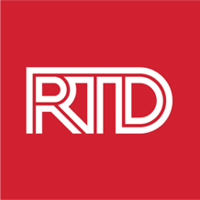
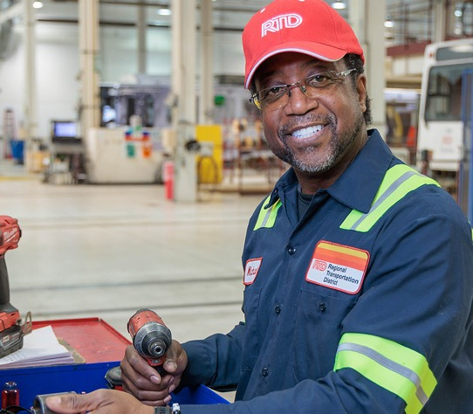
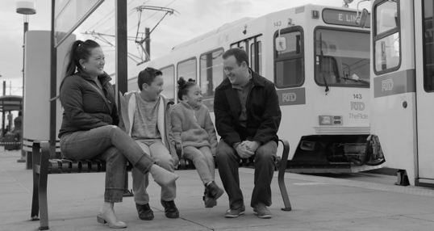
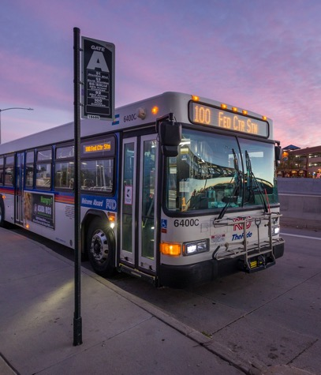
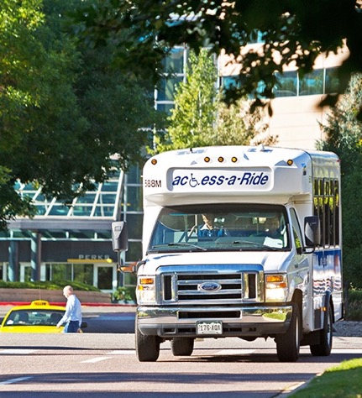
Community Partner Briefing
April 16, 2024
We make lives better
through connections.

Slide 2
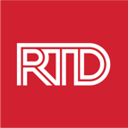
Welcome
Thank you for attending today’s community partner meeting
This meeting will be recorded
Please use the chat feature to ask questions
A moderator will ask questions on behalf of participants
Questions and answers will also be added to the project webpage’s FAQ section
A follow-up email will be sent this afternoon
Include links to all presentation materials, toolkits, FAQs, and other resources
April 16, 2024
2

Slide 3
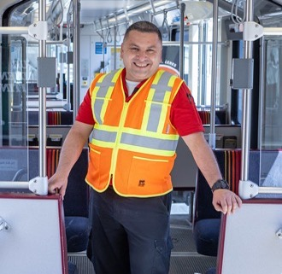
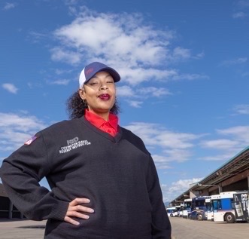
Agenda
Agency Overview
Downtown Rail Reconstruction Project
Coping Panels Project
May 2024 Service Changes
Transit Police Update
Impact Team
How can you support RTD?
How can RTD support you?
April 16, 2024

Slide 4
Agency Overview

Slide 5
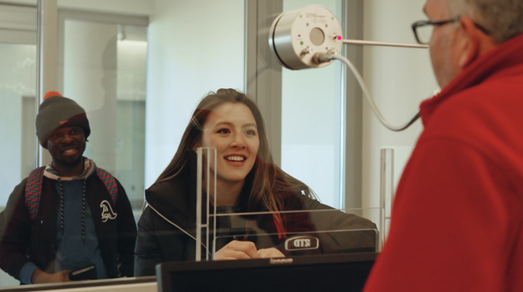
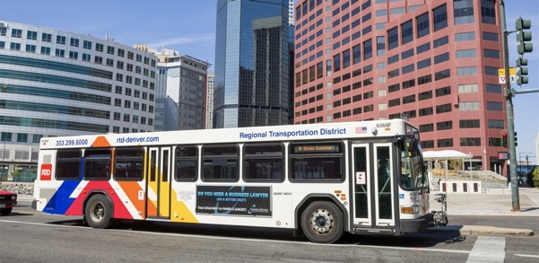
Service Area
Regional transit network
Approximately 65 million boardings in 2023
RTD’s service area
Eight counties and more than 40 municipalities
2,342 square miles
3M+ population
April 16, 2024

Slide 6
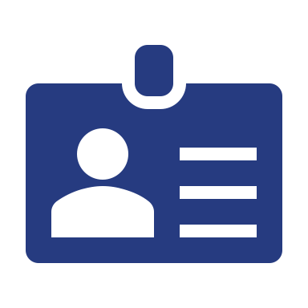
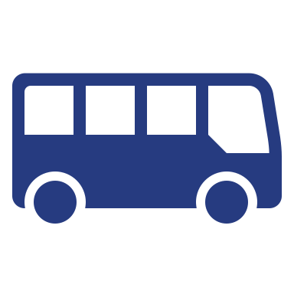
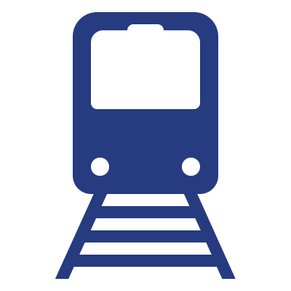
Strategic Initiatives
Back to Basics | People Power | Welcoming Transit Environment
April 16, 2024

Slide 7
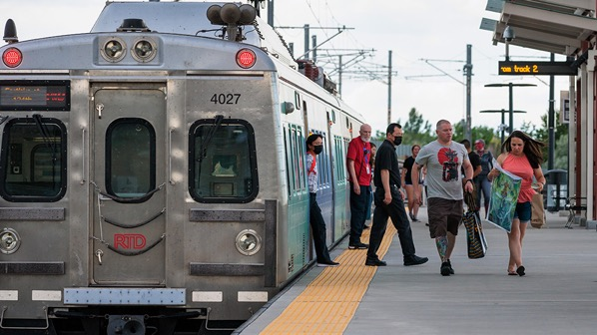
Back to Basics
Redouble efforts to maintain assets in a state of good repair
Leverage sound asset management principles
Enhance internal communications to support an engaged and informed workforce
April 16, 2024
7

Slide 8
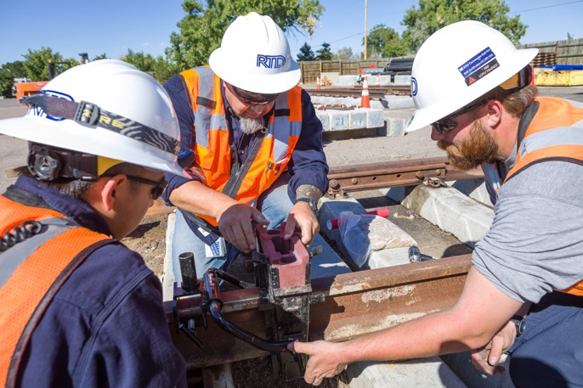
People Power
Address impediments to employee recruitment
Foster a culture of learning and development
Promote opportunities that support employee retention
April 16, 2024
8

Slide 9
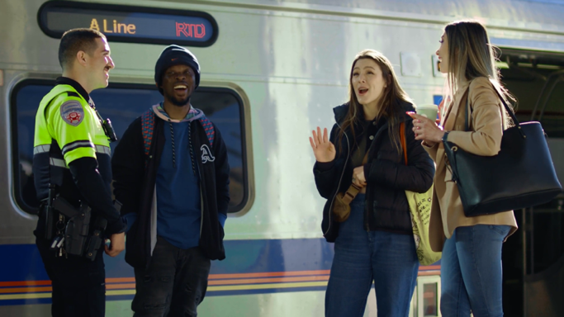
Welcoming Transit Environment
Reduce the impacts of criminal behaviors and Customer Code of Conduct violations
Improve community and employee concerns related to personal safety and security
Create an overall transit environment that provides a safe, convenient, and enjoyable experience for all customers and employees
April 16, 2024
9

Slide 10
State of Good Repair

Slide 11
State of Good Repair
Ensuring assets are in a state of good repair is one of the agency’s highest priorities
Guarantees previous investments in the system remain intact
Supports operationally safe, accessible, and dependable services
Preserves investment in a reliable transit infrastructure
Required by regulatory oversight entities
Extends the design/as-built life of assets
All transit agencies should undertake projects to maintain assets
April 16, 2024
11

Slide 12
Agency Assets
RTD has more than $9 billion in fixed assets
Guided by the Federal Transit Administration’s mandated Transit Asset Management (TAM) Plan
Assets are at varying ages and useful life
Regularly monitored and inspected
Includes facilities, vehicles, rail track, signals, bridges, stations, etc.
April 16, 2024
12

Slide 13
Downtown Rail Reconstruction Project

Slide 14
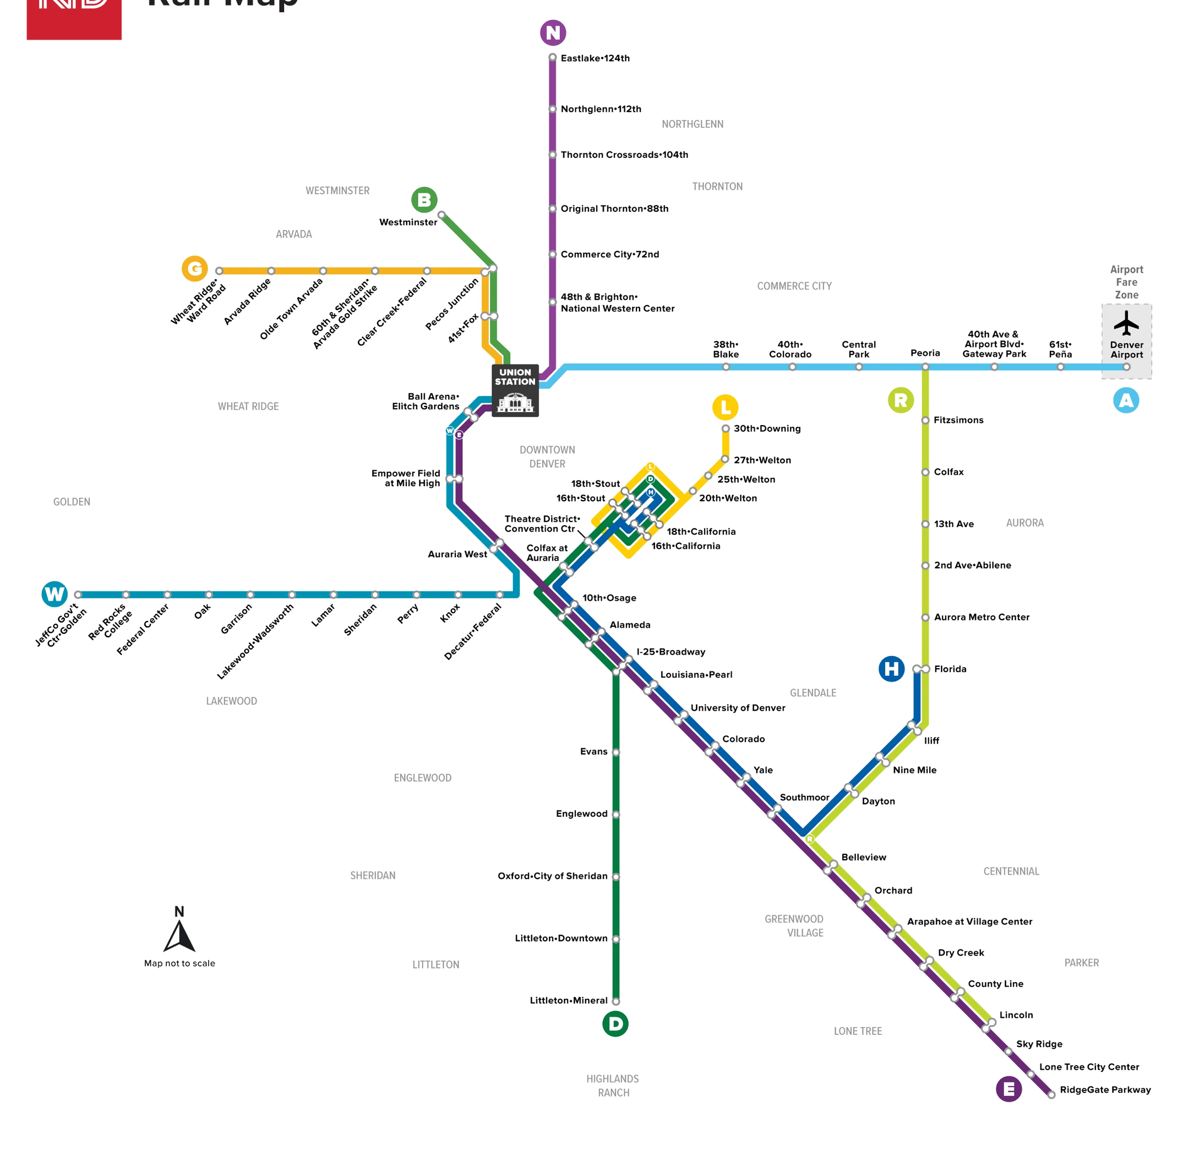
The Downtown Loop
Downtown Loop is part of RTD’s inaugural light rail line
Currently the D, H, and L lines run on the Downtown Loop
April 17, 2024
14

Slide 15
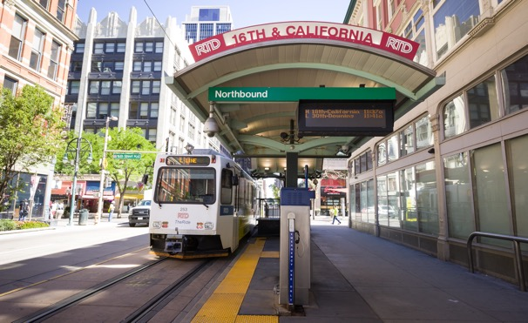
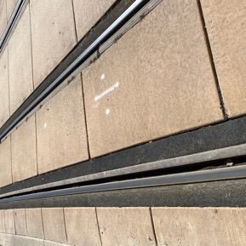
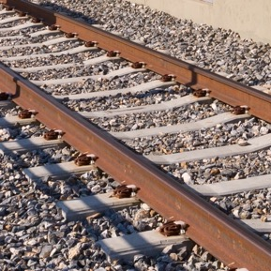
The Downtown Loop
Trains operate in a street-running capacity in lieu of a dedicated right-of-way
Public utilities exist under the rail alignment
The light rail system uses paved track in the Downtown Loop
Paved track reconstruction work needs to be outsourced
Open ballasted track is easier to continuously replace than paved track
Paved Track
Open Ballasted Track
April 17, 2024
15

Slide 16
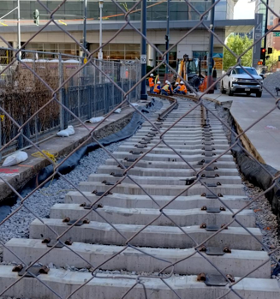
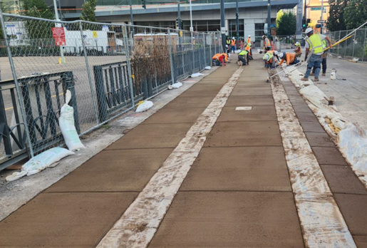
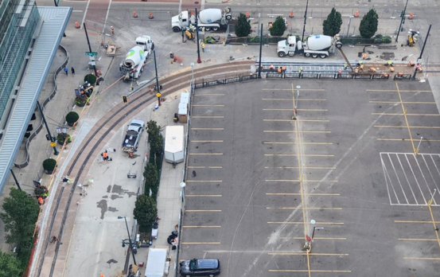
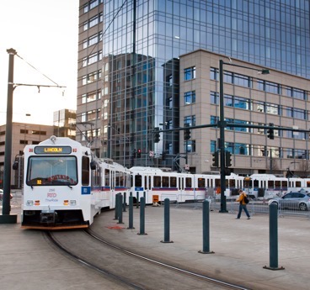
Previous Downtown Projects
2012 – 2013 3 replacement projects
2016 – 2023 14 replacement projects
$19M spent on 17 isolated projects between 2012 and 2023
Replaced targeted segments of curved rail, switches, crossings, signals, and other infrastructure
Work paused due to the opening of new rail lines (e.g., W Line in 2013 and A Line in 2016)
April 16, 2024
16

Slide 17
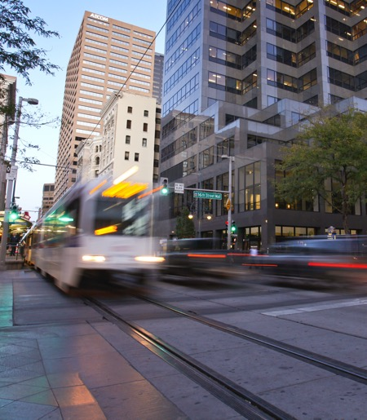
Reconstruction Project Overview
The project was prioritized to maintain assets in a state of good repair
Work emphasizes planned closures versus unplanned service disruptions
Time-specific closures to minimize inconvenience to customers
Near-term reconstruction will be completed in four phases
First phase is a full-depth reconstruction of five at-grade rail/street intersections
Phases 2 - 4 may be done out of order and/or work may overlap
Downtown rail service will be impacted during each phase
$152 million budget appropriation in FY2024 for planning, design, construction, legal consultancy, and project management
April 16, 2024
17

Slide 18
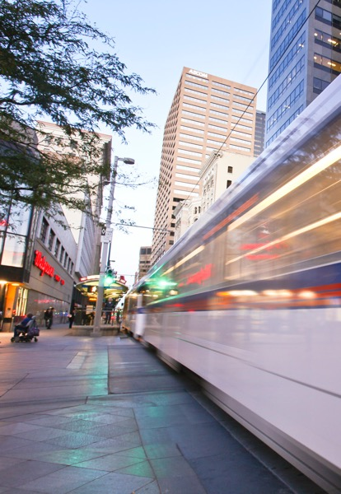
RTD’s First Reconstruction Project
For nearly 30 years, RTD primarily focused its efforts on building and expanding its rail system
This is the first time the agency will undertake a major reconstruction project of this nature
Previous rail-related construction projects were aimed at specific segment enhancements and repairs
Reconstruction improves the customer experience by mitigating service disruptions and unscheduled maintenance
April 16, 2024
18

Slide 19
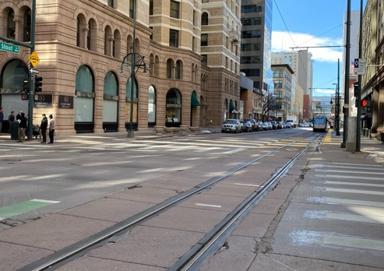
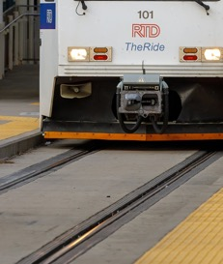
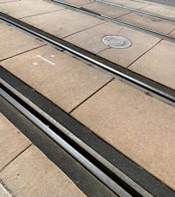
Phase One: Five Intersections
Five intersections in the Downtown Loop will be reconstructed in 2024
The five intersections will not be reconstructed at the same time
Project will progress between May and September
RTD has been meeting with the City and County of Denver (CCD) to discuss potential street closures and develop traffic detour plans
April 16, 2024
19

Slide 20
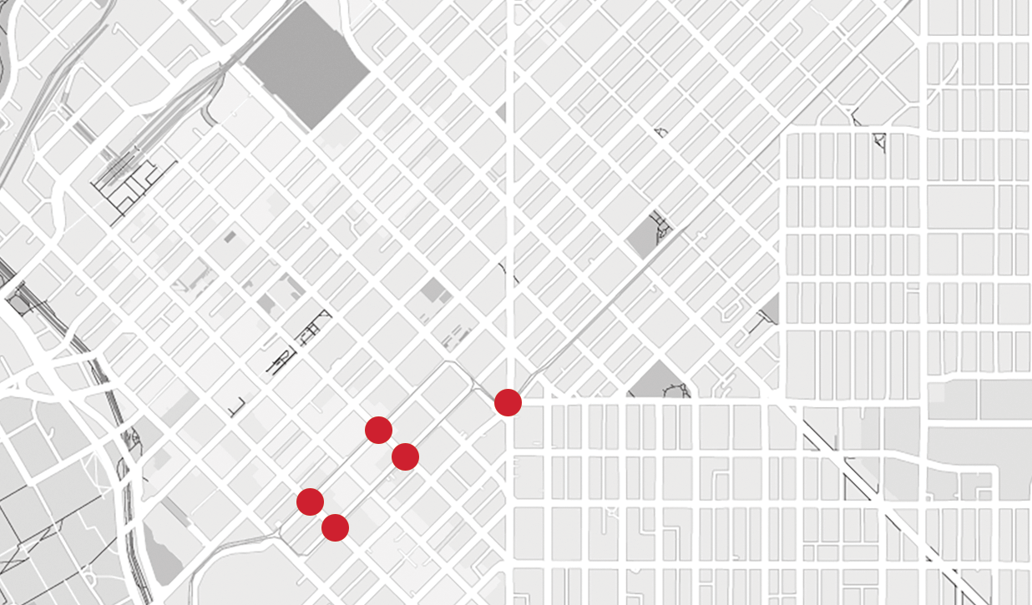
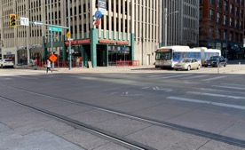
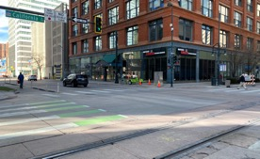
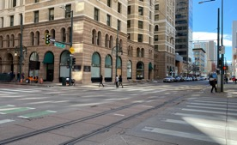
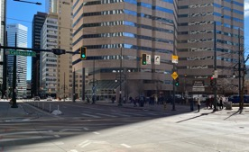
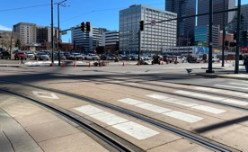
1 Stout and 15th
2 California and 15th
3 Stout and 17th
4 California and 17th
5 Broadway and Welton
Phase One: 2024
5
3
4
1
2

Slide 21
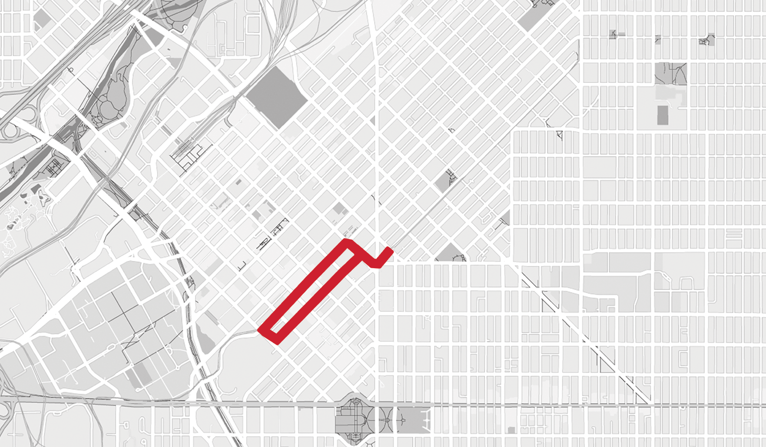
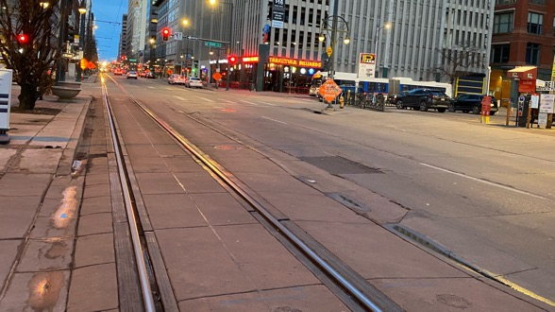
Phase Two: 2025
Phase Two: Downtown Loop Midblock
Full-depth reconstruction of the midblock tangent tracks not previously replaced
Impact to D, H, and L lines

Slide 22
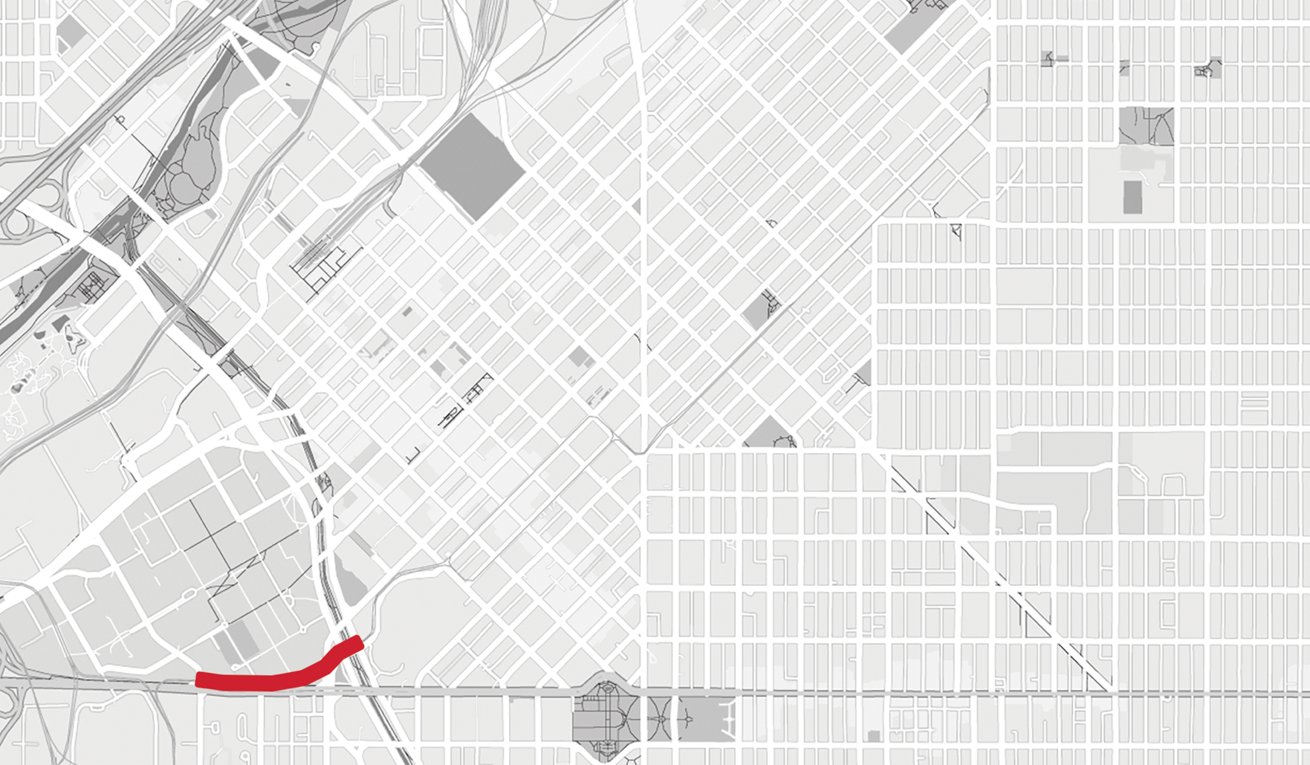
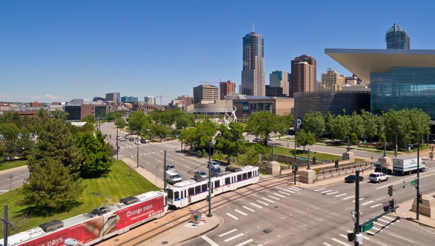
Phase Three: 2025
Phase Three: Colfax Alignment
Full-depth reconstruction of existing light rail track
Excludes track near the Colorado Convention Center
Impact to D and H lines

Slide 23
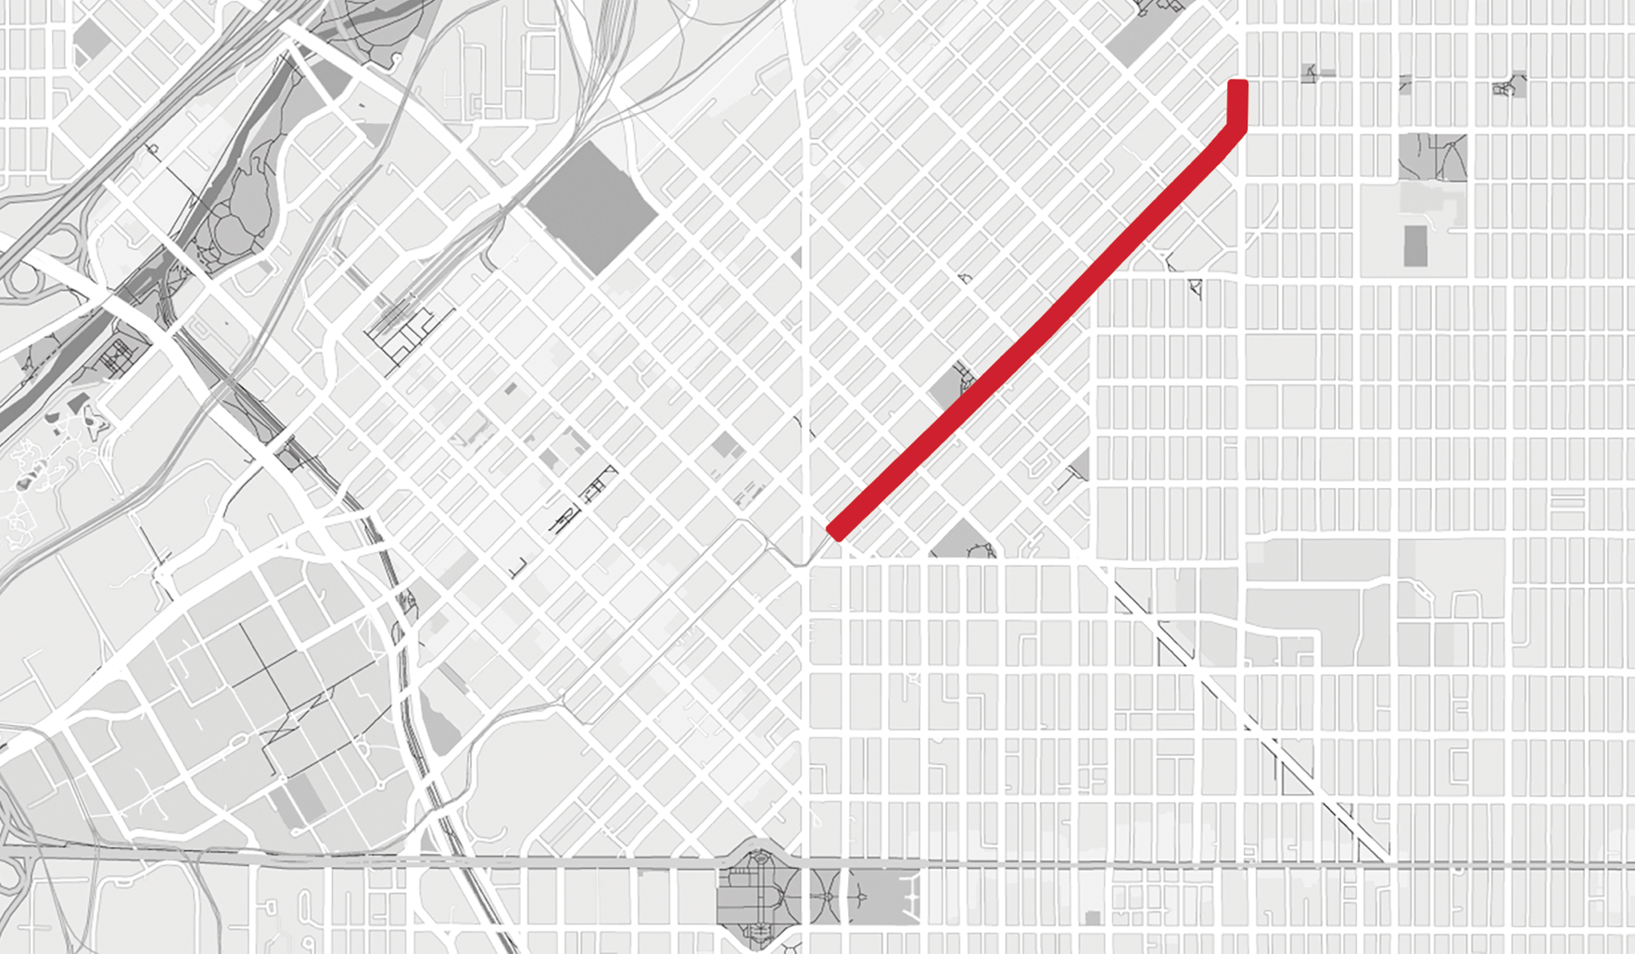
Phase Four: 2025
Phase Four: Welton Street Corridor
Full-depth reconstruction of existing light rail track
Evaluate station accessibility
Replace high blocks at platforms
Impact to L Line

Slide 24
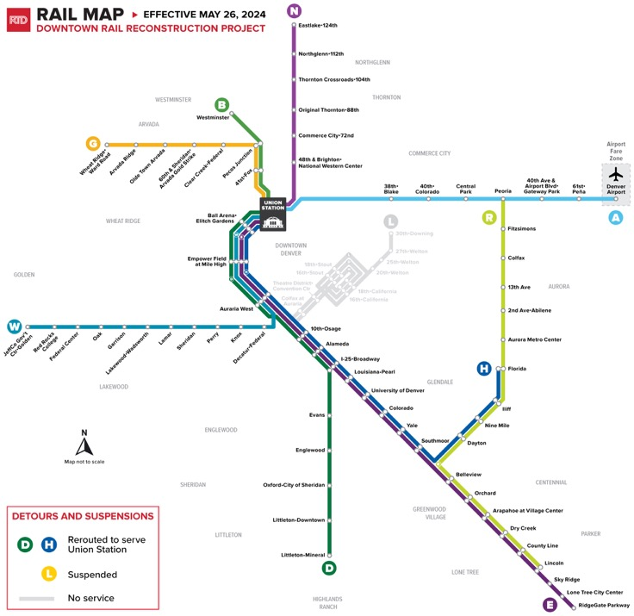
Impacted Rail Lines
D Line will be rerouted to Denver Union Station
Littleton-Mineral Station to Union Station
H Line will be rerouted to Denver Union Station
Florida Station to Union Station
L Line service will be suspended
Bus Route 43 is an alternative
April 16, 2024
24

Slide 25
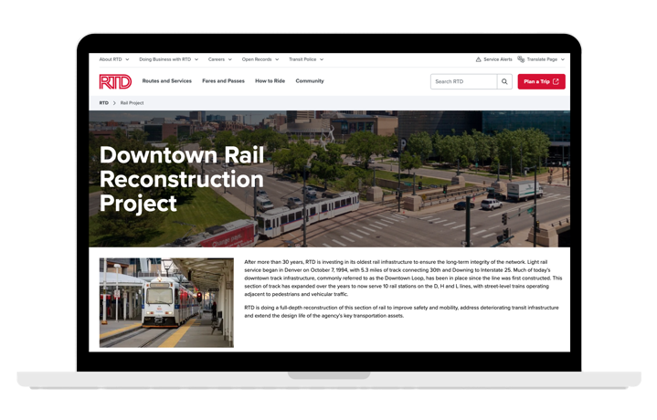
Communications and Outreach
RTD has identified 250+ communication and engagement tactics
Includes digital signs, banners, outreach events, a paid marketing campaign, social media, earned media, mass email, etc.
Staff will visit businesses adjacent to the Downtown Loop in May
A webpage is available with an overview of the project’s four phases, maps, disruption information, and photos
The online resource will be regularly updated
English and Spanish toolkits available for download
rtd-denver.com/railproject
April 16, 2024
25

Slide 26
Community Open House Meetings
Meetings will be held in English and Spanish
Additional meetings will be added as requested and needed
Monday, April 1 5:30 p.m. – 7:30 p.m. Lone Tree Library 10055 Library Way, Lone Tree | Wednesday, April 17 5:30 p.m. – 7:30 p.m. RTD Headquarters 1660 Blake Street, Denver | Wednesday, April 24 5:30 p.m. – 7:30 p.m. Glenarm Recreation Center 2800 Glenarm Place, Denver
Tuesday, April 30 5:30 p.m. – 7:30 p.m. Kitchen Network 1785 N. Quebec Street, Denver | Thursday, May 2 5:30 p.m. – 7:30 p.m. Columbine Library 7706 W Bowles Ave, Littleton
April 16, 2024
26

Slide 27
Coping Panels Project

Slide 28
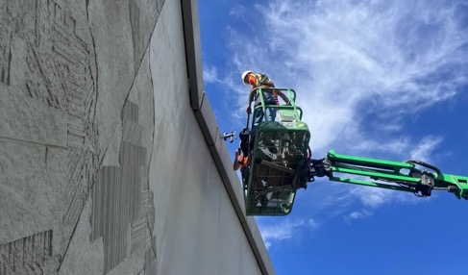
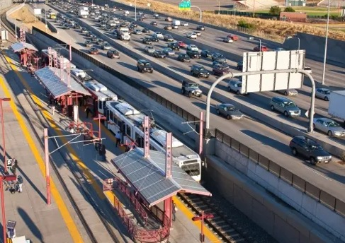
Project Overview
The two-year project to repair the caps on top of retaining walls along I-25
In 2023, approximately half of the maintenance work was completed
The project will resume in May and has been separated into nine segments
Trains must single-track around work crews
The sealant can only be applied during warm weather months
April 16, 2024
28

Slide 29
Service Impacts
Train frequencies will be temporarily adjusted between May and September 2024
The R Line will continue its 30-minute frequency
E and H line trains will be adjusted to one-hour frequencies
Stations served by both lines will have one E and H line train each hour
H
H
H
H
H
H
Florida
Denver Union Station
E
E
E
E
E
E
RidgeGate Parkway
D
Louisiana•Pearl
2 TRAINS EACH HOUR
Colorado
2 TRAINS EACH HOUR
Yale
2 TRAINS EACH HOUR
Southmoor
2 TRAINS EACH HOUR
University of Denver
2 TRAINS EACH HOUR
I-25•Broadway
6 TRAINS EACH HOUR
April 16, 2024
29

Slide 30
Coping Panels Project Timeline
Project work aligns with May 2024 Service Changes
April 2022
April 2023
October 2023
May 2024
September 2024
Board Authorizes Budget Transfer and Contract
Contractor initiates planning work
First Phase Commences
First Phase Completes
Project pauses during cold-weather months
Second Phase Commences
Contractor resumes second and final phase of the project
Project Concludes
April 16, 2024
30

Slide 31
May 2024 Service Changes

Slide 32
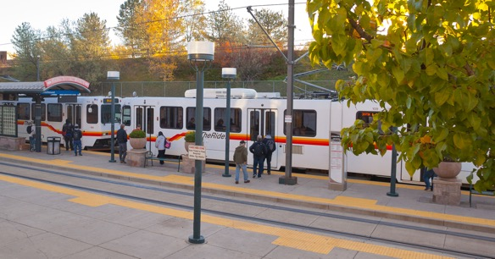
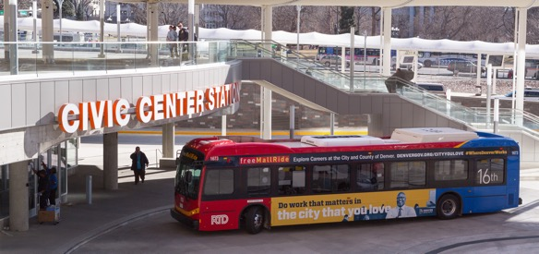
Service Changes
RTD reviews, proposes, and implements changes to its service schedules three times a year
Typically take effect in January, May, and September
In May 2024, RTD will implement minor and major changes to bus routes and rail lines
Service changes enable represented employees to select work shifts, while simultaneously focusing on increased reliability, improved on-time performance, and adjusted travel needs
Account for summer break at schools
Support near-term planned maintenance and reconstruction projects
April 16, 2024
32

Slide 33
May Service Changes
BUS Modified Services | 0L, 8, 11, 12, 20, 24, 30, 37, 44, 45, 48, 49, 51, 65, 73, 83D/L, 105, 120, 120L, 121, 169, 169L, 225, 228, DASH, Evergreen FlexRide, Platte Valley FlexRide, FF1, Free MallRide, Free MetroRide (reinstated), GS, JUMP, NB, RX, and SKIP
RAIL Modified Services | D, E, H, L (suspended), N, R, and W
April 16, 2024
33

Slide 34
May 2024 Service Changes: Rail
Line | Service Changes | Service Span (Sunday – Thursday) | Service Span (Friday and Saturday) | Notes
 | Detoured to Denver Union Station Service span adjustment | 5 a.m. – midnight | 5 a.m. – 2 a.m. | Temporary detour
 | One-hour frequencies (Coping Panels Project) Service span adjustment | 5 a.m. – midnight | 5 a.m. – 2 a.m. | Temporary headways
 | One-hour frequencies (Coping Panels Project) Detoured to Denver Union Station (Downtown Rail Project) Service span adjustment | 5 a.m. – midnight | 5 a.m. – 2 a.m. | Temporary detour and headways
 | Service suspended | ––– | ––– | Temporary suspension of service Route 43 is an alternative
 | Extend Saturday evening service | ––– | Saturday evening | One southbound train at 11:13 p.m. and one northbound at 11:56 p.m.
 | On-time performance schedule adjustment Service span adjustment | 5 a.m. – midnight | 5 a.m. – midnight | No adjustment to current headways
 | Service span adjustment | 4:30 a.m. – midnight | 5 a.m. – 2 a.m. | No adjustment to current headways
D
E
H
L
N
R
W

Slide 35
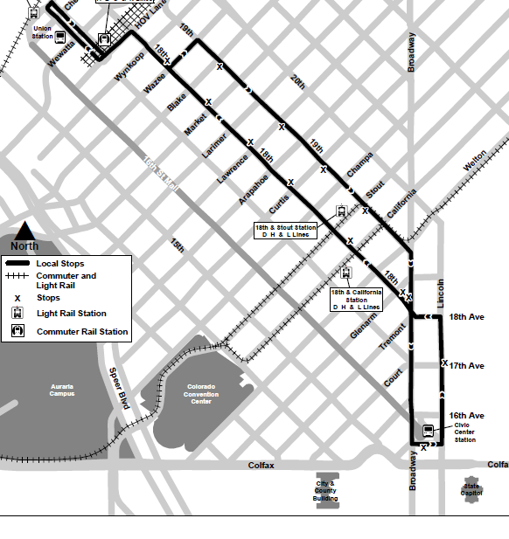
Free MetroRide and MallRide
Temporarily reinstate the Free MetroRide to provide alternative connections between Denver Union Station and destinations within the Central Business District
Service added to support the near-term Downtown Rail Reconstruction Project
MetroRide provided every 10 minutes, seven days a week between 5:45 a.m. and 7 p.m.
The Free MallRide will also have a 10-minute frequency
April 16, 2024
35

Slide 36
Transit Police Update

Slide 37
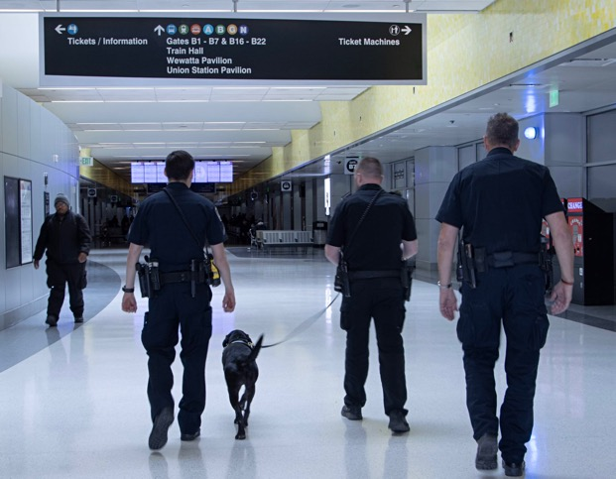
RTD Police Department
RTD has been transitioning from contracted security to Peace Officer Standards and Training (POST) certified officers
Currently, RTD-PD has 60 POST-certified officers, and 19 recruits in the police academy
In August 2022, the agency had 19 sworn officers
Officers are strategically deployed across RTD’s five sectors
RTD plans to add six mental health clinicians and five homeless outreach coordinators in 2024
Starting in early May, RTD-PD will introduce an overnight shift
Allows for 24-hour police support across the transit system
April 16, 2024
37

Slide 38
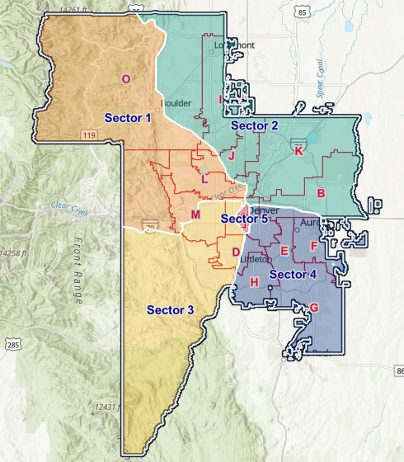
Transit Police Sectors
Supports the strategic deployment of officers and resources
RTD’s service area is divided into five sectors
A commander oversees each sector
Primary point of contact for customers, municipalities, business and property owners
A searchable sector map is available online
Ability to directly contact commanders for non-emergency, problematic issues related to RTD
rtd-denver.com/transit-police
April 16, 2024
38

Slide 39
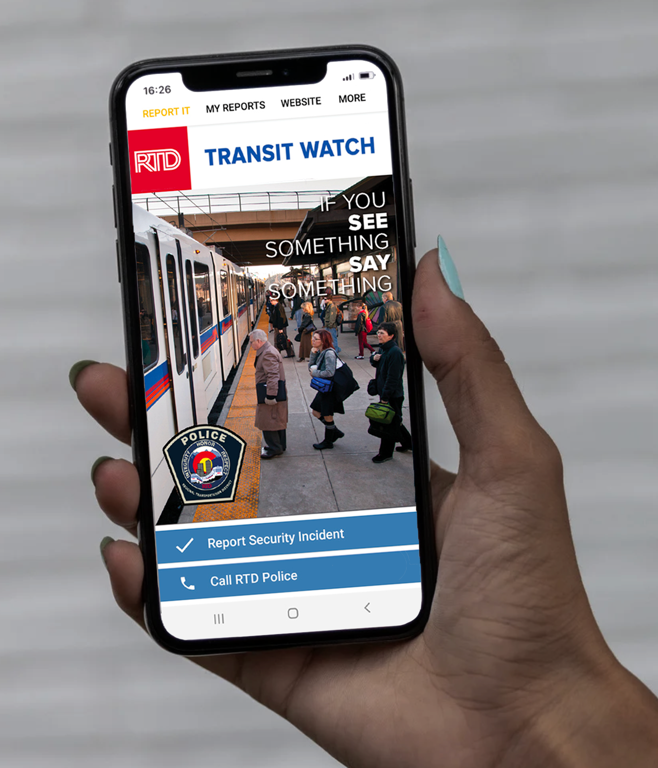
Transit Watch Mobile App
Quick, easy, and anonymous way for customers to directly communicate with Transit Police
Ability to report personal safety and security-related concerns
Available in English and Spanish
Free to download for Apple and Android smartphones
Customers can also call 303.299.2911 or text 303.434.9100
April 16, 2024
39

Slide 40
Respect the Ride Overview
RTD’s Customer Code of Conduct was revised in 2023
Branded as Respect the Ride, the Customer Code of Conduct focuses on providing a safe, convenient, and enjoyable experience for all customers
Deters illegal activities and discourages disruptive behaviors
Emphasizes common courtesy and respect for RTD’s employees, facilities, vehicles, and other customers
April 16, 2024
40

Slide 41
Respect the Ride
Education
Respect the Ride will always be the first step
Customers reminded of common courtesy expectation
Resource Connections
Deploy mental health clinicians and outreach coordinator focusing on unhoused individuals
Provide information regarding community resources and other non-transit-related support
Enforcement
Only in situations where response is warranted beyond education or community resources
May include verbal/written warning, similar to a temporary “time out”
Conducted in fair and reasonable manner
April 16, 2024
41
Notes:
Focusing on an expectation of common courtesy…
Education is key in establishing and maintaining a welcoming transit environment
As such, encouraging customers to Respect the Ride will always be the first step in encouraging appropriate behaviors at stations and stops and aboard vehicles
For individuals who may be in need of public health and safety resources, RTD deploys a professional support team to assist those individuals
The team is comprised of third-party mental health clinicians and an outreach coordinator focusing on unhoused individuals
And in areas where the agency does not have the resources or expertise to assist those individuals, RTD can provide information regarding available community resources
Enforcement of the code is limited to situations where a more direct response is warranted beyond education or resource assistance
Verbal or written warnings are often effective tools, and sworn police officers or contracted transit security personnel engage with contacted individuals in a fair and reasonable manner

Slide 42
Impact Team

Slide 43
Impact Team Ambassadors
RTD will deploy agency employees across its system to support customers through September 2024
The Impact Team will assist customers at stops and stations impacted by the May service changes and major events
Focused on enhancing the customer experience
Impact Team able to answer frequently asked questions, provide trip information, and show customers how to sign up for Service Alerts and purchase fare
In October 2024, RTD will assess the team’s overall impact and make plans for continuing the program in the future
April 16, 2024
43

Slide 44
How can you support RTD?

Slide 45
Partner Toolkit
Be an extension or our team
Share information and updates with your communities
Partner toolkit is available in English and Spanish
Sample news release copy
Sample newsletter copy
Sample social media posts
Article about RTD’s project team
Maps and illustrations
Fact Sheet and FAQs
Photos and b-roll video
April 16, 2024
45

Slide 46
How can RTD support you?

