Slide 1
Partnership Program
2024 Call for Projects Virtual Q&A
May 6, 2024

Slide 2
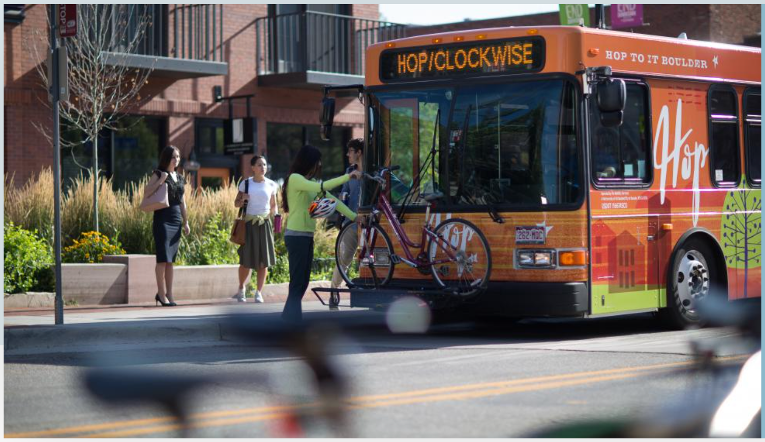
RTD Partnership Program
Purpose: To leverage RTD and local funding to provide additional services that meet a community’s local mobility needs
Creates a dedicated budget set-aside for partnership matching
Establishes a process to evaluate partnerships after implementation
Leverages Subregional Service Councils
Connects people to more mobility options

Slide 3
Partnership Program Workflow – Second Year
Call for projects
RTD hosts Q&A Meeting
Review recommendations with GM/CEO
Announce awardees
Initiate implementation
Technical support/review
IGA development
Applications due
Application evaluation
SSC coordination
Ongoing
May
June-August
August
September-December
2024
Begin new partnership service
Finalize partnership agreements
RTD hosts check-in meeting
Prepare for call for projects
December-January
January-March
March-April
2025

Slide 4
2024 Call for Projects
Call for projects open May 1 – June 3, 2024
Subregional Service Councils will prioritize projects if more than one project is submitted
Only local governments and TMAs/TMOs are eligible
$2 million annually available for 2025, 2026, and 2027
No more than 30% of program funding to one subregion
RTD will fund up to 80% of project costs
RTD will fund up to three years
Notes:
Applicants will be required to put together a pitch of no more than five (5) minutes at the June SSC meeting about their project. This will help the SSCs prioritize the projects submitted in their area.

Slide 5
2024 Project Selection Process
Selection committee develops funding recommendation
Applications scored by RTD staff
Selection committee
RTD Staff
SSC Representatives
DRCOG Staff
SSCs will choose one representative to be on the selection committee in June

Slide 6
2024 Project Selection Criteria
Alignment with RTD Strategic Plan
Local support and ability to meet local needs
Provides service where there is a gap in existing service
Provides service to equity zones
Potential ridership
Project readiness

Slide 7
Scoring Rubric
Selection Criteria | Weight | High (3 points) | Medium (2 points) | Low (1 point)
Alignment with RTD’s Strategic Plan | 10% | The project demonstrates strong alignment with the two Strategic Plan priorities that the Partnership Program seeks to enhance – Community Value and Customer Excellence | The project demonstrates moderate alignment with the two Strategic Plan priorities that the Partnership Program seeks to enhance – Community Value and Customer Excellence | The project demonstrates weak alignment with the two Strategic Plan priorities that the Partnership Program seeks to enhance – Community Value and Customer Excellence
Local support and ability to meet local needs | 20% | The project was prioritized first by the applicant’s Subregional Service Council. | The project was prioritized second by the applicant’s Subregional Service Council. | The project was prioritized third or lower by the applicant’s Subregional Service Council.
Complements existing RTD services | 10% | The project provides a first-last mile connection to frequent (15 minutes or less) RTD service | The project provides a first-last mile connection to semi-frequent (16-59 minutes) RTD service | The project provides a first-last mile connection to infrequent (60 minutes or more) RTD service
Provides service where there is a gap in existing service | 10% | The project implements a service that provides mobility in an area that has no RTD service | The project implements a service that provides mobility in an area that has some RTD service | The project implements a service that provides mobility in an area that has ample RTD service
Provides service to equity populations (from DRCOG data tool) | 15% | Relative to other submitted projects, the project will provide service to a larger number of individuals of color and low-income households. | Relative to other submitted projects, the project will provide service to a medium number of individuals of color and low-income households. | Relative to other submitted projects, the project will provide service to a lower number of individuals of color and low-income households.
Potential ridership | 15% | Relative to other submitted projects, the density of population and jobs in the service area is higher. | Relative to other submitted projects, the density of population and jobs in the service area is medium. | Relative to other submitted projects, the density of population and jobs in the service area is lower.
Project readiness | 20% | Applicant demonstrates a strong ability to deliver project on time as well as manage ongoing operations of the project. Applicant has managed similar past projects or conducted enough planning to fully understand work required to implement. Applicant has staffing necessary to support project implementation. | Applicant demonstrates a medium ability to deliver project on time as well as manage ongoing operations of the project. While applicant may not have managed similar past projects, applicant has conducted enough planning to fully understand work required to implement. Applicant has staffing necessary to support project implementation. | Applicant demonstrates a low ability to deliver project on time as well as manage ongoing operations of the project. Applicant has not managed similar past projects, however, applicant has conducted some planning to understand work required to implement. Applicant does not have staffing necessary to support project implementation.
Please refer to rubric and weighting when developing your pilot project

Slide 8
Intergovernmental Agreements (IGA) or Agreement
Municipal partners will sign an IGA
TMA/TMO partners will sign an agreement
Federal requirements:
Title VI
Drug & Alcohol Testing
Procurement Oversight
RTD requirements:
Records and Auditing
Marketing
Liability & Insurance
Reporting

Slide 9
Vehicle Capital Regulations
Sponsor Leasing
Sponsor Owned
Contractor Owned
Contractor Leased
Reimbursements can be made through a milestones schedule if sponsor will be owning the vehicle

Slide 10
Performance Metrics
Travel Market Category | Previous Family of Services Category | Evaluation Metrics | Current Performance Threshold
Community Fixed Route | Suburban Local | Boardings/ Service Hour | 10 boardings/hour
 |  | OTP | 85%
 |  | Rolling Stock Reliability | 80%
 |  | Cost/Boarding | $14/boarding
Community Demand Response | FlexRide | Boardings/ Service Hour | 2.0 boardings/hour
 |  | Wait Time | 50% of trips wait time <30 mins
 |  | Rolling Stock Reliability | 80%
 |  | Cost/Boarding | $30/boarding
Annual evaluation based on performance metrics
Metrics may be changed year-to-year
Changes to metrics will be published with the Call for Projects
Partnership Program projects will be required to meet RTD’s “Community” service standards
Cost/Boarding is a target not a requirement

Slide 11
Partnership Program Application Portal

Slide 12
Partnership Program Application

Slide 13
DRCOG Data Tool

