Slide 1
Customer Excellence Survey

Slide 2
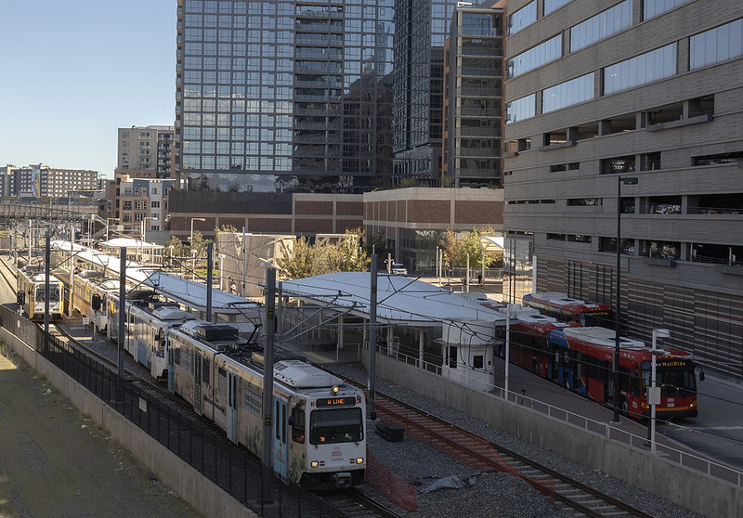
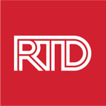
High Level Take Aways
RTD is setting the standard for customer experience with bus and rail service in most areas
Overall satisfaction decreased on rail service, but the overall NPS score increased slightly due to increases in the NPS for both bus and light rail
A high percentage of riders were negatively impacted by the rail construction in downtown Denver
The top opportunities for improvement by type of service are:
BUS: travel time
LIGHT RAIL: travel time
COMMUTER RAIL: frequency of service
September 25, 2024
2

Slide 3
Methodology: Bus and Rail Surveys
Intercept method
Survey period: August 21 through September 1, 2024
Target sample: 1,200 (+/- 2.8% at the 95% confidence level)
1,274 completed surveys
Every route/line sampled in proportion to Spring 2023 ridership
September 25, 2024
3

Slide 4
Customer Characteristics

Slide 5
Customer Characteristics
Most likely to be male and 18-39 years old
54% White or Caucasian
21% Hispanic, Spanish, or Latino/a/x
14% Black/African American
62% reported household incomes of less than $50,000
Most likely to be male and 18-39 years old
53% White or Caucasian
20% Hispanic, Spanish, or Latino/a/x
14% Black/African American
54% reported household incomes of less than $50,000
Most likely to be female and over 65 years old
61% White or Caucasian
12% Hispanic, Spanish, or Latino/a/x
19% Black/African American
90% reported household incomes of less than $50,000
September 25, 2024
5

Slide 6
Customer Characteristics (cont.)
75% use the bus three or more days a week
75% are reliant on bus service
56% use buses to commute to and from work
74% use rail three or more days a week
74% are reliant on rail services
56% uses trains to commute to and from work
33% use AOD for making most of their trips
43% use AAR for most of their trips
43% use services for medical appointments
September 25, 2024
6

Slide 7
Overall Customer Satisfaction

Slide 8
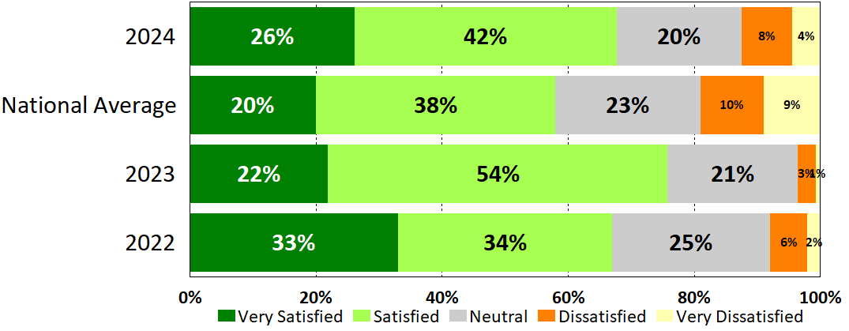
Overall Satisfaction: Bus
September 25, 2024
8
Percentages do not equal 100 due to rounding.

Slide 9
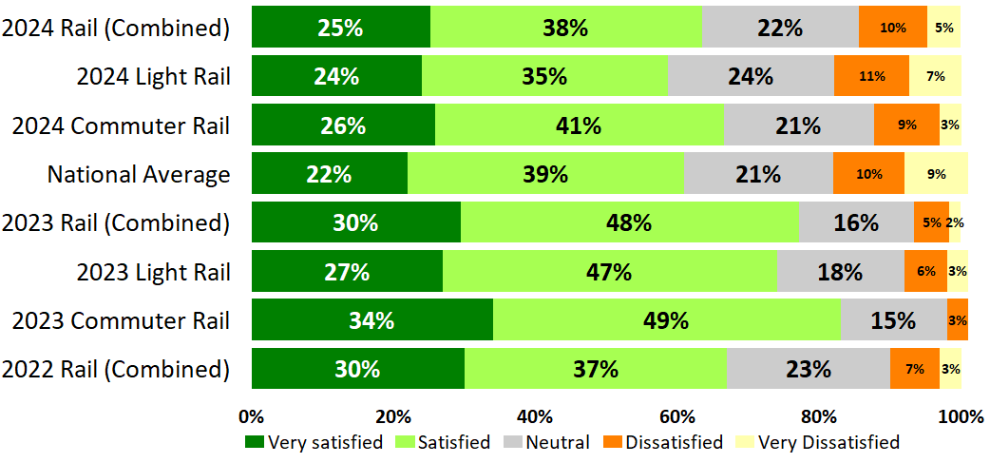
Overall Satisfaction: Rail
Percentages do not equal 100 due to rounding.
September 25, 2024
9

Slide 10
Net Promoter Score

Slide 11
Net Promoter Score
September 25, 2024
11

Slide 12
Customer NPS – Bus, Rail and Paratransit Combined
2024*
2023
2022
0
0
0
-50
50
-50
50
-50
50
-100
13
100
-100
11
100
-100
12
100
*2024 NPS is weighted using 2023 ridership due to 2024 ridership numbers not yet available as of October 2024
September 25, 2024
12

Slide 13
Bus NPS
2024
2023
2022
0
0
0
-50
50
-50
50
-50
50
13
100
7
100
-100
12
100
-100
-100
National Average
0
-50
50
-100
-27
100
September 25, 2024
13

Slide 14
Rail NPS
2024
2023
2022
0
0
0
-50
50
-50
50
-50
50
12
100
19
100
-100
14
100
-100
-100
National Average
0
-50
50
-100
-17
100
September 25, 2024
14

Slide 15
Rail NPS (cont.)
2024
2023
2022
0
0
0
-50
50
-50
50
-50
50
Light Rail
-2
-100
8
100
-100
-2
100
-100
6
100
-2
2024
2023
2022
2024
0
0
0
-50
50
-50
50
-50
50
Commuter Rail
-100
15
100
-100
47
100
-100
28
100
September 25, 2024
15

Slide 16
National Average Comparison

Slide 17
Performance
September 25, 2024
17

Slide 18
Access
September 25, 2024
18

Slide 19
Safety and Comfort
September 25, 2024
19

Slide 20
Information
September 25, 2024
20

Slide 21
Driver (Operator) Behavior
September 25, 2024
21

Slide 22
Community Value
September 25, 2024
22

Slide 23
Service Information
September 25, 2024
23

Slide 24
Service Information (Cont.)
September 25, 2024
24

Slide 25
Mobile Applications and Social Media
September 25, 2024
25

Slide 26
Customer Service
September 25, 2024
26

Slide 27
Operations
September 25, 2024
27

Slide 28
Access to Destinations & Funding
September 25, 2024
28

Slide 29
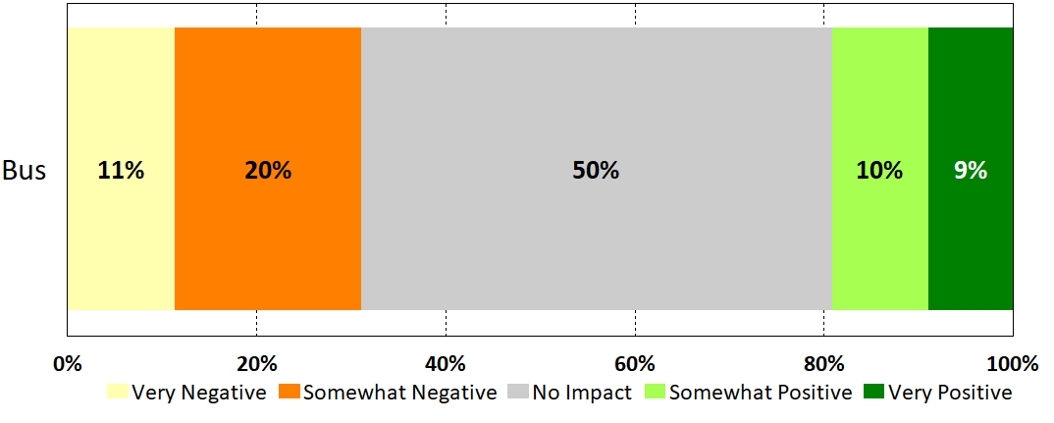
Rail Construction Impact (Bus)
What kind of impact is RTD’s downtown rail reconstruction project having on you?
September 25, 2024
29

Slide 30
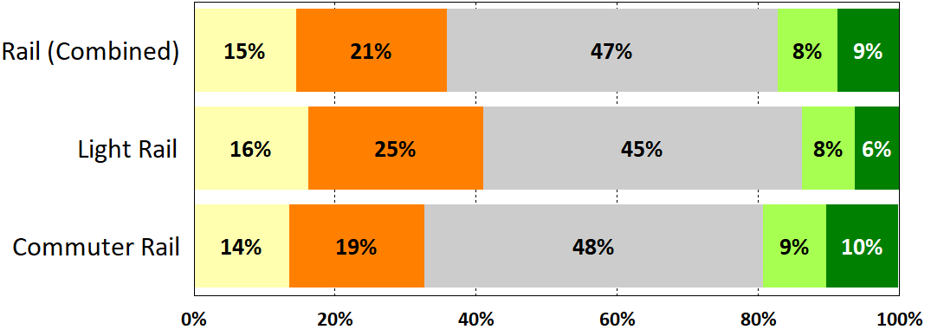
Rail Construction Impact (Rail)
What kind of impact is RTD’s downtown rail reconstruction project having on you?
September 25, 2024
30

Slide 31
Adjustments Due to Rail Construction (Bus)
September 25, 2024
31

Slide 32
Adjustments Due to Rail Construction (Light Rail)
September 25, 2024
32

Slide 33
Adjustments Due to Rail Construction (Commuter Rail)
September 25, 2024
33

Slide 34
Top Importance and Key Driver Analyses

Slide 35
Top Importance: Bus (2023)
Additional items ranked by level of importance:
Bus cleanliness
Accuracy of route schedules and maps
Timely resolution of questions, concerns, or complaints
Ease of finding out if buses are running on schedule
Helpful drivers
Timely arrival of buses
Availability of route schedules and maps
Courteous drivers
Buses being operated safely
Bus stops conveniently located
Mechanical safety of bus
Courteous customer service representatives
Personal security while waiting for bus
RTD system provides value to the community
Access to key public service destinations
September 25, 2024
35

Slide 36
Top Importance: Bus (2024)
Additional items ranked by level of importance:
Timely arrival of buses
Personal security on bus
Ease of finding out if buses are running on schedule
Accuracy of route schedules and maps
Helpful drivers
Personal security while waiting for bus
Bus cleanliness
Buses being operated safely
Courteous drivers
Availability of route schedules and maps
Access to key public service destinations
Mechanical safety of bus
RTD system provides value to the community
Timely resolution of questions, concerns, or complaints
Courteous customer service representatives
September 25, 2024
36

Slide 37
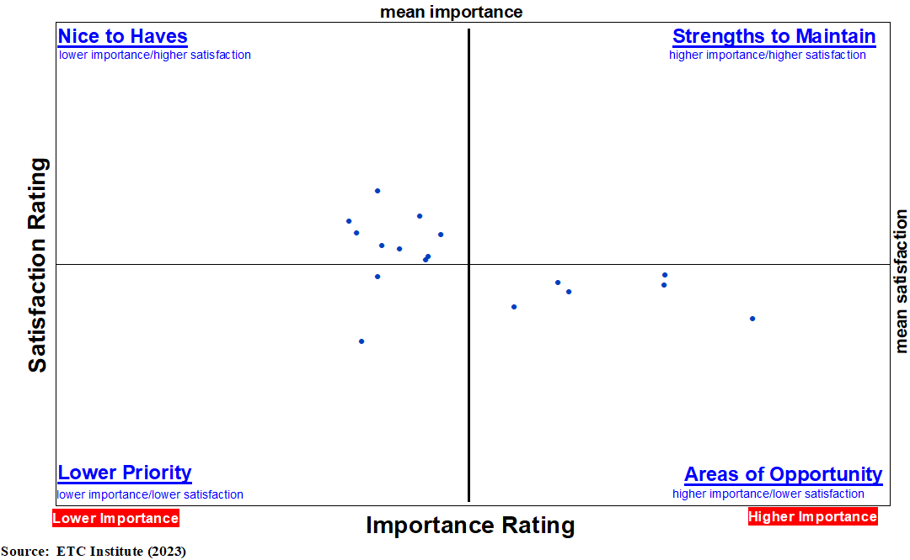
Key Driver Analysis: Bus (2023)
A – Frequency (how often the buses come)
B – Hours of operation
C – Personal security on bus*
D – Fare price
E – Travel time*
F – Bus cleanliness
G – Accuracy of route schedules and maps
H – Ease of finding out if the buses are running on schedule
I – Helpful drivers
J – Availability of route schedules and maps
K – Courteous drivers
L – Buses being operated safely
M – Bus stops conveniently located
N – Mechanical safety of bus
O – Personal security while waiting for bus
P – RTD system provides value to the community
Q – Access to key public service destinations
N
Q
J
L
K
G
P
H
I
E
B
M
C
F
D
A
O
September 25, 2024
37
*strong correlation indicated in regression analysis

Slide 38
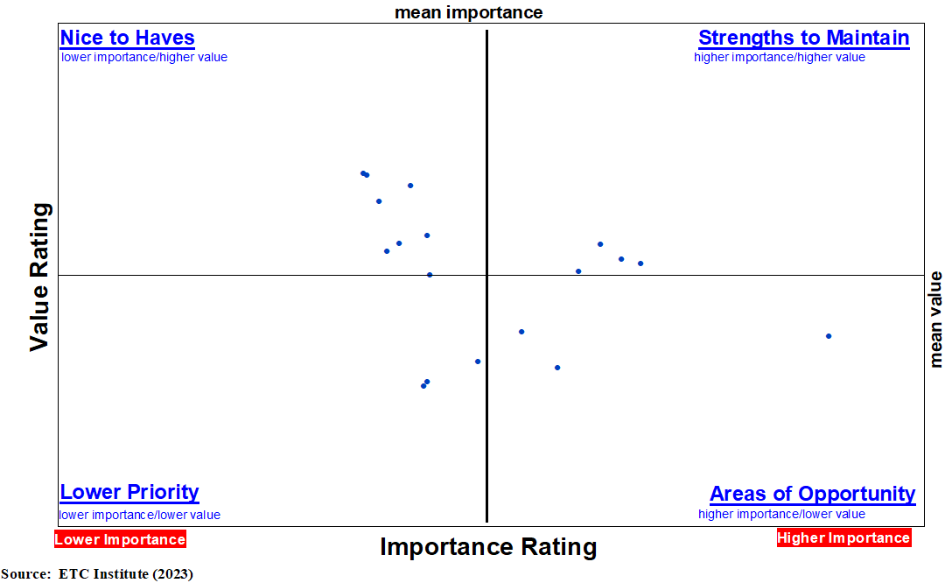
Key Driver Analysis: Bus (2024)
A – Frequency (how often the buses come)
B – Fare price
C – Hours of operation
D – Bus stops conveniently located
E – Travel time*
F – Timely arrival of buses
G – Personal security on buses
H – Ease of finding out if the buses are running on schedule
I – Accuracy of route schedules & maps
J – Helpful drivers
K – Personal security while waiting for bus
L – Bus cleanliness
M – Buses being operated safely
N – Courteous drivers
O – Availability of route schedules & maps
P – Access to key public service destinations
Q – Mechanical safety of bus
R - RTD system provides value to the community
R
Q
P
M
N
J
D
O
E
C
B
I
G
A
K
H
F
L
September 25, 2024
38
*strong correlation indicated in regression analysis

Slide 39
Top Importance: Light Rail (2023)
Additional items ranked by level of importance:
Timely arrival of trains
Personal security on train
Ease of finding out if trains are running on schedule
Train cleanliness
Trains being operated safely
Access to key public service destinations
Accuracy of route schedules and maps
Availability of route schedules and maps
Mechanical safety of train
RTD system provides value to the community
Courteous drivers
Helpful drivers
Personal security while waiting for train
Timely resolution of questions, concerns, or complaints
Courteous customer service representatives
September 25, 2024
39

Slide 40
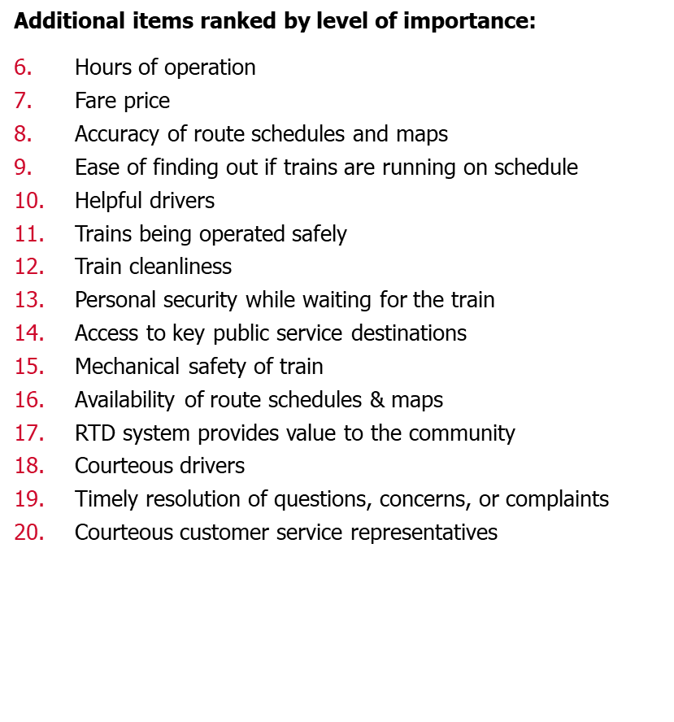
Top Importance: Light Rail (2024)
September 25, 2024
40

Slide 41
Key Driver Analysis: Light Rail (2023)
A – Frequency (how often the trains come)*
B – Fare price
C – Hours of operation
D – Train stops being conveniently located
E – Travel time
F – Personal security on the train
G – Ease of finding out if the trains are running on schedule
H – Train cleanliness
I – Trains being operated safely
J – Access to key public service destinations
K – Accuracy of route schedules and maps
L – Availability of route schedules and maps
M – Mechanical safety of trains
N – RTD provides value to the community
O – Courteous drivers
P – Helpful drivers
Q – Personal security while waiting for the train
M
N
J
P
I
L
D
O
K
E
C
G
F
B
A
Q
H
September 25, 2024
41
*strongest correlation indicated in regression analysis

Slide 42
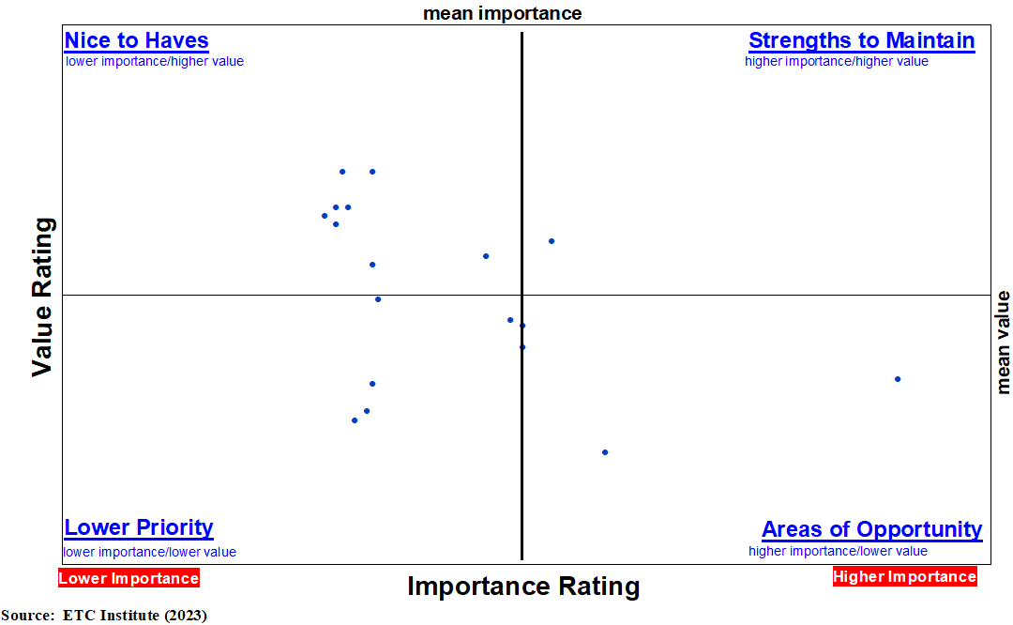
Key Driver Analysis: Light Rail (2024)
A – Frequency (how often the trains come)
B – Timely arrival of trains
C – Train stops being conveniently located
D – Travel time*
E – Personal security on train
F – Hours of operation
G – Fare price
H – Accuracy of route schedules & maps
I – Ease of finding out if trains are running on schedule
J – Helpful drivers
K – Trains being operated safely
L – Train cleanliness
M – Personal security while waiting for train
N – Access to key public service destinations
O – Mechanical safety of train
P – Availability of route schedules & maps
Q – RTD system provides value to the community
R - Courteous drivers
O
K
Q
R
N
P
C
J
G
H
F
D
E
I
A
L
M
B
September 25, 2024
42
*strongest correlation indicated in regression analysis

Slide 43
Top Importance: Commuter Rail (2023)
Additional items ranked by level of importance:
Timely arrival of trains
Availability of route schedules and maps
Personal security on train
Train cleanliness
Ease of finding out if trains are running on schedule
Helpful drivers
Access to key public service destinations
Accuracy of route schedules and maps
Trains being operated safely
Personal security while waiting for train
Courteous drivers
Courteous customer service representatives
Timely resolution of questions, concerns or complaints
RTD system provides value to the community
Mechanical safety of train
September 25, 2024
43

Slide 44
Top Importance: Commuter Rail (2024)
Additional items ranked by level of importance:
Hours of operation
Timely arrival of trains
Train cleanliness
Personal security while waiting for train
Helpful drivers
Accuracy of route schedules & maps
Courteous drivers
Ease of finding out if trains are running on schedule
Trains being operated safely
Availability of route schedules & maps
Mechanical safety of train
Access to key public service destinations
Courteous customer service representatives
RTD system provides value to the community
Timely resolution of questions, concerns, or complaints
September 25, 2024
44

Slide 45
Key Driver Analysis: Commuter Rail (2023)
A – Frequency (how often the trains come)
B – Fare price
C – Travel time*
D – Hours of operation
E – Train stops being conveniently located
F – Availability of route schedules & maps
G – Personal security on train
H – Train cleanliness
I – Ease of finding out if trains are running on schedule
J – Helpful drivers
K – Access to key public service destinations
L – Accuracy of route schedules & maps
M – Trains being operated safely
N – Personal security while waiting for the train
O – Courteous drivers
P – RTD provides value to the community
Q – Mechanical safety of trains
Q
M
P
O
K
F
L
J
H
C
I
G
E
D
B
A
N
45
strongest correlation indicated in regression analysis

Slide 46
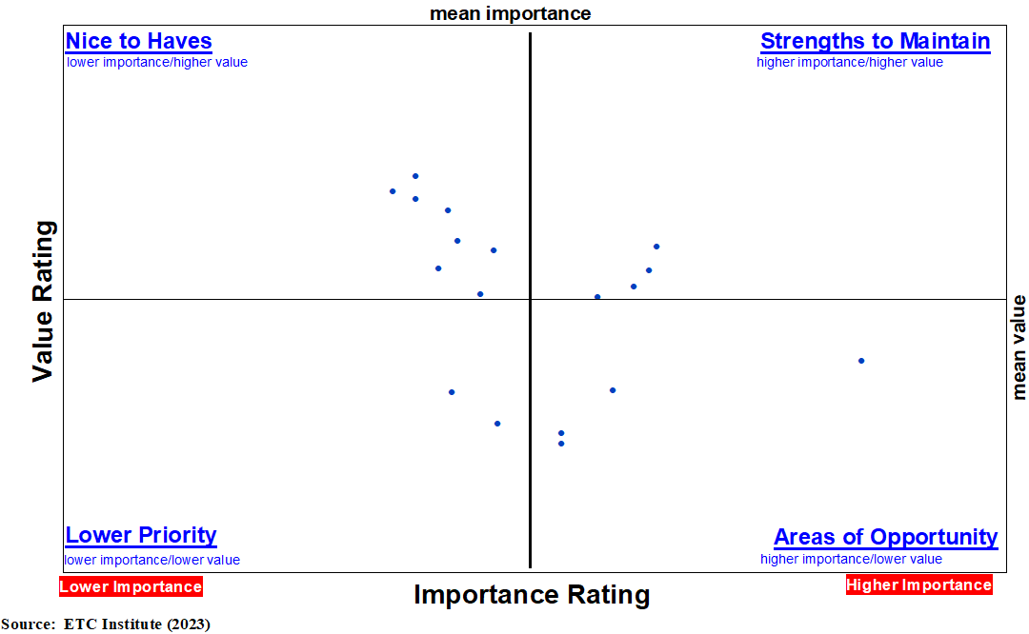
Key Driver Analysis: Commuter Rail (2024)
A – Frequency (how often the trains come)*
B – Train stops conveniently located
C – Fare price
D – Travel time
E – Personal security on train
F – Hours of operation
G – Timely arrival of trains
H – Train cleanliness
I – Personal security while waiting for train
J – Helpful drivers
K – Accuracy of route schedules & maps
L – Courteous drivers
M – Ease of finding out if trains are running on schedule
N – Trains being operated safely
O – Availability of route schedules & maps
P – Mechanical safety of trains
Q – Access to key public service destinations
R – RTD system provides value to the community
P
R
Q
N
L
J
B
O
K
F
D
C
A
M
E
I
G
H
46
strongest correlation indicated in regression analysis

Slide 47
Summary
RTD is setting the standard for customer experience with bus and rail service in most areas
Overall satisfaction decreased on rail service, but the overall NPS score increased slightly due to increases in the NPS for both bus and light rail
A high percentage of riders were negatively impacted by the rail construction in downtown Denver
The top opportunities for improvement by type of service are:
BUS: travel time
LIGHT RAIL: travel time
COMMUTER RAIL: frequency of service
September 25, 2024
47

Slide 48
Questions?
THANK YOU

