Slide 1
2024 Survey Results – Part 1 Community and Paratransit
September 4, 2024
John McKay
Executive Business Partner

Slide 2
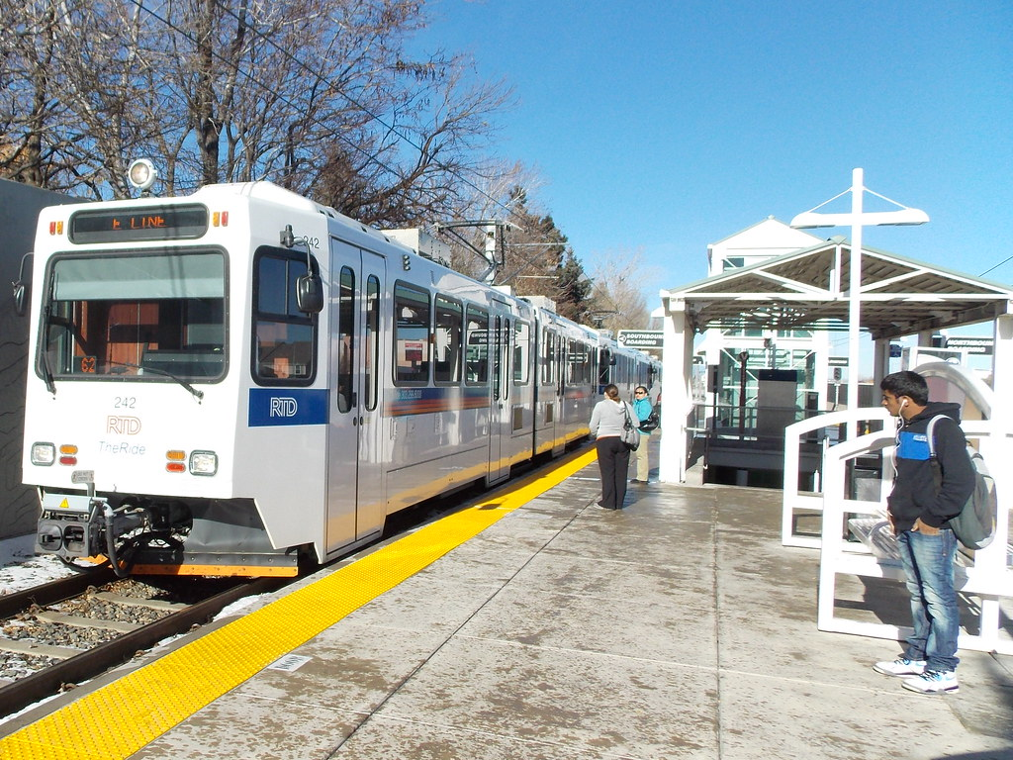
Overview
Introduction
Community Value Survey
Net Promoter Score
National Average Comparison
Top Importance Key Driver Analysis
Customer Excellence Survey – Paratransit
Customer Characteristics
Overall Customer Satisfaction
Net Promoter Score
National Average Comparison
Top Importance and Key Driver Analysis
Conclusion
September 4, 2024
2

Slide 3
Introduction

Slide 4
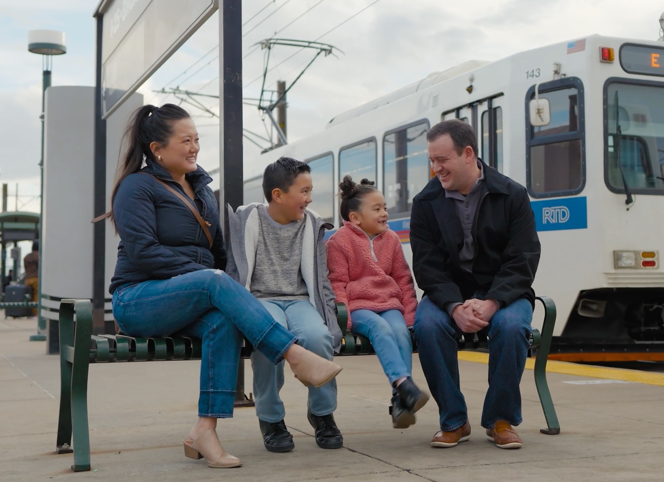
Key Takeaways
Overall satisfaction increased
Satisfaction ratings above national average in many areas
Net Promoter Score increased
New opportunity area in 2024: Paratransit travel time
Access to employment remains an area of opportunity for community members
September 4, 2024
4

Slide 5
Survey Overview
Collection Period
Collection Method
 | Community Value | June – July 2024 | Mail
 | Customer Excellence: Paratransit | June – July 2024 | Mail, email, text
 | Customer Excellence: Rail | August 2024 | Intercept
 | Customer Excellence: Bus | August 2024 | Intercept
September 4, 2024
5

Slide 6
Community Value Survey

Slide 7
Methodology: Community Survey
Distribution: mailed to random sample of households in the Denver metro area
Survey period: June 19 through July 12, 2024
Results were monitored to maintain demographic distribution in proportion to the region
Target sample: 400 (+/- 4.9% at the 95% confidence level)
629 completed surveys
September 4, 2024
7

Slide 8
Awareness and Frequency 2024
Are you aware of RTD, the public transportation system that operates bus, rail and paratransit services in the Denver Metro region?
On average, how often do you use RTD?
99.7%
September 4, 2024
8

Slide 9
Opinion Regarding RTD’s Value
September 4, 2024
9

Slide 10
Reasons for Public Transportation Use
What is your primary purpose for using public transportation?
September 4, 2024
10

Slide 11
Reasons for Discontinued Use
Additional reasons:
Bus/train does not go to places I need to go
Service is too infrequent
It is too expensive
I live in an area where services were reduced or suspended
Bus/train does not operate at times I need it to
I started working from home
I no longer live within service area
I am no longer employed
Schedules are too complicated
Bus/train does not operate on days I need it to
Limiting other non-work travel
I do not feel that RTD’s vehicles are mechanically safe
September 4, 2024
11

Slide 12
Three features that RTD could add to its current service that would make it more appealing for you to use public transportation.
Additional choices:
Shorter trip times
Additional security/fare inspectors
Lower fares
Stops closer to my home
Shelter at transit stops/stations
Cleaner vehicles
Cleaner stops/stations
September 4, 2024
12

Slide 13
How is RTD doing?
Based on your personal experience or anything you may have seen, read, or heard, how would you rate the overall job you think RTD is doing in providing transit service in the Denver area?
September 4, 2024
13

Slide 14
Net Promoter Score: Community
2024
2023
2022
0
0
0
-50
50
-50
50
-50
50
-100
-22
100
-100
-44
100
-100
-33
100
National Average
0
-50
50
-100
-62
100
September 4, 2024
14

Slide 15
RTD Value
How valuable is RTD:
September 4, 2024
% Valuable and Extremely Valuable
15

Slide 16
RTD Value (cont’d)
How valuable is RTD:
September 4, 2024
% Valuable and Extremely Valuable
16

Slide 17
RTD Value (cont’d)
September 4, 2024
% Valuable and Extremely Valuable
17

Slide 18
RTD Value (cont’d)
September 4, 2024
% Valuable and Extremely Valuable
18

Slide 19
Value of RTD
September 4, 2024
% Valuable and Extremely Valuable
19

Slide 20
Levels of Agreement
September 4, 2024
% Agree and Strongly Agree
20

Slide 21
Levels of Agreement
September 4, 2024
% Agree and Strongly Agree
21

Slide 22
Levels of Agreement
September 4, 2024
% Agree and Strongly Agree
22

Slide 23
Top Importance: Community 2024
Additional areas:
Additional areas:
Providing access to places of leisure & recreation
Achieving sustainable practices, reducing pollution/carbon footprint
Providing access to medical facilities
Providing access to the region/adjacent cities & counties
Providing access to educational facilities
Improving quality of life
Providing opportunities for locating affordable housing
Making roads safer for all users
Attracting & retaining more employment opportunities in the region
Supporting community businesses
September 4, 2024
23

Slide 24
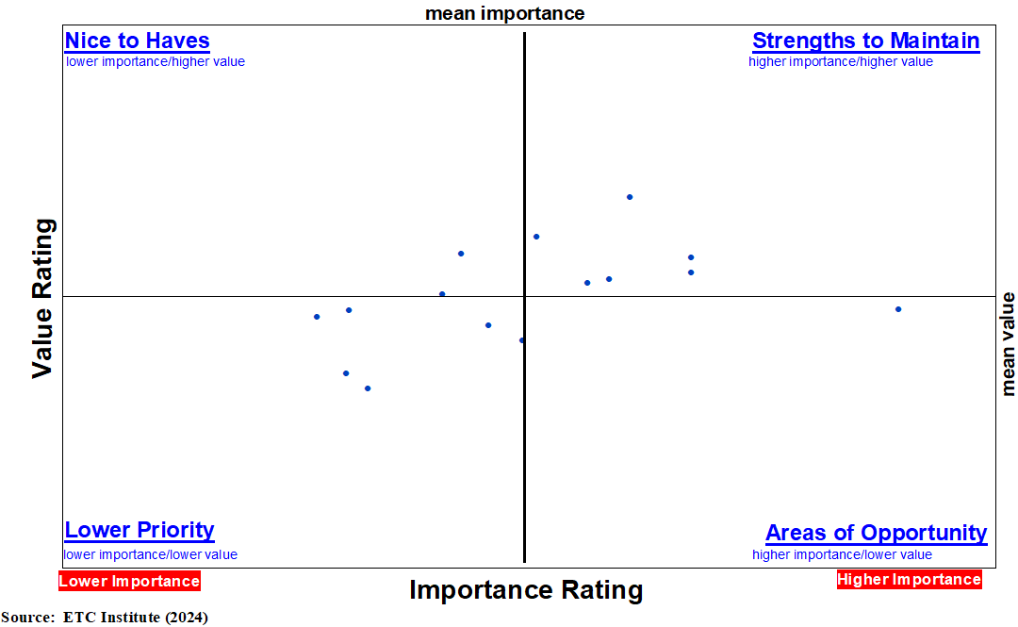
Key Driver Analysis: Community 2024
A – Providing access to places of employment
B – Providing affordable transportation options
C – Reducing traffic congestion
D – Providing transportation options to people with special mobility needs
E – Providing a safe transportation alternative
F – Providing access to places of leisure & recreation
G – Achieving sustainable practices, reducing pollution/carbon footprint
H – Providing access to medical facilities
I – Providing access to the region/adjacent cities and counties
J – Providing access to educational facilities
K – Improving quality of life
L – Providing opportunities to locate affordable housing
M – Making roads safer for all users
N – Attracting and retaining more employment opportunities
O – Supporting community businesses
D
J
G
B
K
F
E
C
O
M
I
A
H
N
L
September 4, 2024
24

Slide 25
Customer Excellence Survey – Paratransit

Slide 26
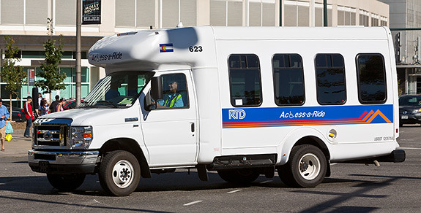
Methodology: Paratransit Surveys
Distribution: mail, email and text message
Survey period: June 18 to July 19, 2024
Target sample: 400 (+/- 4.9% at the 95% confidence level)
528 completed surveys
September 4, 2024
26

Slide 27
Customer Characteristics
Most likely female and over 55 years old
62-63% White or Caucasian
20% Black/African American
12-13% Hispanic, Spanish, or Latino/a/x
52% reported household incomes less than $25,000
62% use Access-a-Ride for most trips
12% use Access-on-Demand for most trips
46% use services for medical appointments
September 4, 2024
27

Slide 28
Overall Satisfaction: Paratransit 2024
28
September 4, 2024
Percentages do not equal 100 due to rounding.

Slide 29
Overall Satisfaction: Paratransit 2023
*National comparative data not available
29
September 4, 2024
Percentages do not equal 100 due to rounding.

Slide 30
Overall Satisfaction: Paratransit
September 4, 2024
30

Slide 31
Net Promoter Score: Paratransit
2024
2023
2022
0
0
0
-50
50
-50
50
-50
50
Access-a-Ride
-100
59
100
-100
20
100
-100
42
100
2024
2023
0
0
-50
50
-50
50
Access-on-Demand
-100
67
100
-100
58
100
September 4, 2024
31

Slide 32
Top Importance: Access-a-Ride 2024
Additional items ranked by level of importance:
Feeling safely secured in vehicle
Drivers operate vehicles safely
Ability to schedule trips for times I need to travel
Personal security (safe from crime) on vehicle
Drivers being courteous
Proper mechanical safety of vehicle
Drivers being helpful
Vehicle comfort
Vehicle cleanliness
Availability of scheduling staff
Timely resolutions of my questions, concerns or complaints
September 4, 2024
32

Slide 33
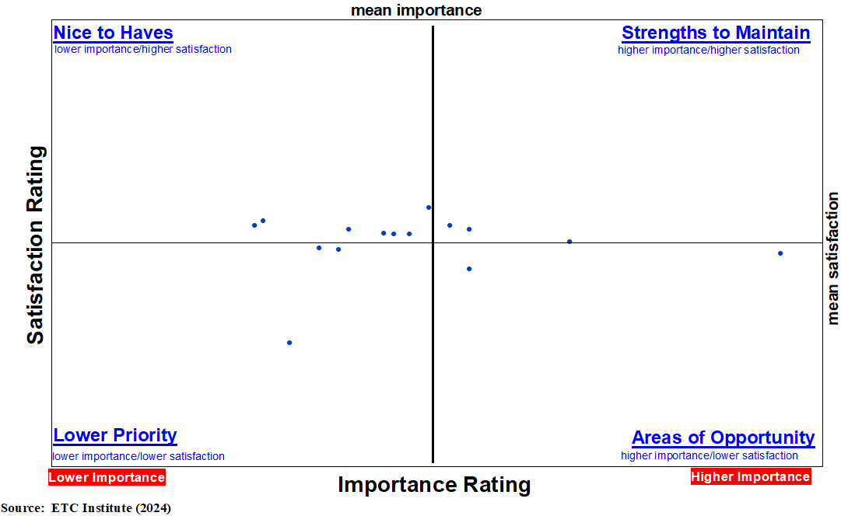
Key Driver Analysis: Access-a-Ride 2024
A – Vehicles arriving within scheduled window
B – Fare price
C – Ease of scheduling a trip
D – Travel Time
E – Ability to get to places I need to go
F – Feeling safely secured in vehicles
G – Operators drive vehicles safely
H – Ability to schedule trips for times I need to travel
I – Personal security (safe from crime) on vehicle
J – Operators being courteous
K – Proper mechanical safety of vehicle
L – Operators being helpful
M – Vehicle comfort
N – Vehicle cleanliness
O – Availability of scheduling staff
N
F
J
I
H
E
C
O
G
B
L
K
A
D
M
33

Slide 34
Top Importance: Access-on-Demand 2024
Additional items ranked by level of importance:
Personal security (safe from crime) on vehicle
Ability to schedule trips for times I need to travel
Feeling safely secured in vehicle
Drivers operate vehicles safely
Drivers being courteous
Drivers being helpful
Vehicle cleanliness
Proper mechanical safety of vehicle
Vehicle comfort
Timely resolutions of my questions, concerns or complaints
September 4, 2024
34

Slide 35
Key Driver Analysis: Access-on-Demand 2024
A – Fare price
B – Ease of scheduling a trip
C – Ability to get to places I need to go
D – Travel time
E – Personal security (safe from crime) while riding
F – Ability to schedule a trip for times I need to travel
G – Feeling safely secured in the vehicle
H – Operators operate vehicles safely
I – Operators being courteous
J – Operators being helpful
K – Vehicle cleanliness
L – Proper mechanical safety of vehicle
M – Vehicle comfort
C
L
E
K
H
B
F
I
D
A
M
J
G
September 4, 2024
35

Slide 36
Conclusion

Slide 37
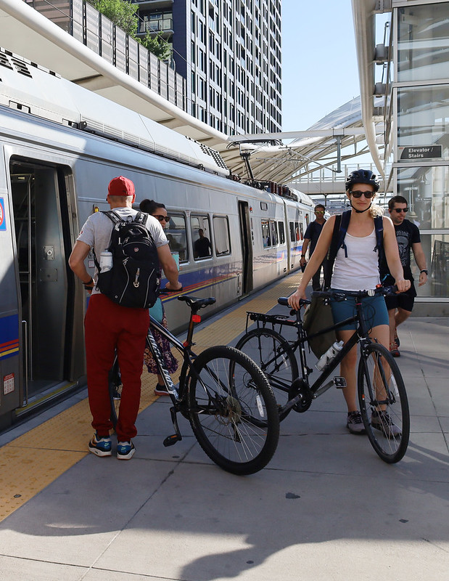
Key Takeaways
Overall satisfaction increased
Satisfaction ratings are above national average in many areas
Net Promoter Score increased
New opportunity area in 2024: Paratransit travel time
Access to employment remains an area of opportunity for community members
September 4, 2024
37

