Slide 1
Triennial Disadvantaged Business Enterprise (DBE) Goal and Methodology for Federal Fiscal
Years (FFY) 2026 – 2028
Public Meeting - June 3, 2025
Alexis Serrano Castro
Small Business Opportunity Office Manager

Slide 2



As we prepare to start, make sure you…
Mute Your Microphone
We are happy you're here! Your microphone will be muted to minimize background noise.
Introduce Yourself
Type in the chat your company name, a one liner of your service, and the best way to contact you. We will distribute the chat transcript to all attendees.
Questions? Feel free to type them in the chat.
Throughout the presentation, feel free to place your questions in the chat, we will be monitoring the chat and answer them when time is available.
This meeting is being recorded to have available as a resource.
By being in this meeting, you consent to being recorded.

Slide 3
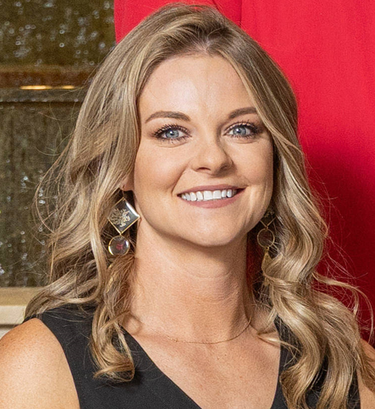

Safety Moment
Crystal Kirklin
Compliance Officer, Small Business Opportunity Office

Slide 4
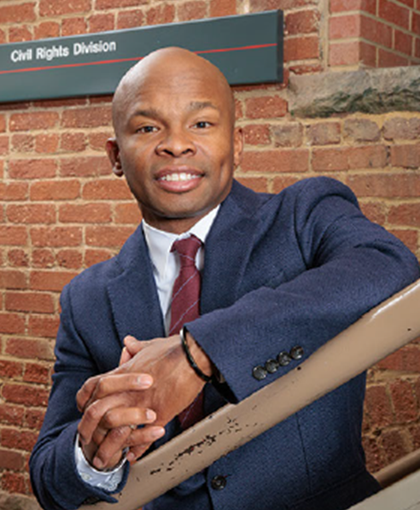
Opening Remarks
Carl Green Jr.
Director, Civil Rights Division

Slide 5
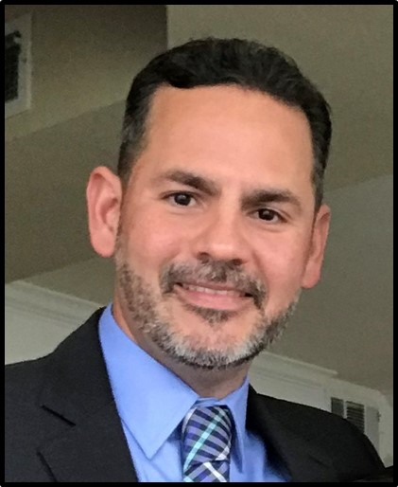
Triennial DBE Goal Methodology
Alexis Serrano Castro
Manager, Small Business Opportunity Office

Slide 6
Agenda
DBE Program History
DBE Program Requirements
DBE Program Highlights
DBE Program Objectives
Triennial Goal Setting Methodology and Rationale
Proposed DBE Triennial Goal

Slide 7
DBE Program History and Requirements
June 03, 2025

Slide 8
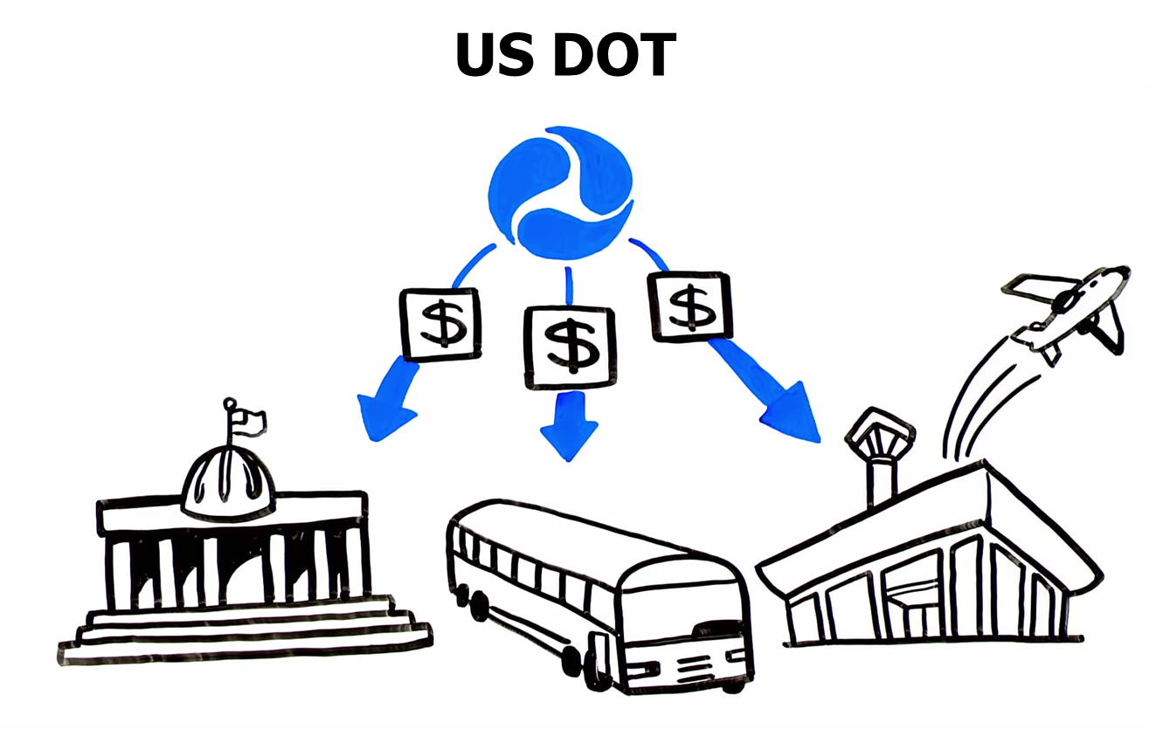
DBE Program Requirements
49 Code of Federal Regulations (CFR) Part 26.21
FTA Recipient Agency or Grantees
Mandated DBE Program
State and Local Government
Airport Entities
Public Transit Agencies
Notes:
Under the Civil Rights Act, the DBE reg was enacted on 1983. With plenty of evidence that certain groups are in disadvantage for federally assisted contracts, It the beginning this provision require that 10% of all US DOT fund authorized for the Highway and Transit assistance programs be expended on DBEs.
African American
Native Americans
Hispanic Americans
Asian Pacific
Subcontinent Asian American
1987 that women were also included on the groups presumed to be in disadvantage
RTD (transit agency) is a recipient agency, we are mandated to have a DBE Program (submitted and approved by the FTA).

Slide 9
49 CFR Part 26.45
Mandated to have a DBE Triennial Goal
Only on federally assisted contracts
Current Period: FFYs 2023-2025 - 14.5%
June 03, 2025
9

Slide 10
DBE Program Highlights
June 03, 2025

Slide 11
DBE Program Highlights
Conforms with regulations of the U.S. Department of Transportation (DOT), 49 CFR Part 26
Ensures the administration, monitoring and implementation requirements set forth in 49 CFR Part 26
Utilizes a Triennial DBE goal to achieve DBE participation for federally-funded projects
June 03, 2025

Slide 12
DBE Program Objectives
June 03, 2025

Slide 13
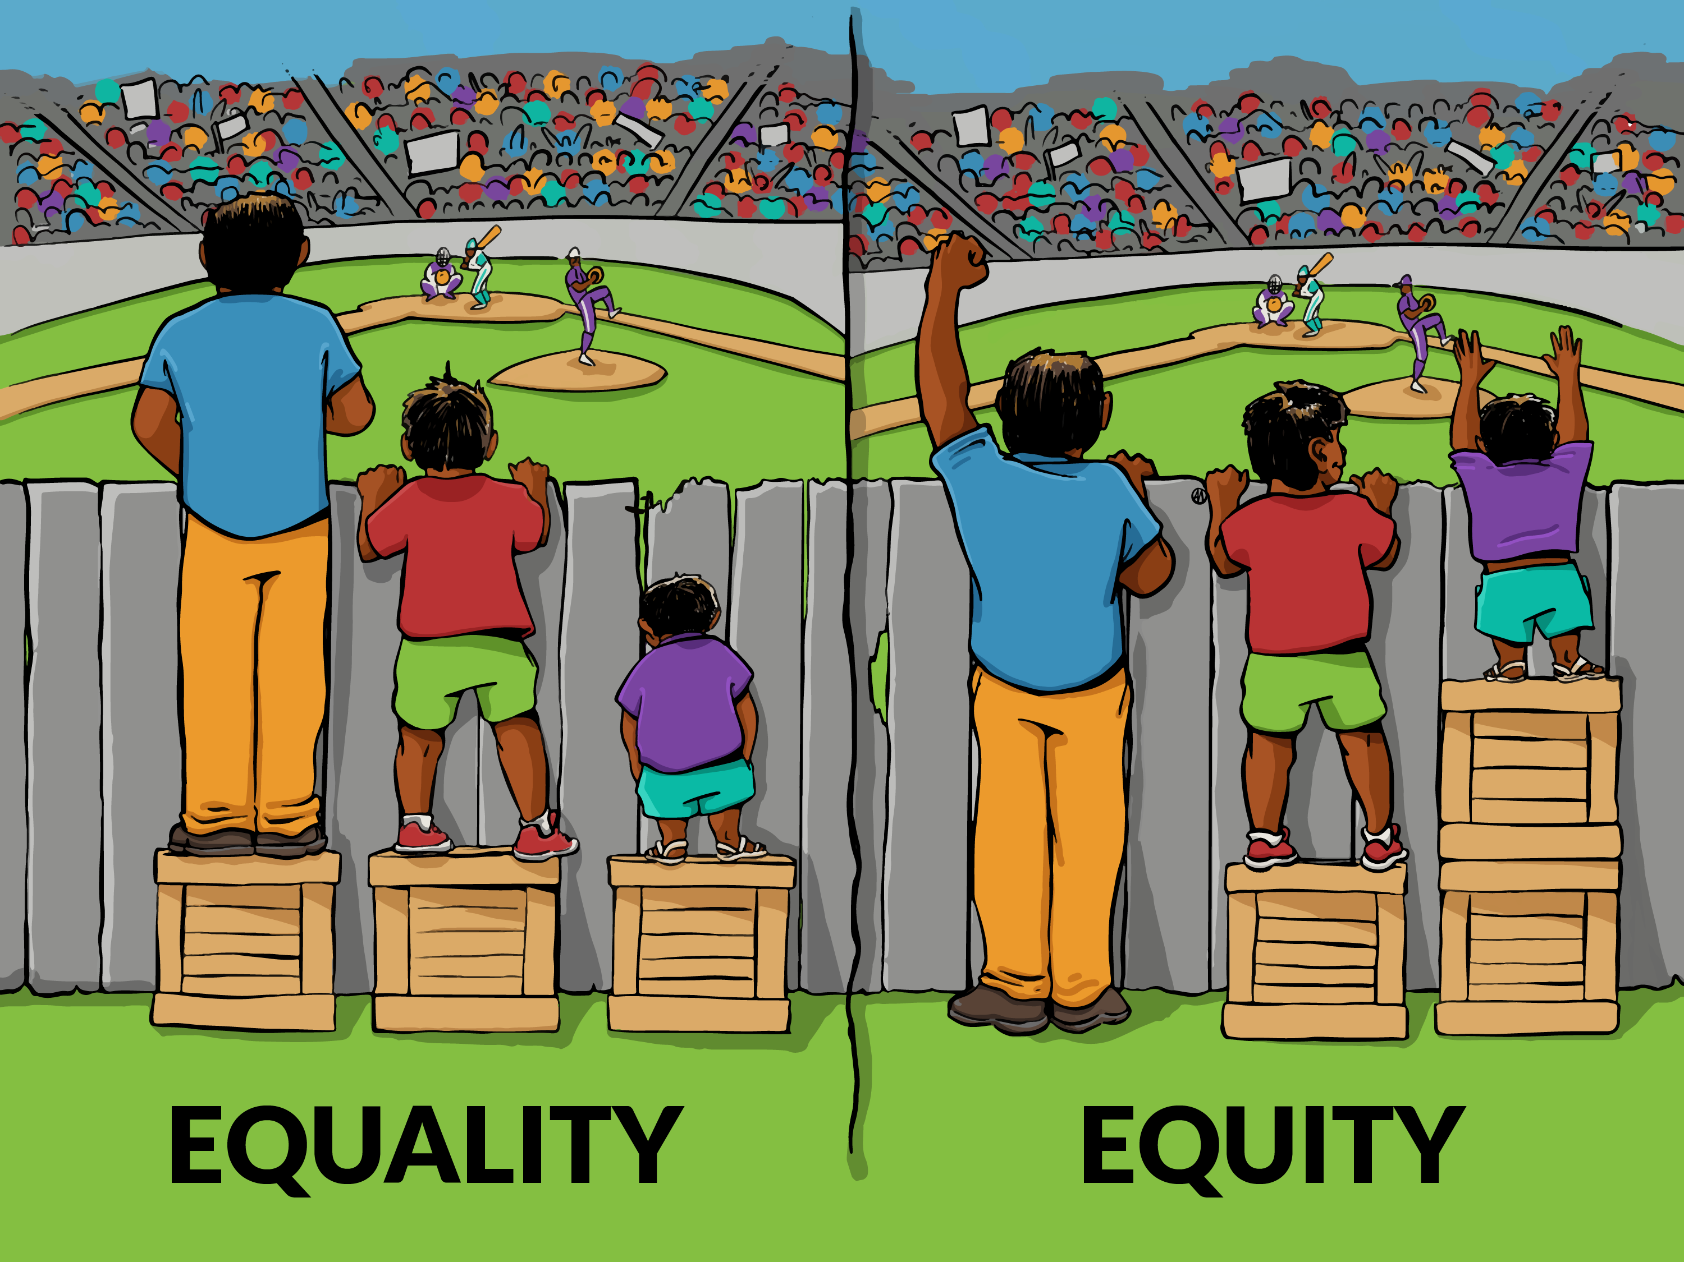
DBE Program Objectives (1 of 3)
Create a “level playing field” for expected DBE participation
DBE Goals must be clearly tied and narrowly tailored to local market
June 03, 2025

Slide 14

DBE Program Objectives (2 of 3)
Recipients can use contract-specific DBE goals based on market area and the identified opportunities relevant to the specific projects or contracts
Quotas or set-asides are not allowed
June 03, 2025

Slide 15
DBE Program Objectives (3 of 3)
Set a specific Triennial DBE Goal based on applicable scopes:
  Design and Construction
  Safety
  Planning
  Several Bus Contracted Services
For FFYs 2026- 2028 (October 1, 2025 - September 30, 2028)
June 03, 2025

Slide 16
Triennial DBE Goal Setting Methodology and Rationale
June 03, 2025

Slide 17
Establishing Triennial DBE Goal
Identify and project of all federally assisted contracts:
  Identify contracting opportunities for upcoming 3-year period
  Request input from all RTD Departments (i.e., Capital Programs, IT, Planning, Rail Operations, Bus Operations, etc.)
  Include potential Intergovernmental Agreements (IGAs) with Municipalities
  Validate information with Grants & Revenue departments
Identify and consolidate listing of DBEs and non-DBEs for opportunities
June 03, 2025

Slide 18
RTD Federally Funded Projects
FFY 2026-2028
June 03, 2025

Slide 19
FFY 2026-2028
New plan contemplates nine federally assisted projects/contracts
Expected to be awarded between October 1, 2025, and September 30, 2028
June 03, 2025
Notes:
With the current already awarded contracts for FFY 2026, 2027 and 2028
You may think was a big amount of money going to DBEs or a DBE Goal hard to achieve, right?
You should know that DBE Triennial Goals in the past has been on 24%, 20.3% and 21%
Doing the assessment is hard, but is only one part of the challenge. Having the PMs supporting the established goals and working as a holistic team, is another one.
Here is how you come to play?

Slide 20
Establishing Triennial DBE Goal
Step One: We must begin goal setting process by determining a “Base Figure” for the relative availability of DBEs
  Determine the number of ready, willing and able DBEs in our market area using the Colorado Unified Certification Program (CUCP) Directory
  Using the Denver Metro Area Census data, we determine the number of all ready, willing and able businesses available in our market to perform work in the same NAICS codes
June 03, 2025

Slide 21
Establishing Triennial DBE Goal (2 of 3)
Step One: “Base Figure”(cont.)
  Divide the number of DBEs by the number of all businesses in our market in applicable NAICS codes to obtain the “Base Figure” (relative availability)
  Weigh the percentages based on estimated percent of project spending in the NAICS code areas
The “Base Figure” availability for the nine projects or contracts = 6.0%
June 03, 2025

Slide 22
Establishing Triennial DBE Goal (3 of 3)
Step Two: Adjustments to the “Base Figure” will consider other factors including:
Number of prospective DBEs in the Denver Metropolitan area (i.e., according to the US Census 35.23% of firms in Denver MSA may be eligible to be certified as DBEs)
Results of Disparity Study findings for Denver City/County. Recommendation of 24% for construction contracts, but our construction projects represent less than 2% on this period
Historically, non-federally funded projects that will now be federally funded
  For example, on the current Triennial DBE participation - 30% of total of federally funded contracts went to Fixed Route services, where only 5% of DBE participation is possible
June 03, 2025
Notes:
After calculating the ‘Base Figure’ we examined other available factors within our marketplace to determine whether we would make any adjustments to the ‘Base Figure’ to obtain our overall DBE goal. The following factors were considered to adjust our ‘Base Figure’:

Slide 23
Expected Projects Contracts for FFY 2026-2028
87.2% of total dollar amount
5.2% DBE Availability
Resulting in 6.0% DBE Availability based on nine expected federally assisted contracts
12.8% of total dollar amount
15.5% DBE Availability
June 03, 2025
Notes:
With the current already awarded contracts for FFY 2026, 2027 and 2028
You may think was a big amount of money going to DBEs or a DBE Goal hard to achieve, right?
You should know that DBE Triennial Goals in the past has been on 24%, 20.3% and 21%
Doing the assessment is hard, but is only one part of the challenge. Having the PMs supporting the established goals and working as a holistic team, is another one.
Here is how you come to play?

Slide 24
Factors Considered
    Discussions with stakeholders including DBEs
    Local market area for RTD and availability of DBEs currently working
    Non-DBEs capable of working who may not currently be certified in Colorado, as reflected in the Denver MSA census data
June 03, 2025
Notes:
After calculating the ‘Base Figure’ we examined other available factors within our marketplace to determine whether we would make any adjustments to the ‘Base Figure’ to obtain our overall DBE goal. The following factors were considered to adjust our ‘Base Figure’:

Slide 25
Factors Considered (cont.)
    Historical data on past participation of DBEs on similar RTD projects
    Predominant impact of bus contracted services (four of the nine new contracts represents 87% of the total federal contract amount)
    The availability of ready, willing and able, certified DBEs capable of participating by potential subcontracting elements
June 03, 2025
Notes:
After calculating the ‘Base Figure’ we examined other available factors within our marketplace to determine whether we would make any adjustments to the ‘Base Figure’ to obtain our overall DBE goal. The following factors were considered to adjust our ‘Base Figure’:

Slide 26
Total Actual DBE Participation
    RTD’s Triennial goal for FFY 2023 through 2025 was 14.5%
      Race-Conscious (RC) 10.5% and Race-Neutral (RN) = 4%
    DBE participation was right on target, with a slight reduction based on DBEs that were under contract, but shortly after lost their DBE certification status.
    Projects not originally planned to be federally funded, became funded with federal grants and had little to no DBE participation possible.
    Fixed Routes - Bus Contracted Services (Groups 32 and Group 33). Based on scopes of work where DBEs can perform, no more than 5% has been able to be attained.
June 03, 2025
Notes:
After calculating the ‘Base Figure’ we examined other available factors within our marketplace to determine whether we would make any adjustments to the ‘Base Figure’ to obtain our overall DBE goal. The following factors were considered to adjust our ‘Base Figure’:

Slide 27

Total Actual DBE Participation vs Recommendation
    Considering the 2023, 2024, and expected DBE participation of 2025, it is recommended to be very modest with DBE goals based on the upcoming contracting opportunities.
    The analysis supports keeping the goal at the Step 1 value of 6.0%
June 03, 2025
Notes:
After calculating the ‘Base Figure’ we examined other available factors within our marketplace to determine whether we would make any adjustments to the ‘Base Figure’ to obtain our overall DBE goal. The following factors were considered to adjust our ‘Base Figure’:

Slide 28
Proposed RN and RC Participation
    Under USDOT regulations, we must meet our DBE participation goal using narrowly tailored means that do not unduly burden non-DBEs.
    To fulfill this obligation, we are required to achieve our DBE participation goal to the greatest extent possible using race-neutral means.
    Race-conscious means may be used only to the extent needed to meet whatever portion of the DBE participation goal that cannot be met through race-neutral means.
June 03, 2025
Notes:
After calculating the ‘Base Figure’ we examined other available factors within our marketplace to determine whether we would make any adjustments to the ‘Base Figure’ to obtain our overall DBE goal. The following factors were considered to adjust our ‘Base Figure’:

Slide 29
Proposed RN and RC Participation (cont.)
The race-neutral efforts include:
An effective outreach program targeted at small businesses, including DBE firms;
Coordinated technical and financial assistance programs;
Monitoring mechanisms to collect program evaluation data;
Accounting for DBE participation obtained through subcontracting on a prime contract without DBE goals; and
Awards of prime contracts to DBEs.
June 03, 2025
Notes:
The race-neutral components of our DBE Program reflect our efforts to reach out and assist companies in ways that are available to all businesses, including minority and women-owned businesses, in our service area. The race-neutral efforts include:

Slide 30
Proposed FFYs 2026-2028
Triennial DBE Goal
June 03, 2025

Slide 31
Triennial DBE Goal
In accordance with USDOT regulation 49 C.F.R. Part 26, RTD has established a goal of awarding 6.0% of the value of federally-funded contracts to DBEs during FFYs 2026-2028
5.5% of the goal will be race-conscious, and 0.5% race-neutral
Notes:
The race-neutral components of our DBE Program reflect our efforts to reach out and assist companies in ways that are available to all businesses, including minority and women-owned businesses, in our service area. The race-neutral efforts include:

Slide 32
Triennial DBE Goal (cont.)
The total Federal assistance contracts for the FFY Triennial period 2026-2028 will be $147.7M
RTD expects that DBEs and other small businesses will be awarded contracts and subcontracts valued in excess of $8,719,161
Real total contract amounts will be $428,256,880 (6%) representing $25,695,412 on DBE contracts
Notes:
The race-neutral components of our DBE Program reflect our efforts to reach out and assist companies in ways that are available to all businesses, including minority and women-owned businesses, in our service area. The race-neutral efforts include:

Slide 33
RTD’s Contracting Opportunities
    $500M in locally funded contracts where SBE goal could be set or small and local firms can fairly compete
      Construction and Maintenance: Construction Management, Rail Replacements, HVAC and Mechanical Maintenance, Painting, Asphalt, Snow Removal, Janitorial, Custodial, On Call Construction contracts, Roofing, Fencing, Printing, Graffiti Removal
      Professional Services in Legal, Planning, Environmental, Bridge Inspections, Information and Technology, Safety, Training, Way Finding, Marketing, among many others
      From $75M to $100M are projected to ended up in DBEs, SBEs or MWBEs
June 03, 2025
Notes:
After calculating the ‘Base Figure’ we examined other available factors within our marketplace to determine whether we would make any adjustments to the ‘Base Figure’ to obtain our overall DBE goal. The following factors were considered to adjust our ‘Base Figure’:

Slide 34
Required Advertisement/Response
30-day review period with RTD: June 3, 2025, to July 3, 2025
45-day Comment Period to RTD and/or DOT: June 3, 2025, to July 18, 2025
Deadline for submitting RTD’s DBE Triennial goal Plan to the FTA: August 01, 2025

Slide 35
Reviewing RTD’s Triennial DBE Plan FFYs 2026-2028
Visit us at Regional Transportation District Office located at:
1660 Blake Street Denver, Colorado 80202
Or
Submit a virtual review request through RTD’s Small Business Office email: SBO@RTD-Denver.com or the SBO website

Slide 36
We make Lives better through connections.

