Slide 1

August 2025 Proposed Service Changes
Gabriel Martinez
Specialist, Community Engagement
Brandon Figliolino Manager, Community Engagement
Jessie Carter
Senior Manager, Service Development
Tegan Rice Senior Service Planner/Scheduler
Notes:
This presentation covers RTD’s proposed Service Changes for August 2025.

Slide 2
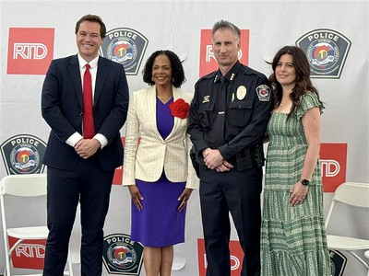

Safety Update
May 13: Steve Martingano sworn-in as RTD’s new Chief of Police and Emergency Management
Served as Acting Chief of Police from November 2024 – May 2025
RTD-PD headcount is currently at 90 officers, with an additional 60 budgeted for 2025
June 16, 2025
2
Notes:
Before giving an overview of the proposed service changes for August 2025, RTD would like to provide a safety update. On May 13th, Steve Martingano was sworn in as RTD’s new Chief of police and Emergency Management. Previously, Chief Martingano swerved as Acting Chief of Police from November of 2024 to May of 2025.
Currently RTD’s Transit Police force consists of 90 officers with an additional 60 budgeted for 2025.

Slide 3
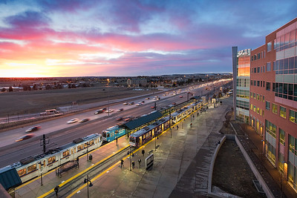

Speed Restrictions Update
In May 2024, the agency began a more robust inspection process of its light rail system As areas of track were identified for maintenance, and depending on the issue, RTD implemented 10 mile-per-hour speed restrictions
Speed restrictions were lifted as track repair work is completed
31 of the 31 speed restrictions implemented over the last year have been fully eliminated from the system
Due to the aging rail network, temporary speed restrictions will continue to be implemented to allow for preventative maintenance work
rtd-denver.com/light-rail-speed-restrictions
June 16, 2025
3
Notes:
Next, RTD has an update on Speed Restrictions. In May of 2024, RTD started a more robust inspection process of its light rail infrastructure. As a result of this process, RTD implemented 10 mph speed restrictions for 31 sections of track. As track work was completed, speed restrictions were lifted. Currently 31 of 31 speed restrictions implemented over the past year have been fully eliminated from the RTD system.
Temporary speed restrictions will continue to be implemented at times to allow for preventative maintenance work.

Slide 4
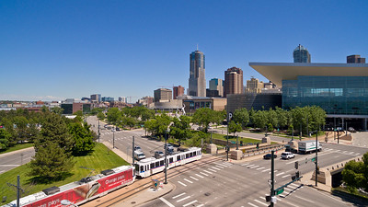
Kalamath Rail Replacement
The second phase of planned rail replacement at Kalamath Street starting this fall
Work will take place between the Auraria Colfax Station and Theatre District Stations prohibiting any trains into central downtown
Rail replacement efforts will impact RTD services in the area, significantly impacting the L Line and altering D and H Lines
June 16, 2025
4
Notes:
Phase 1 of a planned rail replacement project along Kalamath Street ended in the Fall of 2024. The second phase will start this fall between the Auraria Colfax Station and Theatre District Stations, prohibiting any trains from operating in central downtown.
These rail replacement efforts will impact RTD services in the area, significantly impacting the L Line and altering D and H Lines

Slide 5




Overview
What are Service Changes? | Proposed Changes | Feedback and Input | Timeline and Next Steps
June 16, 2025
5
Notes:
Now we’ll discuss the proposed service changes for August 2025. By the end of this presentation, you will better understand service changes at RTD, including the proposed changes for August 2025. We’ll also tell you how you can provide feedback and learn about the next steps in the review process.

Slide 6
What are Service Changes?
Notes:
Let’s go over what service changes are, when they occur, and how they impact RTD services.

Slide 7
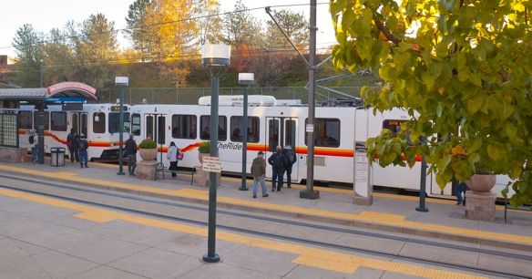
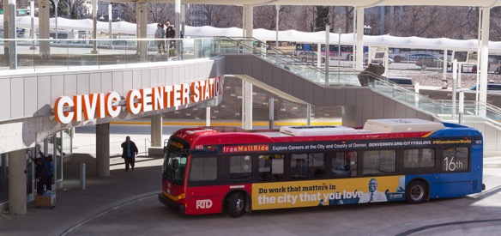
Service Changes
RTD reviews, proposes, and implements changes to its service schedules three times a year
Typically take effect in January, May/June, and August/September
Service changes support multiple objectives
Increase reliability
Improve on-time performance
Enable represented employees to select work shifts
Account for changes in ridership
Advance the implementation of RTD’s System Optimization Plan
Support scheduled maintenance projects
June 16, 2025
7
Notes:
RTD reviews, proposes, and implements changes to its service schedules three times per year. Usually they take effect in January, May/June, and August/September. Service changes support multiple objectives, such as increasing reliability of RTD services, improving on-time performance, enabling represented employees to select work, and accounting for changes in ridership.

Slide 8
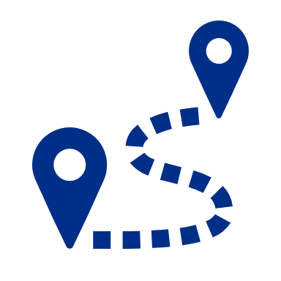




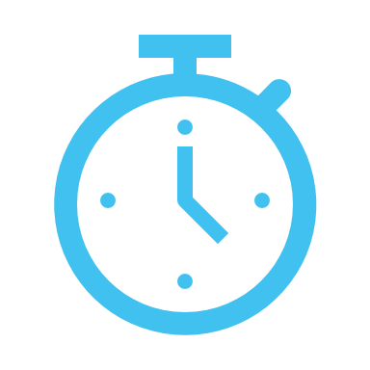
Categories of Service Changes
 | Route Adjustment Detours or changes to routes or stops to optimize efficiency, improve accessibility, respond to changing travel patterns, or facilitate maintenance projects. |  | Service Increase Increases to the frequency, trips, span of service, or operating hours. |  | Service Reduction Reductions to the frequency, trips, span of service, or operating hours.
 | Seasonal Adjustment Temporary modifications made to bus and rail services in response to seasonal variations in demand or operational conditions. |  | Schedule Timing Alterations to the running time of bus and rail services, typically to better align with customer demands and trip connections, and to improve on-time performance.
June 16, 2025
8
Notes:
There are five categories of Service Changes. Route Adjustments, Service Increase, Service Reduction, Seasonal Adjustment, and Schedule Timing. Route Adjustments consist of detours or changes to routes or stops to optimize efficiency, improve accessibility, respond to changing travel patterns, or facilitate maintenance projects. A Service Increase consists of increases to the frequency, trips, span of service, or operating hours. A Service Reduction consists of reductions to the frequency, trips, span of service, or operating hours. A Seasonal Adjustment consists of temporary modifications made to bus and rail services in response to seasonal variations in demand or operational conditions. Finally, the Schedule Timing category consists of alterations to the running time of bus and rail services, typically to better align with customer demands and trip connections, as well as improvements to on-time performances.

Slide 9
August 2025 Proposed Changes
Notes:
In this section, we’ll explain the proposed changes for August 2025.

Slide 10
Schedule Timing
Notes:
Let’s cover the proposed Schedule Timing changes for August 2025 first.

Slide 11

Schedule Timing
Trip time adjustments are recommended to better coordinate with additional train services into Denver Union Station
E Line | Union Station to RidgeGate Parkway Station
W Line | Union Station to Jefferson County Government – Golden Station
Schedule Timing Adjustment
Alterations to the running time of bus and rail services, typically to better align with customer demands and trip connections, and to improve on-time performance.
June 16, 2025
11
Notes:
Due to the resumption of the Downtown Rail Replacement taking place this fall, trains will not be able to access the central downtown loop. With the need to accommodate additional services in Denver Union Station RTD proposes trip time adjustments for the E Line and W Line to make room for the additional service. These adjustments will allow better coordination with additional train services into Denver Union Station.
(Optional) For reference, the capacity of Denver Union Station is 12 trains per hour maximum for reliable service.

Slide 12
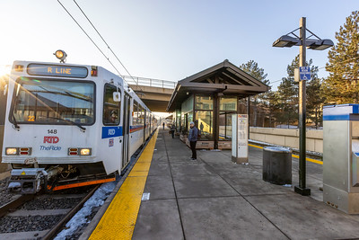
Schedule Timing
Trip time adjustments to accommodate schedule changes anticipated on the E and H Lines
R Line | Lincoln Station to Peoria Station
Schedule Timing Adjustment
Alterations to the running time of bus and rail services, typically to better align with customer demands and trip connections, and to improve on-time performance.
June 16, 2025
12
Notes:
Due to the restart of the Downtown Rail Replacement project this fall, RTD proposes trip time adjustments to accommodate schedule changes anticipated on the E and H lines. It’s proposed for the R Line schedules to be shifted to prevent train conflicts with the changes to the E and H lines operations.

Slide 13
Schedule timing
These adjustment are recommended to improve on-time performance, connections with other routes, or increase coverage during highest ridership segments/times
Route | Name
3L | East Alameda Limited
10 | East 12th Avenue
28 | 28th Avenue
36 | Fort Logan
44 | 44th Avenue
76 | Wadsworth Crosstown
83D/L | Cherry Creek/ Parker Road Limited
Route | Name
323 | Skyline Crosstown
324 | Main Street Crosstown
CV | Pine Junction/Conifer/Denver
EV | Evergreen/Denver
RX | Brighton/Denver Express
116X | South Simms Express
Schedule Timing
Alterations to the running time of bus and rail services, typically to better align with customer demands and trip connections, and to improve on- time performance.
June 16, 2025
13
Notes:
Schedule timing adjustments are recommended for the following routes to improve on time performance, connections with other routes, or increase coverage during highest ridership segments/times:
Routes 3L, 10 , 28, 36, 44, 76, 83D and 83L, 323, 324, CV, EV, RX, and 116X

Slide 14
Service Increases
Notes:
In this section, we’ll explain the proposed service increases for August 2025.

Slide 15

Proposed Service Increases
Increases to the frequency, trips, span of service, or operating hours.
Route | Name | Change
104L | Wagon Road/DEN Limited | Extend the service hours to 12:20am from DEN to increase connections for airport personnel and customers
135 | Smoky Hill Road | Increase peak AM and PM period service frequency to 30 minutes per the Systems Optimization Plan
225 | Boulder/Lafayette via Baseline | Reinstate regular service levels and include extension to Willoughby
Service Increase
Increases to the frequency, trips, span of service, or operating hours.
June 16, 2025
15
Notes:
For Route 104L, it is recommended to extend the service hours to 12:20 a.m. from Denver International Airport to increase connections for airport personnel and customers.
Service increases for routes 135 and 225 are also proposed.

Slide 16
Proposed Service Increases
Increases to the frequency, trips, span of service, or operating hours.
Route | Name | Change
327 | Eastside Crosstown | Extend the weekday service span until 7 p.m., southbound, to address needs of transit dependent workers and match service hours of local Longmont routes
AT | Arapahoe Station/DEN | Add an additional northbound trip at 10:03 p.m. from Arapahoe Station on Weekdays.
Service Increase
Increases to the frequency, trips, span of service, or operating hours.
June 16, 2025
16
Notes:
Service increases for the 327 and AT from Arapahoe to DIA are also proposed.

Slide 17
Proposed Service Increases
Increases to the frequency, trips, span of service, or operating hours.
Route | Name | Change
FF2 | Boulder/Denver Express | Add three eastbound AM and PM peak trips, as well as two westbound AM and three PM peak trips to increase capacity
FF4 | Boulder Junction/Civic Center | Reinstate Route FF4 by adding four AM peak and four PM peak trips in each direction
LX2 | Longmont/Denver Express | Add three AM and two PM southbound peak trips; add two AM and three PM peak trips northbound
Service Increase
Increases to the frequency, trips, span of service, or operating hours.
June 16, 2025
17
Notes:
Service increases for the FF2, FF4, and LX2 from Longmont to Denver are also proposed.

Slide 18
Route Adjustments
Notes:
In this section, we’ll explain the proposed Route Adjustment changes for August 2025.

Slide 19
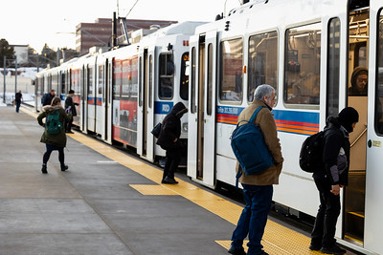
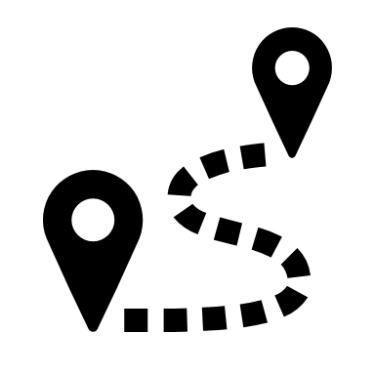
Route Adjustment
Recommended to be diverted to Denver Union Station during construction project
D Line | 18th & California Station to Mineral
Route Adjustment
changes to routes or stops to optimize efficiency, improve accessibility, respond to changing travel patterns, or facilitate maintenance projects.
June 16, 2025
19
Notes:
Due to the resumption of the Downtown Rail Replacement Project occurring between the Auraria Colfax and Theatre District Stations the D Line will not be able to operate through the central downtown loop. It is proposed to run the D Line to Denver Union Station as was done Summer 2024.

Slide 20
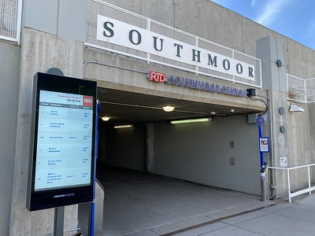
Route Adjustment
Due to light rail reconstruction, it is proposed for H Line Trains to operate only between Florida and Southmoor stations
Customers must transfer to the E Line to continue to destinations along the Southeast and Central Platte Valley corridors
H Line | 18th & California Station to Florida Station
Route Adjustment
changes to routes or stops to optimize efficiency, improve accessibility, respond to changing travel patterns, or facilitate maintenance projects.
June 16, 2025
20
Notes:
Due to the resumption of the Downtown Rail Replacement Project occurring between the Auraria Colfax and Theatre District Stations the H Line will not be able to access the central downtown loop. Due to capacity constraints of how many trains can reliably operate at Denver Union Station it is proposed to run the H Line between Southmoor and Florida Stations. Transfers can be made to the E Line from the Southmoor Station.
RTD hired a consultant who evaluated alternative services for the downtown rail replacement.
1) 16 trains (D,E,H,W) in/out of DUS which resulted in the least reliable service for the customers, likely resulting in several dropped trips.
2) Operating the D Line between Mineral and I-25/Broadway Station. Due to trains operating through the station every 3-minutes was not the most reliable service for customers resulting in significant delays.
3) Operating the H Line between Southmoor and Florida was deemed the most reliable and least impactful to the customers with short transfer times to the E Line averaging 2-minutes northbound and 8-minutes southbound.

Slide 21
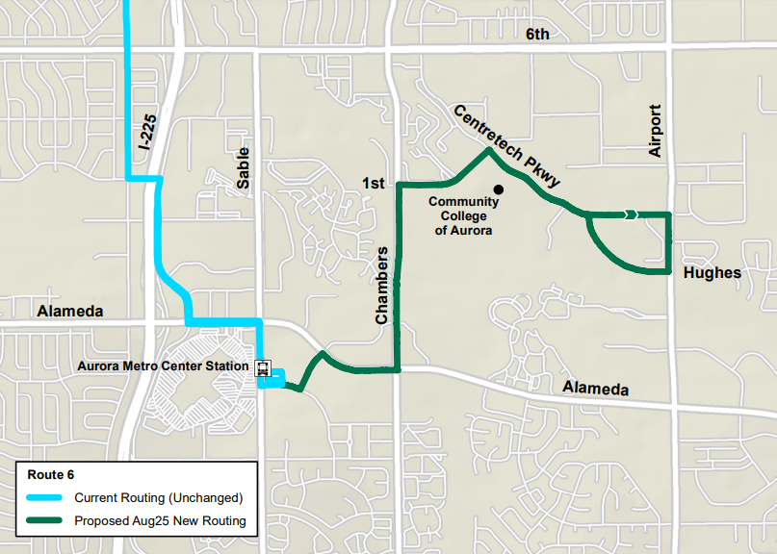
Proposed Route Adjustment (cont.)
Route | Name
6 | East 6th Avenue
Select trips to extend past Aurora Metro Center to serve Community College of Aurora via Centretech Parkway on weekdays only
Route Adjustment
Detours or changes to routes or stops to optimize efficiency, improve accessibility, respond to changing travel patterns, or facilitate maintenance projects.
June 16, 2025
21
Notes:
It’s proposed to adjust route 6 to extend past Aurora Metro Cetner to serve Community College of Aurora via Centretech parkway on weekdays only.

Slide 22
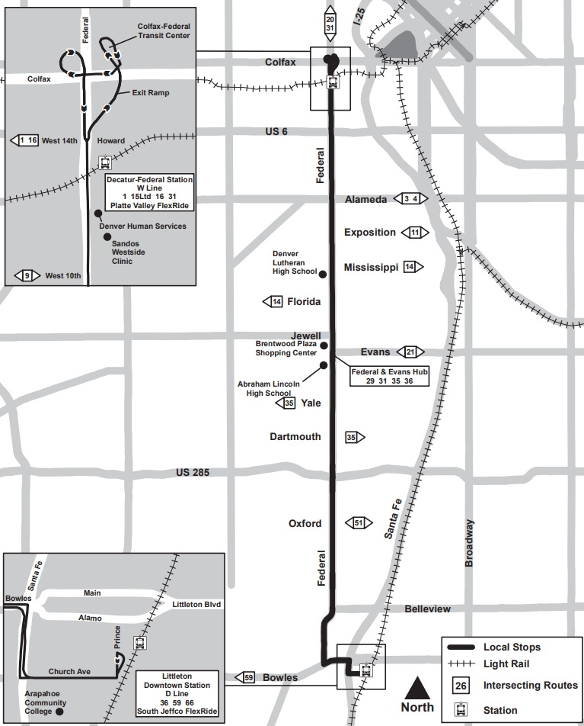
Proposed Route Adjustment (cont.)
Route | Name
30 | South Federal
Extend the Route 30 to serve Littleton/ Downtown Station via Federal Blvd.
Route Adjustment
Detours or changes to routes or stops to optimize efficiency, improve accessibility, respond to changing travel patterns, or facilitate maintenance projects.
June 16, 2025
22
Notes:
The proposed route adjustment for Route 30 would serve Littleton/Downtown Station via Federal Blvd.

Slide 23
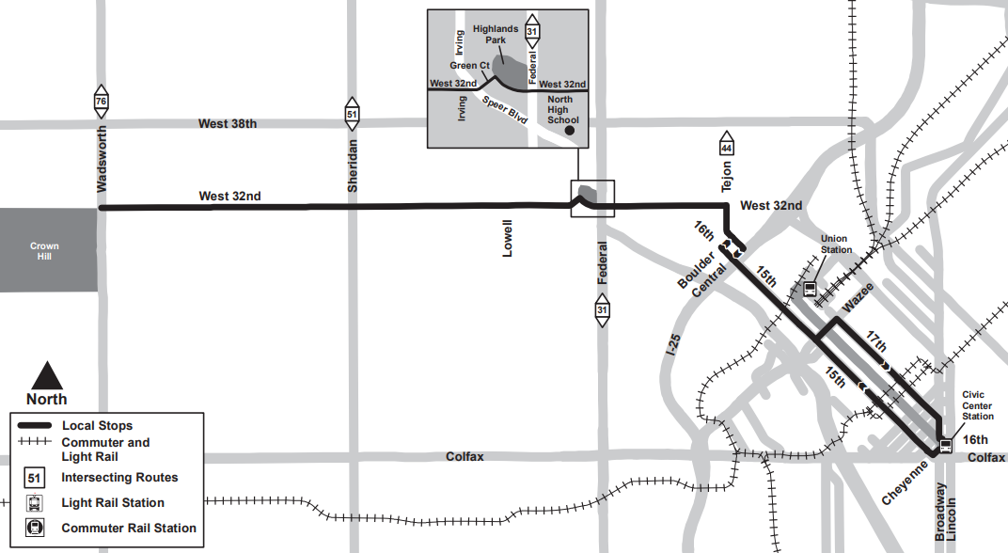
Proposed Route Adjustment (cont.)
Route | Name
32 | 32nd Avenue
Extend Route 32 via 15th and 17th streets from Denver Union Station to Civic Center Station
Route Adjustment
Detours or changes to routes or stops to optimize efficiency, improve accessibility, respond to changing travel patterns, or facilitate maintenance projects.
June 16, 2025
23
Notes:
Next, it’s proposed to extend Route 32 via 15th and 17th Streets from Union Station to Civic Center Station.

Slide 24
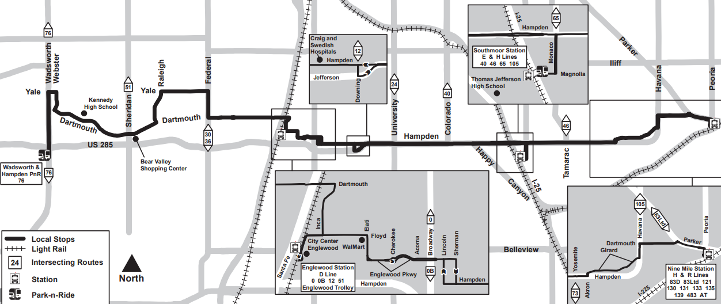
Proposed Route Adjustment (cont.)
Route | Name
35 | Hampden Avenue
Provide service between Nine Mile Station and Wadsworth/Hampden Park-n-Ride via Hampden and Dartmouth Avenues, eliminating the deviation to Evans/Federal Transfer Center and the portion of the route south of the Wadsworth/Hampden Park-n-Ride to Long and Bowles
Route Adjustment
Detours or changes to routes or stops to optimize efficiency, improve accessibility, respond to changing travel patterns, or facilitate maintenance projects.
June 16, 2025
24
Notes:
It is proposed to reroute trips of Route 35 between Federal/Evans and Wadsworth/Hampden Park-and-Ride, covering areas no longer served by Route 30, due to its extension to Littleton/Downtown Station. The recommendation also includes the truncation of Route 35 south of Wadsworth/Hampden, to eliminate service duplication to Long/Bowles, as detailed in the System Optimization Plan(SOP). Per the SOP, service frequency would be increased to 30 minutes for most of the day. Additionally, it is recommended to replace the seasonal tripper service on the Route 30 with a concurrent tripper on the Route 35, covering the same area and time as the previously discontinued seasonal tripper service.
Route adjustment

Slide 25
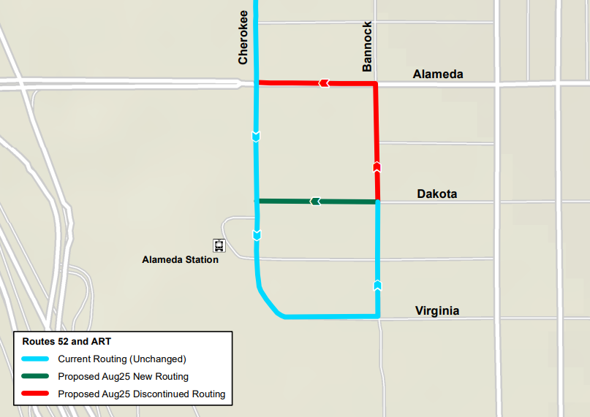
Proposed Route Adjustment (cont.)
Route | Name
52 | West 52nd Avenue/South Bannock St
ART | Art District Connector
Reroute northbound trips on Route 52 and Route ART near the southern terminal to take a left on Dakota Ave instead of Alameda Ave to improve on-time performance, as well as enhancing operational safety.
Route Adjustment
Detours or changes to routes or stops to optimize efficiency, improve accessibility, respond to changing travel patterns, or facilitate maintenance projects.
June 16, 2025
25
Notes:
RTD proposes rerouting northbound trips on Route 52 and Route ART near the southern terminal to take a left on Dakota Ave instead of Alameda Ave to improve on-time performance, as well as enhancing operational safety.

Slide 26
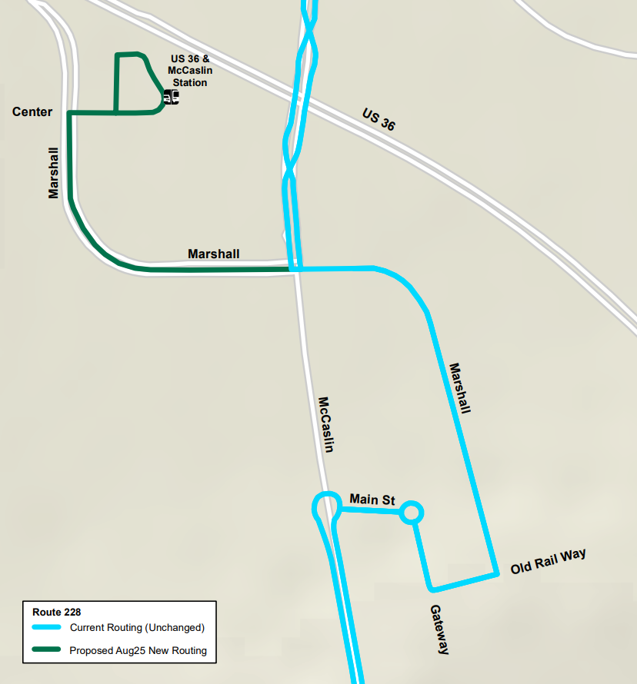
Proposed Route Adjustment (cont.)
Route | Name
228 | Louisville/Broomfield
Reroute Route 228 to serve US36 & McCaslin Station to improve connections to nearby routes
Route Adjustment
Detours or changes to routes or stops to optimize efficiency, improve accessibility, respond to changing travel patterns, or facilitate maintenance projects.
June 16, 2025
26
Notes:
In order to address a safety issue related to a turning movement on Route 228, southbound from McCaslin Boulevard onto Marshall Road, it is proposed to reroute the route into US36 & McCaslin Station, Gate C (Superior side), via Marshall Rd. This will add US36 & McCaslin Station as a new stop and connection point to the route, allowing for significant improved connectivity to regional routes along US36, including Flatiron Flyer and AB, as well as will eliminate the current safety issue.

Slide 27
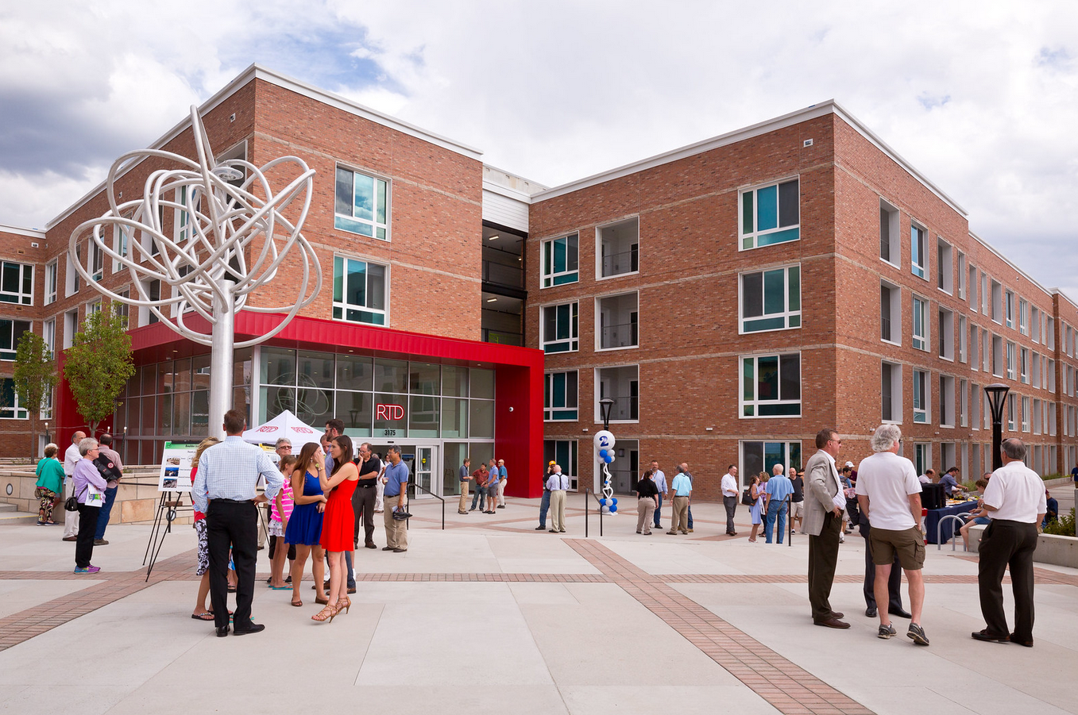
Proposed Route Adjustment (cont.)
Route | Name
AB2 | Boulder/DEN
Move weekday Route AB2 trips from Downtown Boulder Station to Boulder Junction Depot Square Station
Route Adjustment
Detours or changes to routes or stops to optimize efficiency, improve accessibility, respond to changing travel patterns, or facilitate maintenance projects.
June 16, 2025
27
Notes:
As listed in the System Optimization Plan, it is proposed to move Route AB2 trips from current Downtown Boulder Station to Boulder Junction Depot Square Station, on weekdays as the station is to be reopened with the reinstatement of Route FF4 - Boulder Junction/ Civic Center Station. Saturday AB2 trips would continue to operate from Downtown Boulder Station.
Saturday trips will be designated as AB3.

Slide 28
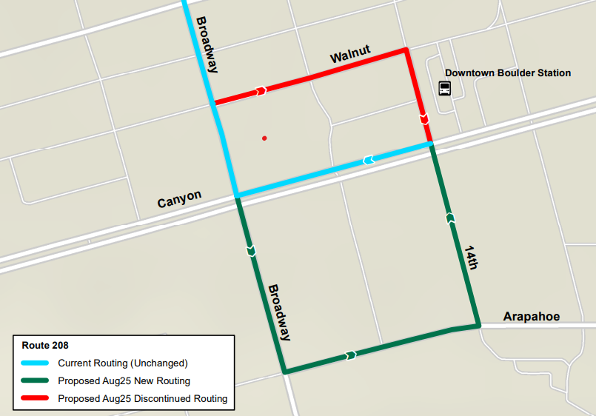
Proposed Route Adjustment (Boulder)
Route | Name
208 | Louisville/Broomfield
It is proposed to move Route 208 to a new gate at Downtown Boulder Station
Route Adjustment
Detours or changes to routes or stops to optimize efficiency, improve accessibility, respond to changing travel patterns, or facilitate maintenance projects.
June 16, 2025
28
Notes:
The City of Boulder will be completing the long-awaited build out of additional bus gates along 14th Street, between Canyon Boulevard and Arapahoe Avenue. This will address a longstanding space shortage that has been in place for multiple years.
With service being reimplemented per the System Optimization Plan moving routes 208, 225, DASH and JUMP to the new gates will free up gate space for current regional routes, layover and recovery, as well as needed space for Loop Extras (also known as back-up buses).
Routes DASH and JUMP would be in the gates facing northbound on 14th Street, whiles routes 208 and 225 would be in the gates facing southbound.

Slide 29
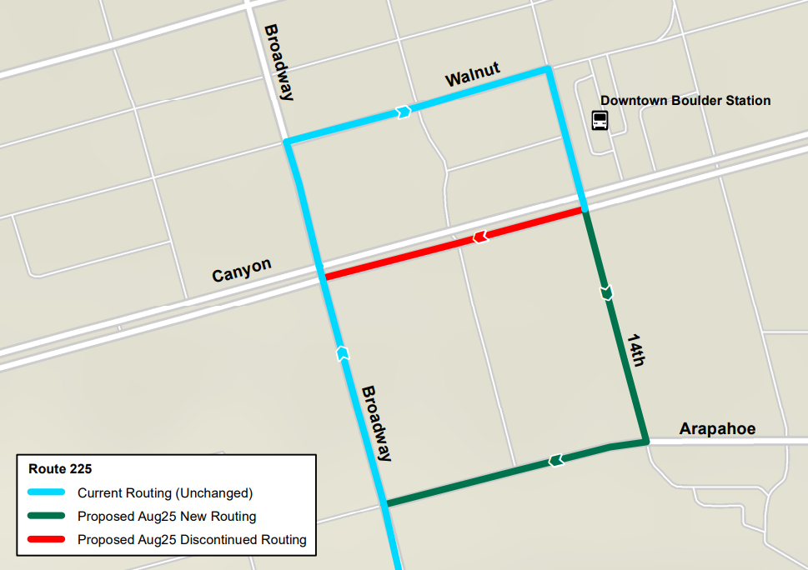
Proposed Route Adjustment (Boulder)
Route | Name
225 | Boulder/Lafayette via Baseline
It is proposed to move Route 225 to a new gate at Downtown Boulder Station
Route Adjustment
Detours or changes to routes or stops to optimize efficiency, improve accessibility, respond to changing travel patterns, or facilitate maintenance projects.
June 16, 2025
29
Notes:
The City of Boulder will be completing the long-awaited build out of additional bus gates along 14th Street, between Canyon Boulevard and Arapahoe Avenue. This will address a longstanding space shortage that has been in place for multiple years.
With service being reimplemented per the System Optimization Plan moving routes 208, 225, DASH and JUMP to the new gates will free up gate space for current regional routes, layover and recovery, as well as needed space for Loop Extras (also known as back-up buses).
Routes DASH and JUMP would be in the gates facing northbound on 14th Street, whiles routes 208 and 225 would be in the gates facing southbound.

Slide 30
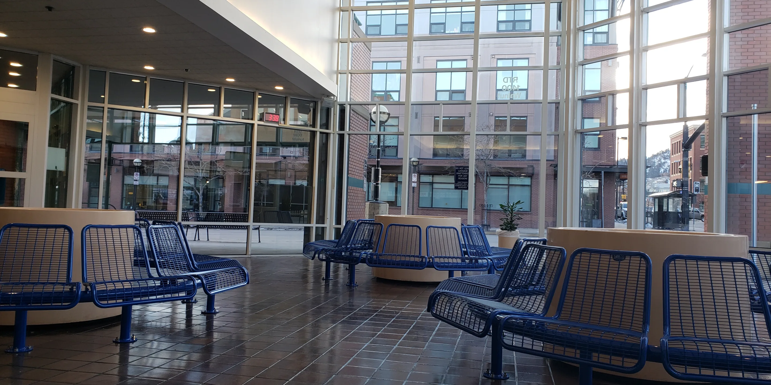
Proposed Route Adjustment (Boulder)
Route | Name
DASH | Boulder/Lafayette via Louisville
It is proposed to move routes 208, 225, DASH, and JUMP to new gates at Downtown Boulder Station
Route Adjustment
Detours or changes to routes or stops to optimize efficiency, improve accessibility, respond to changing travel patterns, or facilitate maintenance projects.
June 16, 2025
30
Notes:
The City of Boulder will be completing the long-awaited build out of additional bus gates along 14th Street, between Canyon Boulevard and Arapahoe Avenue. This will address a longstanding space shortage that has been in place for multiple years.
With service being reimplemented per the System Optimization Plan moving routes 208, 225, DASH and JUMP to the new gates will free up gate space for current regional routes, layover and recovery, as well as needed space for Loop Extras (also known as back-up buses).
Routes DASH and JUMP would be in the gates facing northbound on 14th Street, whiles routes 208 and 225 would be in the gates facing southbound.

Slide 31
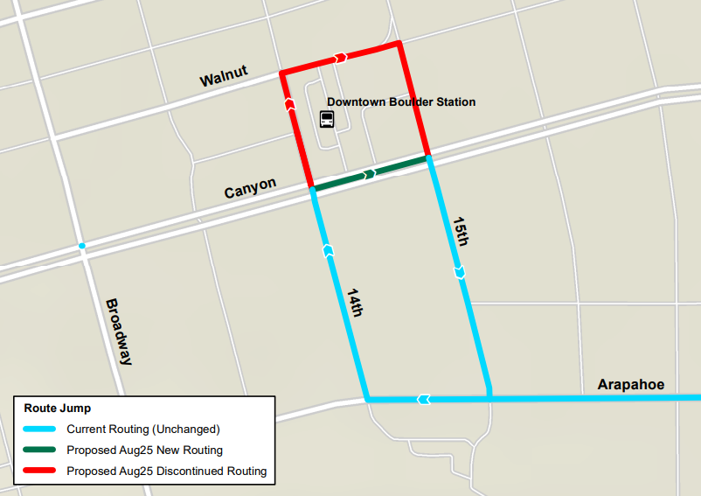
Proposed Route Adjustment (Boulder)
Route | Name
JUMP | Boulder/Lafayette/Erie
It is proposed to move routes 208, 225, DASH, and JUMP to new gates at Downtown Boulder Station
Route Adjustment
Detours or changes to routes or stops to optimize efficiency, improve accessibility, respond to changing travel patterns, or facilitate maintenance projects.
June 16, 2025
31
Notes:
The City of Boulder will be completing the long-awaited build out of additional bus gates along 14th Street, between Canyon Boulevard and Arapahoe Avenue to relieve congestion. This will address a longstanding space shortage that has been in place for multiple years.
With service being reimplemented per the System Optimization Plan moving routes 208, 225, DASH and JUMP to the new gates will free up gate space for current regional routes, layover and recovery, as well as needed space for Loop Extras (also known as back-up buses).
Routes DASH and JUMP would be in the gates facing northbound on 14th Street, whiles routes 208 and 225 would be in the gates facing southbound.

Slide 32
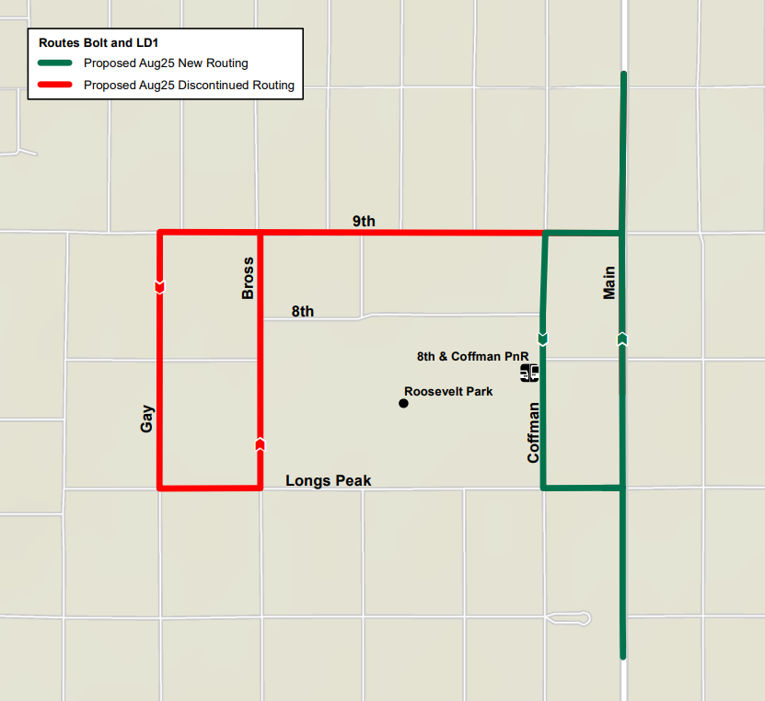
Proposed Route Adjustment (cont.)
Route | Name
BOLT | Boulder/Longmont
LD1 | Longmont/Denver
It is proposed to reroute these routes back to Coffman between 9th and Longs Peak to remove trips off Gay Street
This would allow access to the 8th and Coffman Park-n-Ride
Route Adjustment
Detours or changes to routes or stops to optimize efficiency, improve accessibility, respond to changing travel patterns, or facilitate maintenance projects.
June 16, 2025
32

Slide 33
Service Reductions
Notes:
In this section, we’ll explain the proposed service reduction changes for August 2025.

Slide 34
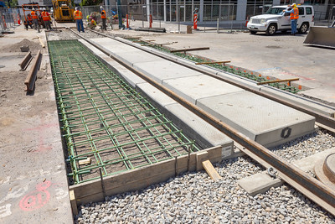


Service Reduction
Suspend L Line due to the downtown rail reconstruction project
Route 43 available to serve customers
L Line | 30th & Downing Station to 16th & Stout Station
Service Reduction
Reductions to the frequency, trips, span of service, or operating hours.
June 16, 2025
34
Notes:
It’s proposed to suspend the L Line due to High Block Work associated with the the Downtown Rail Replacement Project occurring between the Auraria Colfax Station, Theatre District Station, and Welton corridor
Route 43 will remain available to serve customers in this area.

Slide 35
Service Reduction (cont.)
Route | Name | Proposed Change
29 | Riverbend | Route 29 would be replaced by extended trips on the Route 30
31 | Federal Boulevard | Eliminate duplicative trips southbound on Sundays due to changes to the Route 30
Service Reduction
Reductions to the frequency, trips, span of service, or operating hours.
June 16, 2025
35
Notes:
Previous 29 trips would be replaced by extended trips by the route 30
As listed in the Systems Optimization Plan, a reduction of trips on Route 31 on Sundays only is recommended to eliminate duplicative trips southbound due to the increased service and expanded coverage provided by changes to the Route 30.

Slide 36
Seasonal Adjustments
Notes:
In this section, we’ll explain the proposed changes for August 2025.

Slide 37

Seasonal Adjustments
Seasonal adjustments are recommended for the following routes
Route | Name
11 | Mississippi Avenue
20 | 20th Avenue
24 | University Boulevard
35 | Hampden Avenue
42 | Montbello via Allbrook/GVR
Route | Name
45 | Montbello via 51st/GVR
51 | Sheridan Boulevard
65 | Monaco Crosstown
73 | Quebec Street
Seasonal Adjustment
Temporary modifications made to bus and rail services in response to seasonal variations in demand or operational conditions.
37
June 16, 2025
Notes:
Seasonal adjustments are recommended for the following routes, 11, 20, 24, 35, 42, 45, 51, 65,and 73

Slide 38
Seasonal Adjustments (cont.)
These adjustments reinstate seasonal service
Route | Name
NB | Boulder/Nederland/Eldora
SKIP | Broadway (Boulder)
204 | Table Mesa/Moorhead/North 19th
205 | 28th St/Gunbarrel
Route | Name
206 | Conestoga/Arapahoe/Fairview HS
208 | Iris/Valmont
DASH | Boulder/Lafayette via Louisville
JUMP | Boulder/Lafayette/Erie
Seasonal Adjustment
Temporary modifications made to bus and rail services in response to seasonal variations in demand or operational conditions.
June 16, 2025
38
Notes:
Seasonal adjustments are also recommended for routes NB, SKIP, 204, 205, 206, 208, DASH, and Jump
NB – Boulder/ Nederland/ Eldora
Reinstate seasonal service to Nederland Park-n-Ride due to Eldora Ski Resort being operational
SKIP – Broadway (Boulder)
Reinstate regular fall/winter service levels

Slide 39
Feedback and Input
Notes:
In this section we’ll discuss how to provide feedback and input.

Slide 40





Provide Feedback
Online Survey | Customer Care | Public Comment
Complete the online survey at rtd-denver.com/service-alerts/service-changes | Share feedback with a call center agent at 303.299.6000 | Attend a virtual or in-person meeting of the Board of Directors
Community Events | Email
Visit with RTD staff at a local community event | Send an email to service.change@rtd-denver.com
June 16, 2025
40
Notes:
Whether you are a frequent customer or a community member affected by changes at RTD, your feedback is important to us. There are many ways you can provide public comment on the proposed service changes for August 2025. To provide feedback online, visit www.rtd-Denver.com/service-changes to complete an online survey. If you wish to provide feedback over the phone, contact our Customer Care Team during normal business hours at 303-299-6000. The RTD Team hosts events in the community during which you can also provide public comment. Visit the RTD Events page online to see where we’ll be next. If you prefer to provide comment via email, send a note over to Service.change@rtd-Denver.com. Lastly, all customers and members of the public are invited to attend RTD Board of Directors meetings.

Slide 41
Public Comment Process
Customers wishing to provide public comment orally should “raise” their virtual hand and will be called on one at a time
Each speaker will have two minutes to provide comment
Once the timer has expired, you'll hear a brief chime
Please conclude your comments at that point
Once two minutes has expired, a new speaker will be called to provide comment
Customers who wish to type their comments may do so by inputting them into the Q&A function
RTD staff will not respond to questions or comments posed; their role is to document the feedback
Interested in having a dialogue with staff? Join an upcoming session of the RTD Ask a Service Planner series
June 16, 2025
41
Notes:
RTD has established the following Public Comment Process (refer to slide)
Customers wishing to provide public comment orally should “raise” their virtual hand and will be called on one at a time.Each speaker will have two minutes to provide comment.
Once the timer has expired you'll hear a brief chime. At this point, please conclude your comments.
Once two minutes has expired, a new speaker will be called to provide comment.
Customers who wish to type their comments may do so by inputting them into the Q&A function
RTD staff will not respond to questions or comments posed; their role is to document the feedback
If you’re Interested in having a dialogue with staff, please join an upcoming session of the RTD Ask a Service Planner series. The next one is Tuesday, June 17th from 5-630 pm

Slide 42
Public Comment Process
Customers are asked to be respectful of RTD staff and fellow attendees.
To ensure there is adequate time for public comment, if you agree with a previous speaker’s comments, you are encouraged to say, or type in the Q&A, “I agree with what has been stated.”
One hour is scheduled for this meeting. If you are not called to provide comment, you can submit your comment via the RTD website or attend another public meeting session.
June 16, 2025
42
Notes:
Customers are asked to be respectful of RTD staff and fellow attendees.
To ensure there is adequate time for public comment, if you agree with a previous speaker’s comments, you are encouraged to say, or type in the Q&A, “I agree with what has been stated.”
One hour is scheduled for this meeting. If you are not called to provide comment, you can submit your comment via the RTD website or attend another public meeting session.

Slide 43
Timeline and Next Steps
Notes:
Here we’ll discuss the timeline and next steps for the proposed August 2025 Service changes.

Slide 44
Timeline
June 11 - 26
June 26
July 15
July 29
August 31
Public Meetings and activities to solicit feedback
Public comment and feedback deadline
Proposed Service Changes and public comments shared with the Operations, Safety, and Security Committee
Board of Directors take action on the proposed August 2025 Service Changes
If approved, the Service Changes take effect
June 16, 2025
44

Slide 45
Notes:
Thank you for riding RTD.

