Slide 1
Employee Survey Results
2025
May 27, 2025
John McKay
Executive Business Partner
Ben Celius
Senior Performance Analyst
Jake Stoudenmire
Manager, Market Research
Notes:
We are here with you today to share the results of this year’s employee survey
It’s a lengthy presentation so if you have questions and discussion that can wait until the end it would be best to do so
If you have a quick clarification question on one of the slides, I am happy to answer it as we are going through – but we do have over 120 slides to get through and it would be great to have some time for discussion at the end
We will email you the whole presentation today so that you can review on your own as well

Slide 2


Outline
Introduction
Employee Net Promoter Score
Composite Index Score
Employee Favorability
Largest Improvement
Strategic Initiatives
Key Takeaways
May 28, 2025
2
Notes:
Here are the contents of today’s presentation
We will start by providing an introduction and high-level overview of the results.
We will walk through the results of each survey question along with a comparison to 2023 data
To most effectively communicate the results with all employees, a summarized version of this presentation is being prepared – we will review that timeline at the end of this presentation.

Slide 3
Key Takeaways
Continued favorable response increase
Efficacy of efforts related to improvement areas
Higher overall favorability less influenced by tenure in 2025
Employee Net Promoter Score/Employee Ownership Composite Index consideration
Key Driver Analysis highlights opportunities for 2025-26
May 28, 2025
3
Notes:
All but one area showed improvements this year
Both the composite and eNPS showed improvements as well
Key Drivers…
Tenure favorability flattened this year with a less pronounced difference in favorability by tenure.

Slide 4

Introduction
Survey purpose
Administration
Survey structure
Response rate
Participation
Notes:
We’ll start with some background information

Slide 5
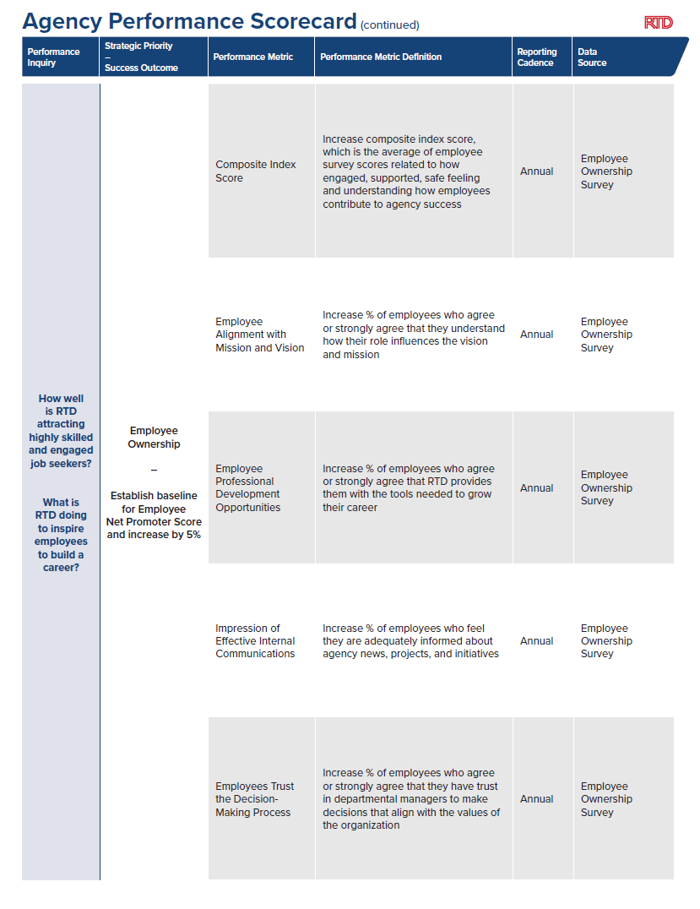
Survey Purpose
Measure success related to Strategic Plan
Garner
  Direct employee feedback
  Understanding of employee satisfaction and engagement
Provide insight into opportunity areas
May 28, 2025
5
Notes:
All but one area showed improvements this year
Both the composite and eNPS showed improvements as well
Key Drivers…
Tenure favorability flattened this year with a less pronounced difference in favorability by tenure.

Slide 6




Survey Administration
Four-week survey period (April 15 through May 16, 2025)
16 in-person events at nine different facilities
Methods to complete the survey:
  At events using a tablet or printed survey
  Online via emailed link, QR code, browser icons on breakroom desktops, Hub promotion, and Hot Sheet inclusion
  Printed copies available at all operations and maintenance facilities
May 28, 2025
6

Slide 7





Survey Structure
Five job-related questions – department/division, reporting location, tenure, represented/non-represented, supervisor/non-supervisor
Likeliness of recommendation to friends and family (Net Promoter Score)
Scale: 0-10
Satisfaction of 11 internal services
Scale: Very Satisfied (5) Satisfied (4) Neutral (3) Dissatisfied (2) Very Dissatisfied (1)
Have not used this service (0)
17 favorability questions – all worded in the affirmative
Scale: Strongly Agree (5) Agree (4) Neutral (3) Disagree (2) Strongly Disagree (1)
10 retention-related questions
Ranking from 1 to 10 for importance as well as how RTD is meeting expectations on each topic
One open-ended question
May 28, 2025
7
Notes:
Retention related questions had level of satisfaction for all 10 this year.

Slide 8
Response Rate
2025 Response Rate
2024 Response Rate
2023 Response Rate
32%
1,014 surveys submitted
3,114 total employees
36%
1,056 surveys submitted
2,958 total employees
47%
1,259 surveys submitted
2,686 total employees
Four-week survey period |  | Three-week survey period |  | Four-week survey period
Paper survey option (18%) |  | Paper survey option (24%) |  | Paper survey option (17%)
Digital tablets |  | Digital tablets |  | Digital tablets
37 multiple choice question, one ranking question |  | 37 multiple choice question, one ranking question |  | 35 multiple choice questions
One open-ended question |  | One open-ended question |  | Five open-ended questions
RTD swag giveaways |  | Snacks and RTD swag giveaways |  | ID holder giveaway
May 28, 2025

Slide 9
Survey Participation By Work Unit
9
May 28, 2025
Notes:
This chart shows participation from the perspective of all surveys submitted
“Other” encompasses:
“Prefer not to say”
“Not listed”
Skipped question

Slide 10
Participation: Percentage of Total Surveys Submitted (cont'd)
Tenure
Representation Status
Supervisory Status
May 28, 2025
10
Notes:
This shows 2024 survey participation by tenure, representation status, and supervisory status.

Slide 11

Employee Net Promoter Score
Notes:
The other high-level indicator we have is the employee net promoter score, which does tell a bit of a different story.
I will remind you that this is typically an external survey measure, but it can be adapted as one way to measure employee perception.

Slide 12
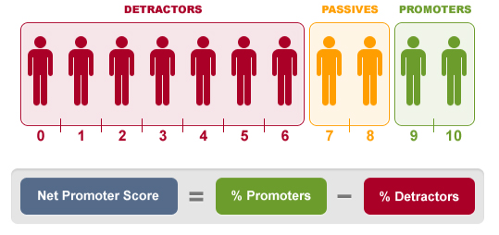
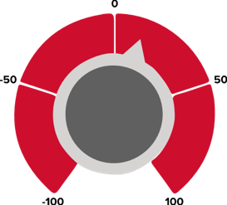
Employee Net Promoter Score
How likely are you to recommend working at RTD to friends or family?
Agency-Wide
4
NPS
-1
NPS
4
NPS
-2
NPS
Measured on a scale of -100 to +100
Promoters – Detractors = eNPS
NPS traditionally measures customer’s willingness to recommend product or service
2025
2024
May 28, 2025
12
Notes:
The question that is used to calculate the employee NPS is: how likely are you to recommend working at RTD to friends or family? On a scale of zero to 10.
Responses of 0 – 6 are labeled as “detractors”
Responses of 9 and 10 are labeled as “promoters”
The percentage of detractors is subtracted from the percentage of promoters, giving us the overall employee net promoter score, measured on a scale of -100 to 100.

Slide 13



Employee Net Promoter Score: 2025
Agency-Wide
How likely are you to recommend working at RTD to friends or family?
Net Promoter Score =
% Promoters
-
% Detractors
-1
NPS
0 | 1 | 2 | 3 | 4 | 5 | 6 |  | 7 | 8 |  | 9 | 10
Detractors |  |  |  |  |  |  |  | Passives |  |  | Promoters
31% |  |  |  |  |  |  |  | 34% |  |  | 35%
4
NPS
May 28, 2025
13
Notes:
Net Promoter Score is a metric commonly used to measure customer satisfaction and can be adapted to employee satisfaction, eNPS is derived from responses on a scale from 0-10 to the question, “How likely are you to recommend working at RTD to friends or family?”
Those responding 0-6 are considered detractors, 7-8 are passives, and 9-10 are promoters.
The percentage of detractors is subtracted from the percentage of promoters resulting in the eNPS, measured on a scale of -100 to 100.
The eNPS for 2024 is -2.
Comparing this year’s NPS to last year’s requires a discussion because we used a different scale in our employee survey last year.

Slide 14

Composite Index Score
Notes:
We will now move on to introducing a new metric, the employee ownership composite index score
As a reminder, the employee ownership composite index score came out of the November 2022 Leadership Team meeting with TransPro
The Index score represents an average of the agree and strongly agree responses from six survey questions, which are intended to represent engagement, support, and safety.
The benefits of using a composite index score are that it more accurately captures what employees value in their jobs versus a single metric that may not capture the expressed needs of the entire workforce.

Slide 15
Employee Ownership Composite Index Score
Agency-Wide
Composite index score is the average of employee survey scores related to how engaged, supported, safe feeling and understanding of how employees contribute to agency success.
16%
Engagement
Supervisor Support
Resource Support
Physical Safety
Safe from Crime
Psychological Safety
May 28, 2025
15
Notes:
The 2025 employee ownership composite index score is 78%, an increase of 16% from 2023
The next slide shows the data for each of the six questions

Slide 16
Employee Ownership Composite Index Score (cont'd)
Agree and Strongly Agree
Agency-Wide
May 28, 2025
16
Notes:
The chart here shows the data that is averaged to calculate that score.

Slide 17
Employee Ownership Composite Index Score (cont'd)
Agree and Strongly Agree
By Tenure
67%
May 28, 2025
17
Notes:
Here you see the index score broken down by tenure
Note the more closely grouped scores across tenure groups this year.

Slide 18

Employee Favorability
Notes:
Also included in the survey were 17 prompts designed to measure employee sentiment regarding a variety of measures.
The prompts were worded in the affirmative, and a favorable response to a given prompt is considered as “agree” or “strongly agree” for assessment purposes.
Generally, the majority of respondents responded favorably to all prompts save one.

Slide 19
Employee Favorability: Average Agency-Wide
(1 of 4)
Agree and Strongly Agree
67%
May 28, 2025
19
Notes:
This data represents the average of “agree” and “strongly agree” responses to all 17 positive/negative response questions
Treats me with respect received the most favorable rating.

Slide 20
Employee Favorability: Average Agency-Wide
Agree and Strongly Agree
(2 of 4)
67%
May 28, 2025
20

Slide 21
Employee Favorability: Average Agency-Wide
Agree and Strongly Agree
(3 of 4)
67%
May 28, 2025
21

Slide 22
Employee Favorability: Average Agency-Wide
Agree and Strongly Agree
(4 of 4)
67%
May 28, 2025
22
Notes:
As Adequately informed improved, 3rd lowest is replaced by frequent feedback.
Feeling safe from crime in the work environment remains the lowest rank, but still shows large improvement since 2023.

Slide 23
Employee Favorability by Tenure
Agree and Strongly Agree
May 28, 2025
23
Notes:
This data represents the average of “agree” and “strongly agree” responses to all 17 positive/negative response questions for each tenure.

Slide 24

Year-Over-Year Improvements

Slide 25
I have trust in my departmental manager(s) to make decisions that align with the values of the organization.
Agree and Strongly Agree
Agree and Strongly Agree
+8%
67%
May 28, 2025
25
Notes:
79% of all survey participants agree or strongly agree with this question regarding decisions that align with organizational values.
Represented appears to be an area of opportunity.

Slide 26
I have the resources to successfully perform my duties
Agree and Strongly Agree
Agree and Strongly Agree
67%
+7%
May 28, 2025
26
Notes:
77% of all survey participants agree or strongly agree they have resources to perform their duties.
Supervisors responded much more favorably than non-supervisors
Non-rep responded more favorably than rep

Slide 27
Year-Over-Year Improvement (Over 5%)
Agree and Strongly Agree
67%
May 28, 2025
27
Notes:
Five questions saw at least 5% improvement YoY.
Large difference between decisions that align and mission/vision

Slide 28
Significant (15%+) Improvement Over Two Years
Agree and Strongly Agree
67%
May 28, 2025
28
Notes:
TEN questions saw at least 15% improvement in two years.

Slide 29
Significant (15%+) Improvement Over Two Years (cont’d)
Agree and Strongly Agree
(2 of 2)
67%
May 28, 2025
29

Slide 30

Strategic Initiatives
Back to Basics
People Power
Welcoming Transit Environment
Notes:
Let’s review the scores as they relate to the Strategic Initiatives

Slide 31

Back to Basics: Internal Communication

Slide 32
I am adequately informed about agency news, projects, and initiatives
Agree and Strongly Agree
Agree and Strongly Agree
67%
+20%
May 28, 2025
32
32
Notes:
76% now report feeling adequately informed. 20% move since 2023.
Supervisors once again responded more favorably than non-sup
Represented remain an opportunity area.

Slide 33

People Power: Employee Retention
Notes:
We will move on to another topic – satisfaction of internal services
We asked about seven internal services last year and added four more this year

Slide 34
I plan to be working for RTD one year from now
May 28, 2025
34
Notes:
84% now report planning to be with RTD in one year.

Slide 35
Top Three Most Important Employment/Workplace Characteristics*
May 28, 2025
35
*New question in 2024
Notes:
“When thinking about things that make you want to stay in a job or with an employer, which of the following are most important to you?”
Last year Compensation was far above other items for reasons for staying.
Work hours and schedules were a distant second.

Slide 36
Top Three Most Important Employment/Workplace Characteristics *
May 28, 2025
36
*New question in 2024
Notes:
Compensation became less of a focus this year
Work hours remained the same while tools and equipment became an increased focus.

Slide 37
Key Driver Analysis - 2025
Survey Question: Regarding these topics, how well do you feel RTD meets your expectations?*
A | Fair compensation
B | Manageable workloads
C | Desirable hours/schedule
D | Professional development opportunities
E | Opportunities for advancement
F | Team culture
G | Agency culture
H | Agency values
I | Information technology
J | Tools and equipment
Higher Satisfaction
Lower Importance
Higher Importance
Areas of Opportunity
Lower Satisfaction
May 28, 2025
37

Slide 38
Key Driver Analysis – 2024
Survey Question: Regarding your top three choices above, how well do you feel RTD meets your expectations?*
A | Fair compensation
B | Manageable workloads
C | Desirable hours/schedule
D | Professional development opportunities
E | Opportunities for advancement
F | Team culture
G | Agency culture
H | Agency values
I | Information technology
J | Tools and equipment
Higher Satisfaction
Lower Importance
Higher Importance
Areas of Opportunity
Lower Satisfaction
May 28, 2025
38
*New question in 2024

Slide 39

Welcoming Transit Environment: Employee Security
Notes:
We will move on to another topic – satisfaction of internal services
We asked about seven internal services last year and added four more this year

Slide 40
I feel that I am safe from crime in the work environment
Agree and Strongly Agree
Agree and Strongly Agree
67%
+25%
May 28, 2025
40
Notes:
70%of all survey participants agree or strongly agree they feel safe from crime in the work environment. A 32% gain since 2023.
Represented remains an opportunity area.

Slide 41

Key Takeaways

Slide 42
Key Takeaways
Continued favorable response increase
Efficacy of efforts related to improvement areas
Higher overall favorability less influenced by tenure in 2025
Employee Net Promoter Score/Employee Ownership Composite Index consideration
Key Driver Analysis highlights opportunities for 2025-26
May 28, 2025
42
Notes:
All but one area showed improvements this year
Both the composite and eNPS showed improvements as well
Key Drivers…
Tenure favorability flattened this year with a less pronounced difference in favorability by tenure.

