Slide 1
September 2026
Proposed Service Changes
Notes:
Good afternoon/evening and thank you for joining us.
My name is ____ and I am joined by ______, my colleague in Service Development.
Tonight, we are going to present RTD’s proposed service changes for September 2026.

Slide 2

Overview
What are Service Changes? | Proposed Changes | Feedback and Input | Timeline and Next Steps
2
Notes:
First, I will define service changes and the reasons RTD adjusts bus and rail schedules.
Then, ____ will go over the proposed changes.
After the presentation, you will be invited to provide comments on the changes and ask questions.
We’ll then provide a timeline for the next steps and conclude our meeting.

Slide 3
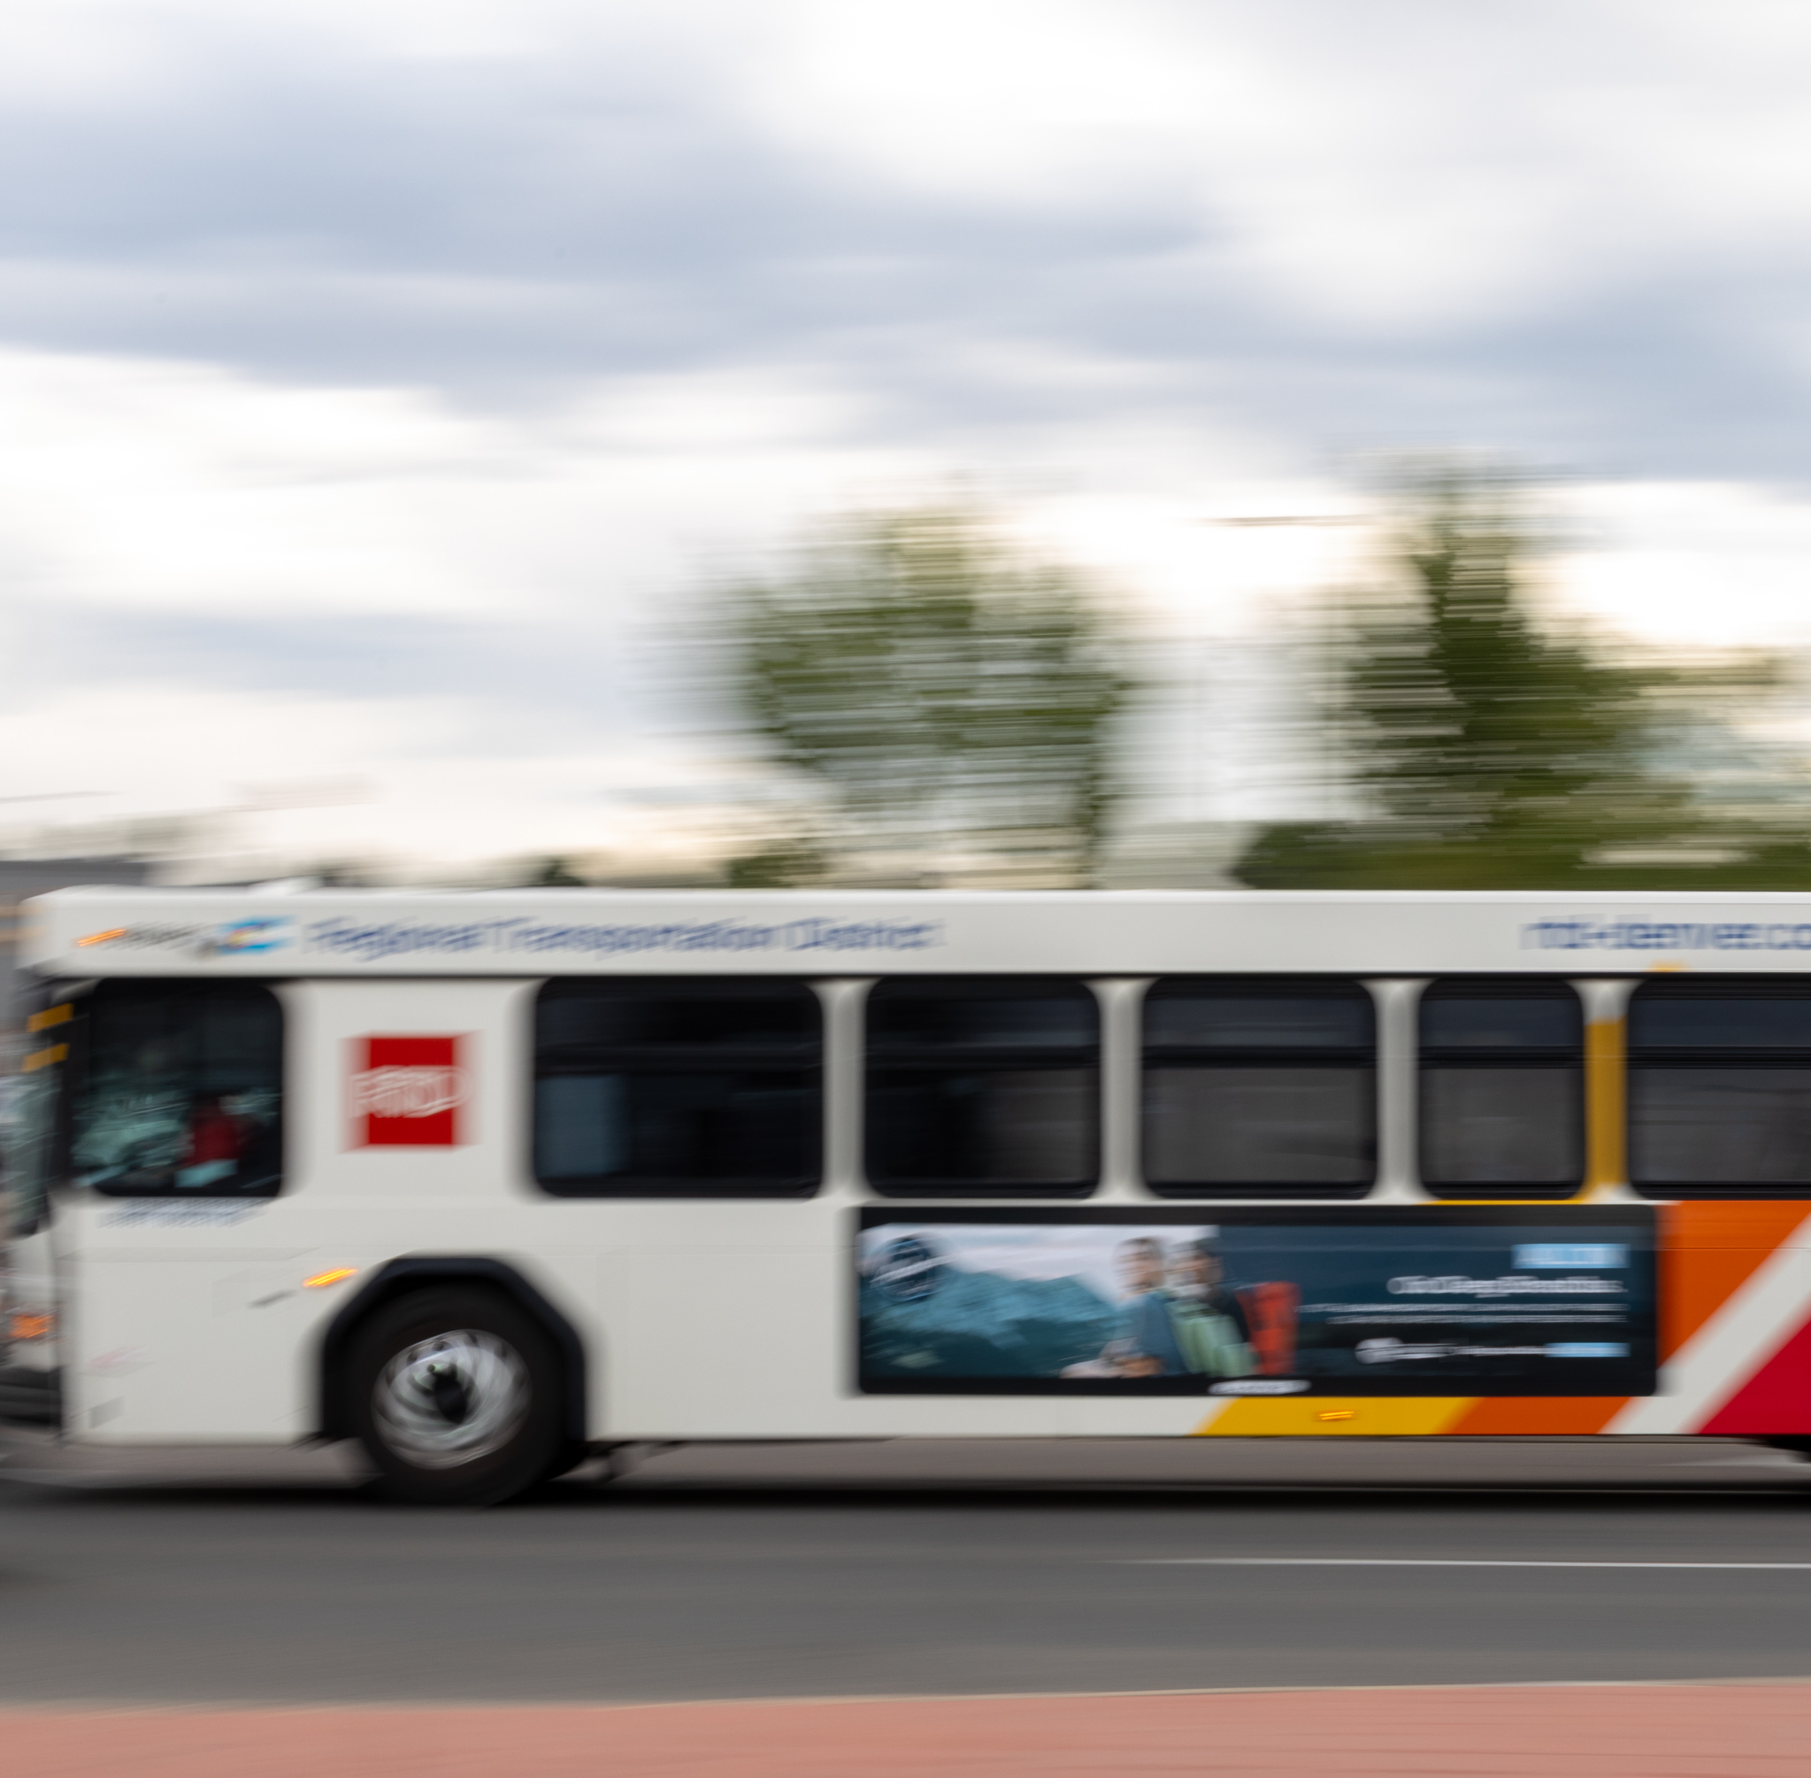
Order of Operations
Staff present the proposed Service Changes
During the presentation, customers submit their questions and comments using the Q&A feature
Following the presentation, staff answer questions related to the proposed Service Changes
  To resolve questions, or provide comments, on topics unrelated to Service Changes, join RTD for an upcoming Ask a Service Planner, or contact Customer Care at 303-299-6000
Concluding the question-and-answer session, customers verbalize their comments on proposed changes, if they choose
3
Notes:
Let’s chat briefly about the opportunity for public comment.
First, [RTD employee's name] will present the proposed changes for September.
During the presentation, you can submit your questions about changes via the Q&A feature, located at the bottom of the screen.
Following the presentation, staff will answer the questions related to the proposed changes.
Concluding the question-and-answer session, you can provide your comments on the proposed changes, if you choose RTD staff asks that any questions or comments provided tonight be related to the proposed service changes.
For questions or comments about routes and lines not proposed to be changed, please attend an upcoming Ask a Service Planner session or contact Customer Care at 303.299.6000.

Slide 4
What are Service Changes?
Notes:
So, what are service changes?

Slide 5
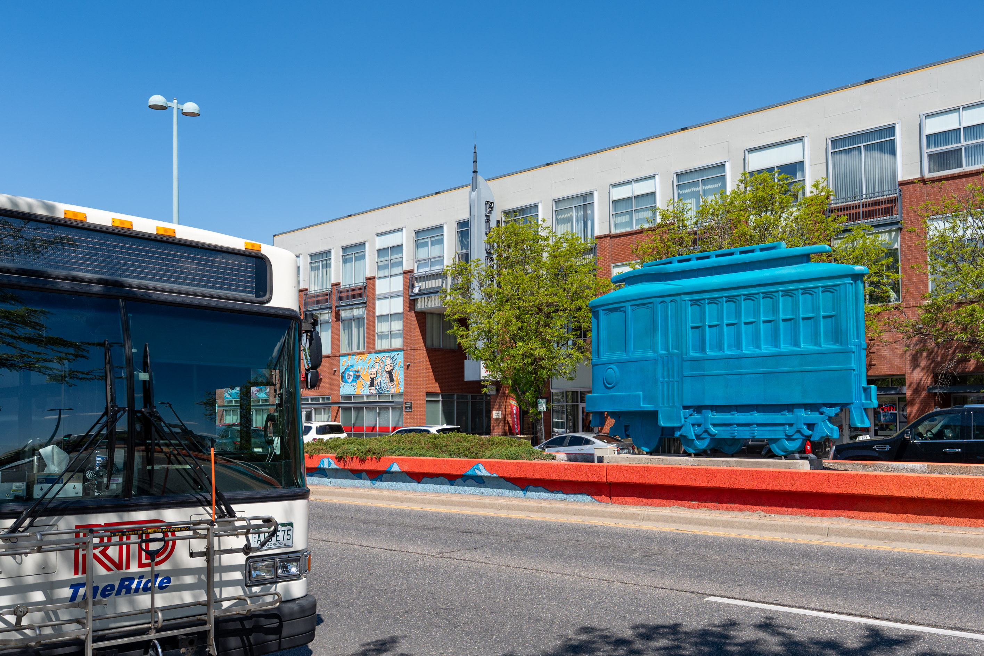
Service Changes
RTD reviews, proposes, and implements changes to its service schedules three times a year
  Changes typically take effect in January, June, and September
Service changes support multiple objectives
  Increase reliability
  Improve on-time performance
  Enable represented employees to select work shifts
  Account for changes in ridership
  Support scheduled maintenance projects
5
Notes:
RTD reviews, proposes, and implements changes to its service schedules three times a year, typically in January, June, and September.
Service changes support multiple objectives, including increasing service reliability, improving on-time performance, enabling represented employees to select work shifts, accounting for changes in ridership, and supporting scheduled maintenance projects.

Slide 6
Categories of Service Changes
 | Categories
 | Route Adjustment Detours or changes to routes or stops to optimize efficiency, improve accessibility, respond to changing travel patterns, or facilitate maintenance projects. |  | Service Increase Increases to the frequency, trips, span of service, or operating hours. |  | Service Reduction Reductions to the frequency, trips, span of service, or operating hours.
 | Categories (Cont.)
 | Seasonal Adjustment Temporary modifications made to bus and rail services in response to seasonal variations in demand or operational conditions. |  | Schedule Timing Alterations to the running time of bus and rail services, typically to better align with customer demands and trip connections, and to improve on-time performance.
6
Notes:
RTD categorizes service changes in five ways:
Route adjustments are detours or changes to a bus route or rail line to optimize efficiency, improve accessibility, respond to changing travel patterns, or facilitate maintenance projects.
Service increases are increases to the frequency, number of trips, span of service, or operating hours.
Service reductions are reductions to the frequency, number of trips, span of service, or operating hours.
Seasonal adjustments are temporary modifications made in response to seasonal variations in demand or operational conditions.
Schedule timing are minor alterations to the running time of bus and rail services, typically to better align with customer demands and trip connections, and to improve on-time performance.

Slide 7
Proposed Changes
Notes:
[RTD employee's name] will now present the proposed changes for September.

Slide 8
Schedule Timing

Slide 9
Rail Schedule Timing
Route | Name | Proposed Changes
T | Lincoln Station to I-25/Broadway Station | Minor changes to weekday, Saturday, and Sunday/Holiday schedules.
W | Union Station to Jefferson County Government Center-Golden Station | Minor changes to weekday, Saturday, and Sunday/Holiday schedules.
Schedule Timing
Alterations to the running time of bus and rail services, typically to better align with customer demands and trip connections, and to improve on- time performance.
9

Slide 10
Bus Schedule Timing
Route | Name | Description
1 | West 1st Avenue | Minor changes to weekday, Saturday and Sunday/Holiday schedules.
11 | Mississippi Avenue | Minor changes to weekday, Saturday and Sunday/Holiday schedules.
14 | West Florida Avenue | Minor changes to weekday, Saturday and Sunday/Holiday schedules.
37 | Smith Road Industrial | Shift westbound trips for better spacing with no change to levels of service.
105 | Havana Street | Minor changes to weekday, Saturday and Sunday/Holiday schedules.
153 | Chambers Road | Minor changes to weekday, Saturday and Sunday/Holiday schedules.
204 | Table Mesa / Moorhead / North 19th | Adjust northbound running times between 7 a.m. – 10 a.m.
Schedule Timing
Alterations to the running time of bus and rail services, typically to better align with customer demands and trip connections, and to improve on- time performance.
10

Slide 11
Bus Schedule Timing (cont.)
Route | Name | Proposed Change
206 | Conestoga / Arapahoe / Fairview High School | Adjust the 7:57 a.m. southbound departure from Conestoga/Arapahoe to 7:48 a.m.
323 | Skyline Crosstown | Shift the 5:52 p.m. weekday, eastbound trip from Bent/Dry Creek to 6 p.m.
AB | Airport to Boulder | Adjust schedules to align trips into a consistent 30-minute, clock-face pattern (:00 and :30) between US 36 and Table Mesa Park-n-Ride and Denver International Airport.
FREE | 16th Street FreeRide | Minor schedule adjustments to weekend service.
LD | Longmont / Denver | Adjust the 5:30 p.m. departure from Union Station to 5:40 p.m.
LX | Longmont / Denver Express | Adjust the 4:06 p.m. departure from Union Station to 4:20 p.m.
Schedule Timing
Alterations to the running time of bus and rail services, typically to better align with customer demands and trip connections, and to improve on- time performance.
11

Slide 12
Service Increases

Slide 13
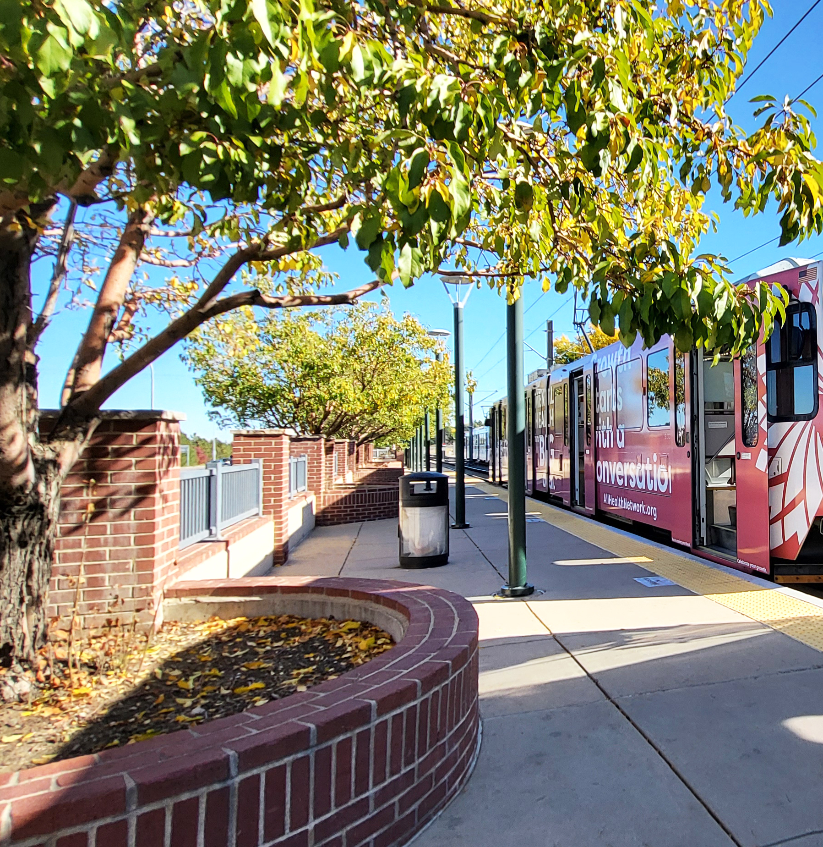
Rail Service Increase
Route | Name | Proposed Change
C | Union Station to Mineral Station | Permanently reinstate C Line once Downtown Rail Reconstruction Project is complete.
Schedule Timing
Alterations to the running time of bus and rail services, typically to better align with customer demands and trip connections, and to improve on- time performance.
13

Slide 14
Proposed Service Increases
Route | Name | Proposed Change
72 | 72nd Avenue | Extend route to Clear Creek Crossing Transfer Center in Wheat Ridge via 58th Ave.; add five weekday trips in the mornings.
AL | Denver International Airport to Longmont | New route would provide hourly service from 6 a.m. to 10 p.m. daily, with service operating from 8th Ave. and Coffman St. to US 287 with stops at Niwot Park-n-Ride and Lafayette Park-n-Ride to E-470 to Denver International Airport.
Service Increase
Increases to the frequency, trips, span of service, or operating hours.
14

Slide 15
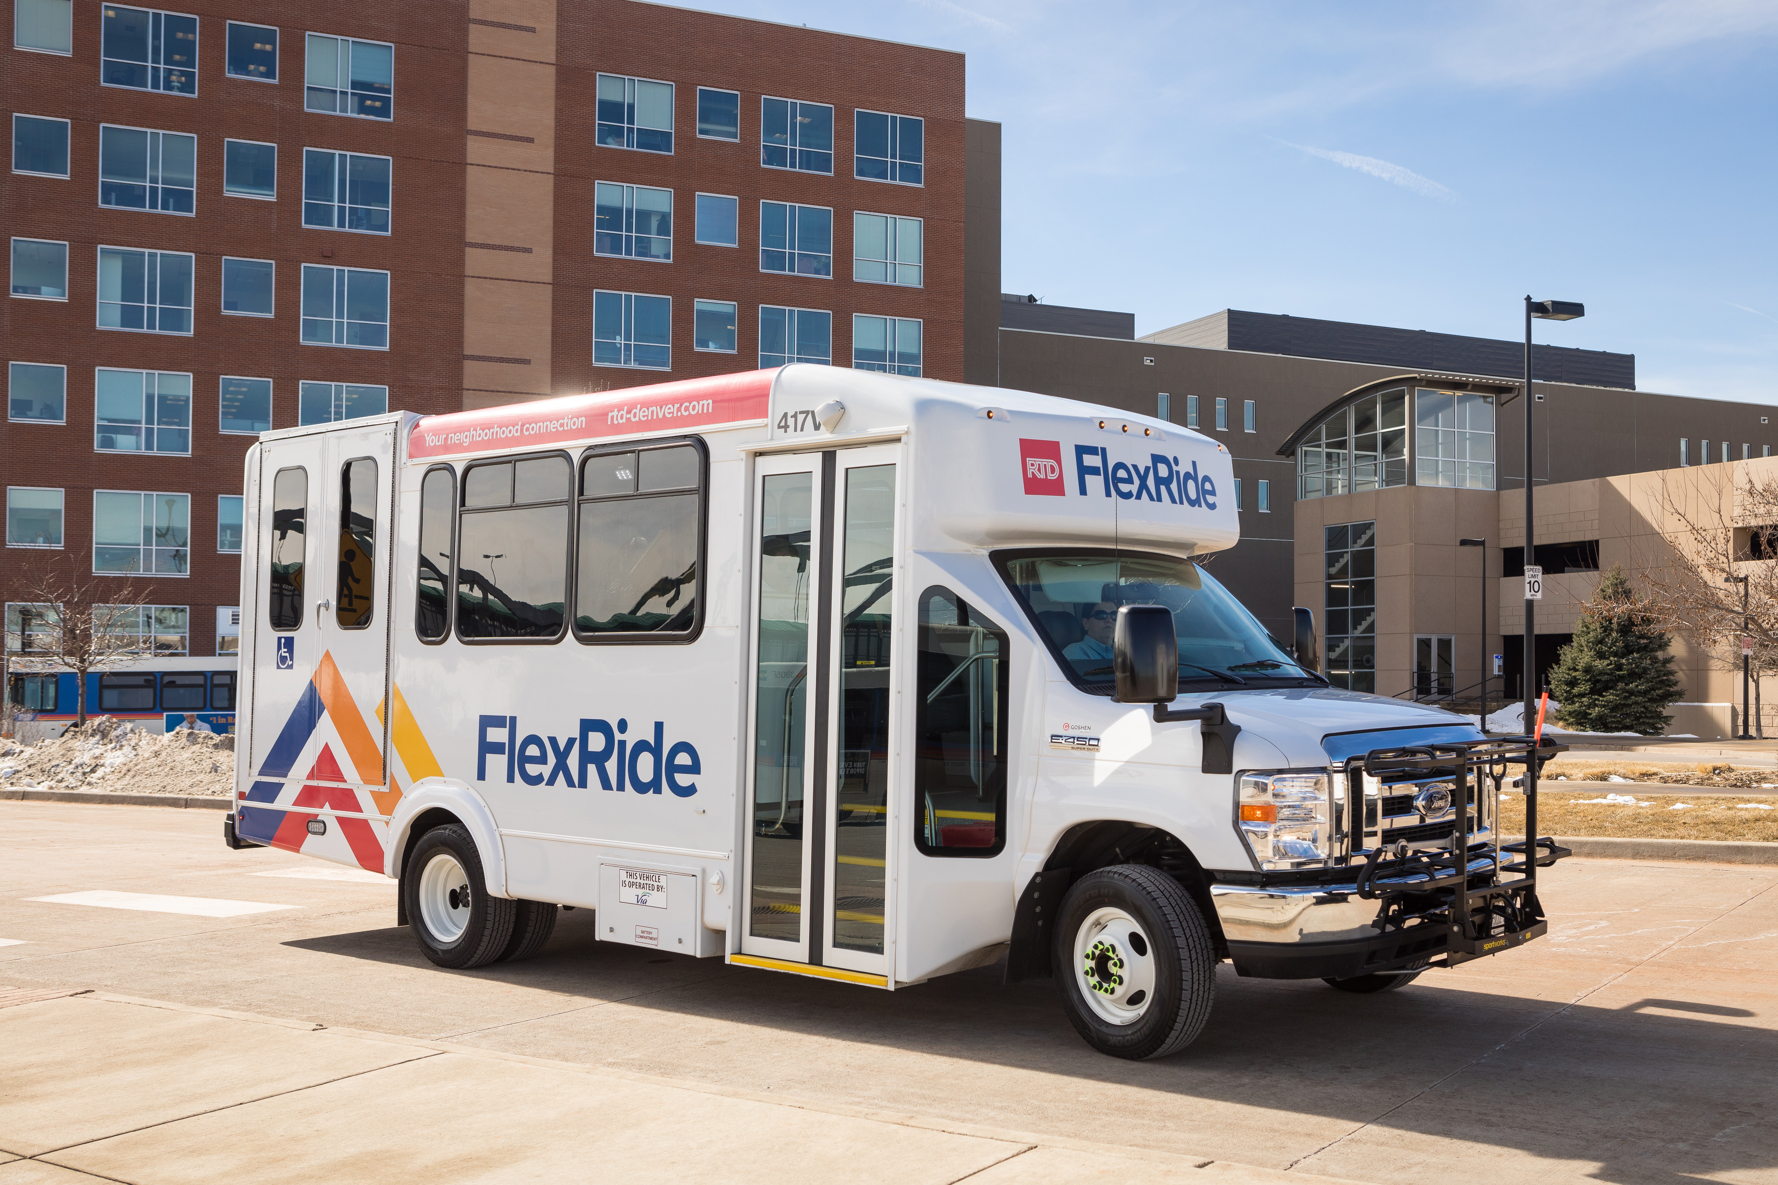
Proposed FlexRide Service Increases
Route | Name | Proposed Change
BMFX | Broomfield FlexRide | Extend weekday service to 9 p.m., with an extra vehicle added during a.m. and p.m. peaks. Add a second vehicle during Saturday peak hours. Implement Sunday service from 9 a.m. to 4 p.m.
ILFX | Interlocken / Westmoor FlexRide | Extend weekday service to 9 p.m.
Service Increase
Increases to the frequency, trips, span of service, or operating hours.
15

Slide 16
Route Adjustments

Slide 17
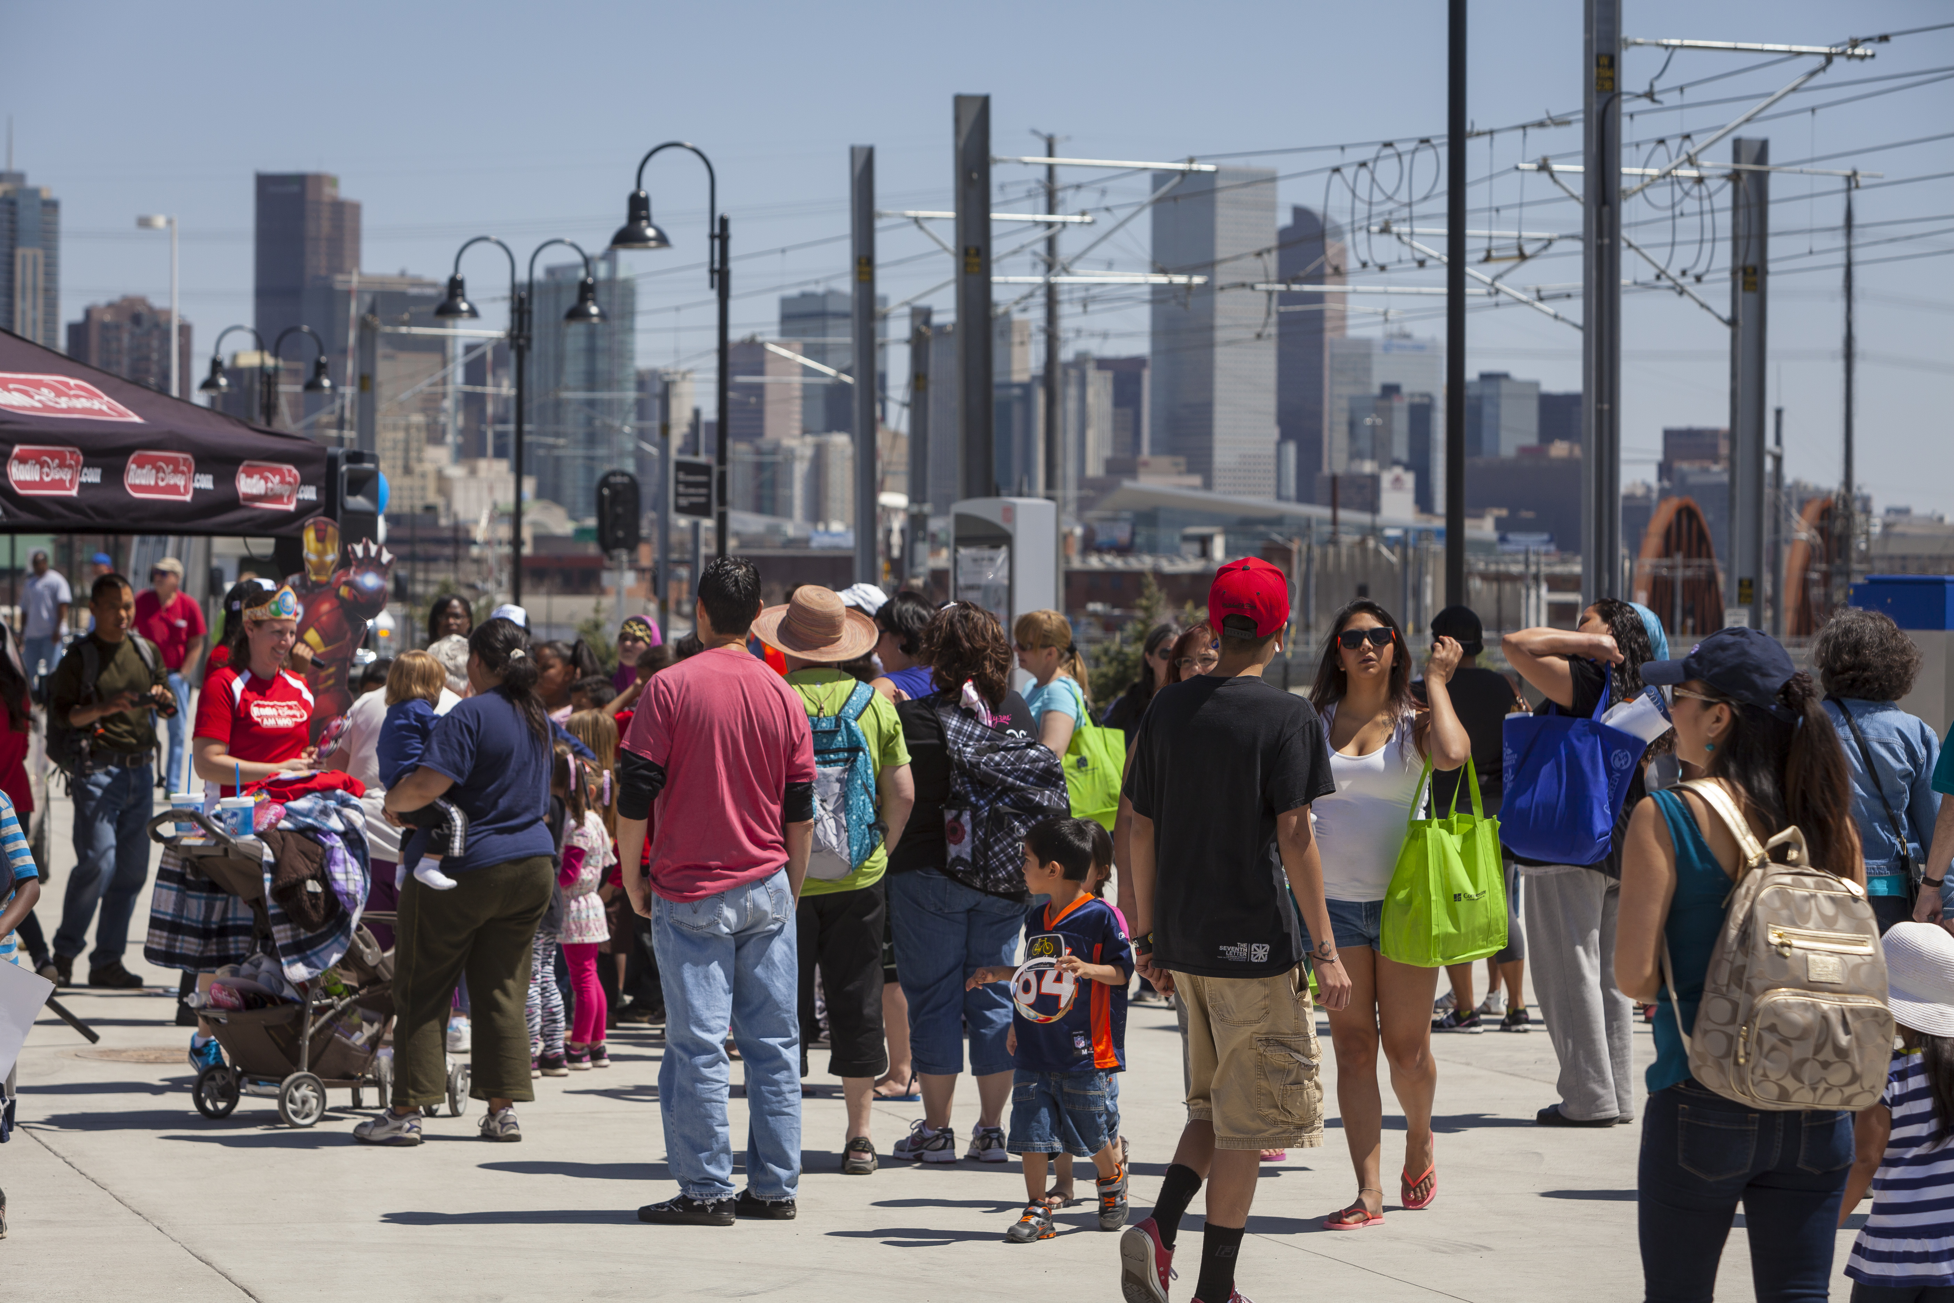
Proposed Route Adjustments
Route | Name | Proposed Change
9 | West 10th Avenue | Adjustment to serve "Z" stops in downtown Denver and relocation to Gate 8 at Union Station
10 | East 12th Avenue | Reroute service to Decatur•Federal Station as western terminal via Auraria Pkwy., West Colfax Ave., and Federal Blvd.
Route Adjustment
Detours or changes to routes or stops to optimize efficiency, improve accessibility, respond to changing travel patterns, or facilitate maintenance projects.
17

Slide 18
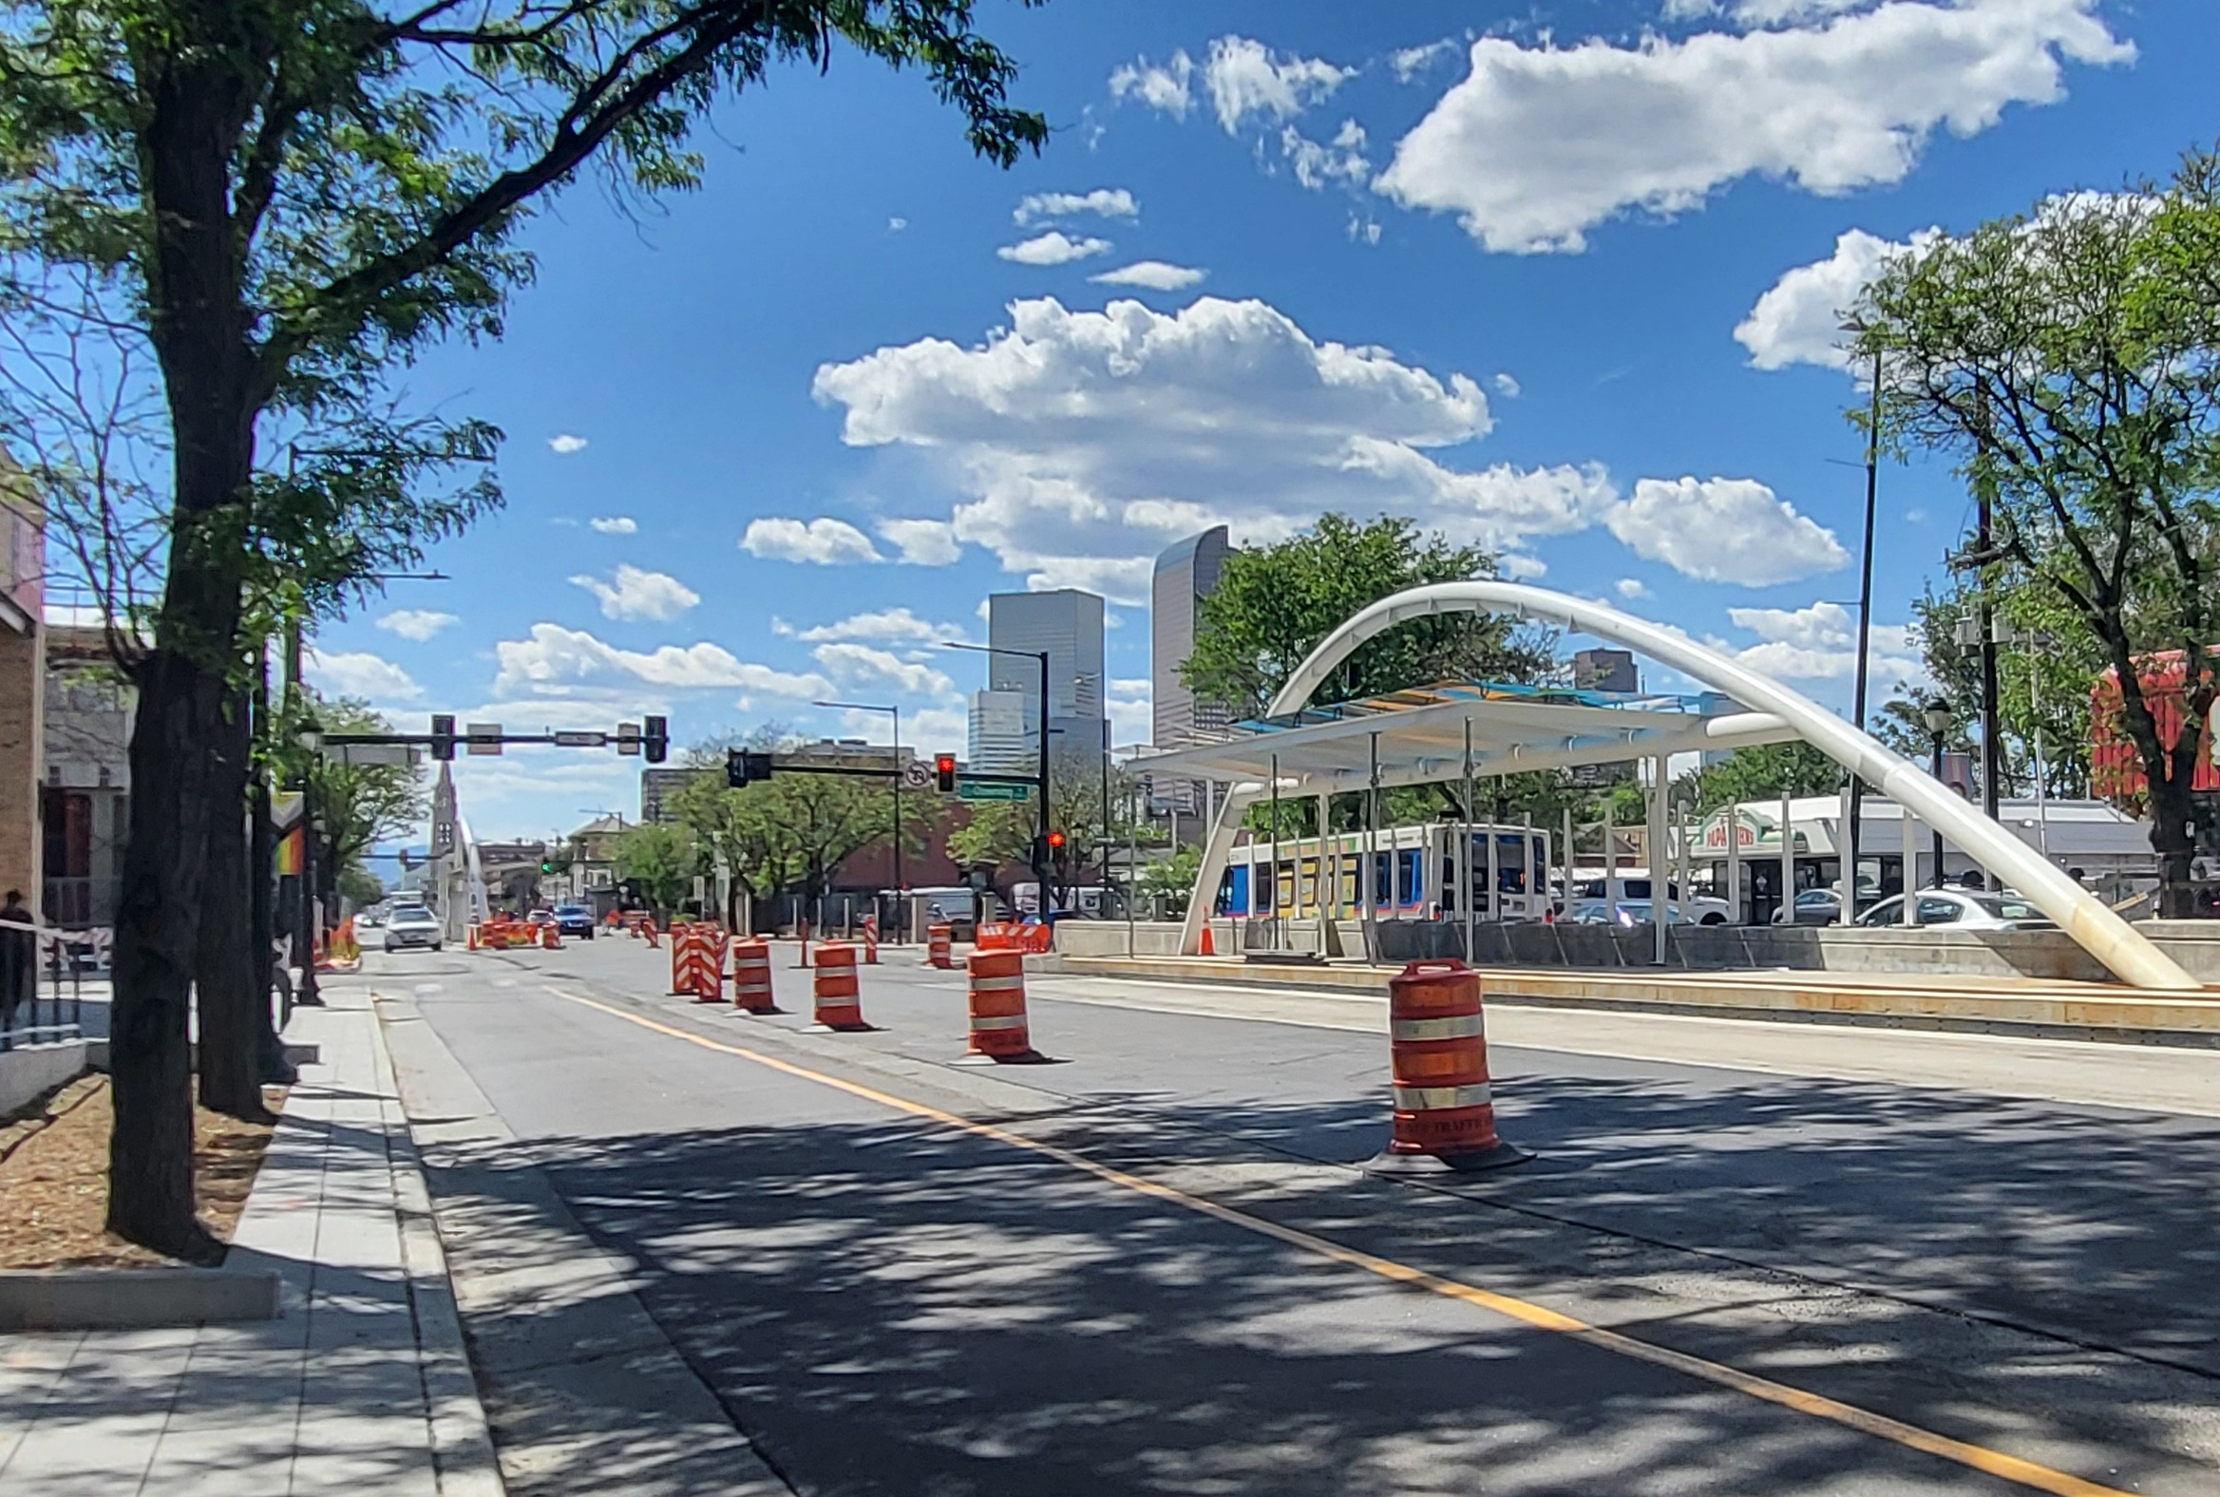
Proposed Colfax Route Adjustments
Route | Name | Proposed Change
15 | East Colfax Avenue | Implement dedicated lane operations along Colfax Ave. between Broadway and Colorado Blvd.
15L | East Colfax Limited | Reroute service to Union Station while implementing dedicated lane operations along Colfax Ave. between Broadway and Colorado Blvd. Western segment of route that serves Decatur Federal will be discontinued.
Route Adjustment
Detours or changes to routes or stops to optimize efficiency, improve accessibility, respond to changing travel patterns, or facilitate maintenance projects.
18

Slide 19
Proposed Bus Route Adjustments
Route | Name | Proposed Change
20 | 20th Avenue | Split the existing Route 20 into Route 20 and Route 23, with Route 20 serving the eastern portion of the route, terminating at Decatur•Federal Station.
23 | West 20th Avenue | Split the existing Route 20 into Route 20 and Route 23, with Route 23 serving the western portion of Route 20 along 20th Ave., terminating at Union Station.
32 | West 32nd Avenue | Relocate western terminal from Olde Town Arvada Station to Clear Creek Crossing Transfer Center in Wheat Ridge via 32nd Avenue.
52 | West 52nd Avenue / South Bannock | Reroute to serve to Ralston Rd./64th Ave.
Route Adjustment
Detours or changes to routes or stops to optimize efficiency, improve accessibility, respond to changing travel patterns, or facilitate maintenance projects.
19

Slide 20
Proposed Bus Route Adjustments
Route | Name | Proposed Change
53 | North Sheridan Blvd / Broomfield | Extend route to Orchard Pkwy. and 144th Ave.
59 | West Bowles | Relocate westbound departure gate to Downtown•Littleon Station Gate C.
72 | 72nd Avenue | Extend route to Clear Creek Crossing Transfer Center in Wheat Ridge via 58th Ave.; add five weekday trips in the mornings.
73 | Quebec Street | Realign routing near Belleview Station, with no changes to current bus stop locations or access.
83L | Cherry Creek / Parker Road Limited | Extend route to Denver Union Station via 15th and 17th streets.
Route Adjustment
Detours or changes to routes or stops to optimize efficiency, improve accessibility, respond to changing travel patterns, or facilitate maintenance projects.
20

Slide 21
Proposed Bus Route Adjustments (cont.)
Route | Name | Proposed Change
225 | Boulder / Lafayette via Baseline | Adjust route to return service to Willoughby Corner before 7 a.m. and after 7 p.m. while reinstating fall/winter service levels.
ART | Art District Connector | Current northbound detour made permanent.
DASH | Boulder / Lafayette via Louisville | Reinstate service to Willoughby Corner before 7 a.m. and after 7 p.m., with minor schedule adjustments and reinstatement of fall/winter service levels.
JUMP | Boulder / Lafayette / Erie via Arapahoe | Eliminate right turn at Canyon St. and add a stop at Gate J at Downtown Boulder Station.
NB | Boulder / Nederland / Eldora | Reinstate seasonal service to Eldora Ski Resort.
Route Adjustment
Detours or changes to routes or stops to optimize efficiency, improve accessibility, respond to changing travel patterns, or facilitate maintenance projects.
21

Slide 22
Service Reductions

Slide 23
Rail Service Reductions
Route | Name | Reason
D | 18th•California – Littleton•Mineral Station | Discontinue the D Line, which is currently not operating while the final phases of the Downtown Rail Reconstruction Project take place.
L | 30th•Downing – 16th•Stout | L Line will remain suspended until completion of the Downtown Rail Reconstruction Project in 2027.
Schedule Timing
Alterations to the running time of bus and rail services, typically to better align with customer demands and trip connections, and to improve on- time performance.
23
Notes:
Upon project completion, the L Line is proposed to return and operate between 30th•Downing and at least I-25•Broadway. Service beyond I-25•Broadway may be considered based on ridership demand, available funding, and operational needs.

Slide 24
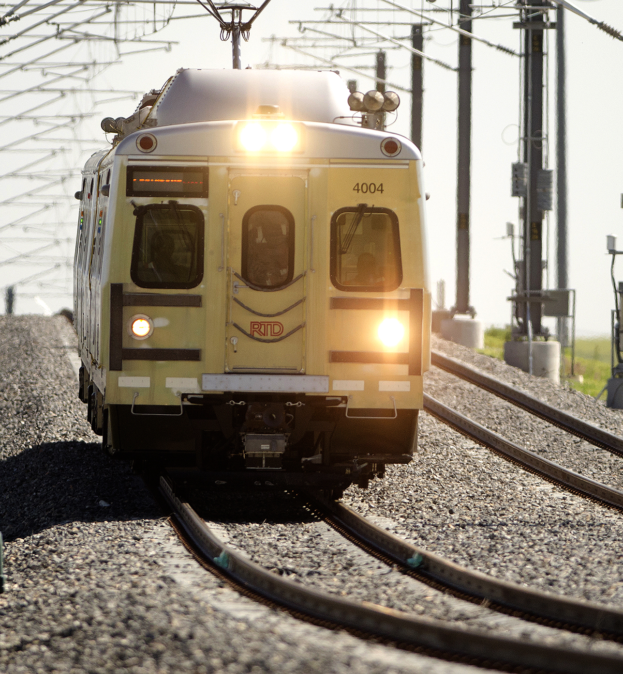
Rail Service Reductions (cont.)
Line | Name | Proposed Change
A | Union Station – Denver Airport | Schedule adjustments, modifying early morning and evening service frequencies as follows: - 3 a.m. to 6 a.m.: 30-minute frequency - 6:00 a.m. to 7:30 p.m.: 15-minute frequency - 7:30 p.m. to end of service: 30-minute frequency.
Schedule Timing
Alterations to the running time of bus and rail services, typically to better align with customer demands and trip connections, and to improve on- time performance.
24

Slide 25
Bus Service Reductions
Route | Name | Proposed Change
228 | Lafayette / Louisville / Broomfield | Discontinue service due to low utilization (3.9 boardings per hour)
WGFX | Wagon Road FlexRide | Discontinue service due to low utilization (1 boarding per hour)
Service Reduction
Reductions to the frequency, trips, span of service, or operating hours.
25

Slide 26
Seasonal Adjustments

Slide 27
Seasonal Adjustments
Route | Name
11 | Mississippi Avenue
24 | University Blvd
35 | Hampden Avenue
42 | Montbello via Albrook / Green Valley Ranch
45 | Montbello / Green Valley Ranch
51 | Sheridan Blvd
65 | Monaco Parkway
73 | Quebec St
Minor changes to weekday, Saturday, and Sunday/Holiday schedules are proposed for the following routes while also reinstating seasonal tripper service.
Seasonal Adjustment
Temporary modifications made to bus and rail services in response to seasonal variations in demand or operational conditions.
27

Slide 28
Seasonal Adjustments (cont.)
Route | Name
105 | Havana Street
225 | Boulder / Lafayette via Baseline
DASH | Boulder / Lafayette via Louisville
NB | Boulder / Nederland / Eldora
SKIP | Broadway (Boulder)
Minor changes to weekday, Saturday, and Sunday/Holiday schedules are proposed for the following routes while also reinstating seasonal tripper service.
Seasonal Adjustment
Temporary modifications made to bus and rail services in response to seasonal variations in demand or operational conditions.
28

Slide 29
Feedback and Input
Notes:
[shift back to facilitator] Now, we invite you to provide your comments and questions about the proposed service changes.

Slide 30
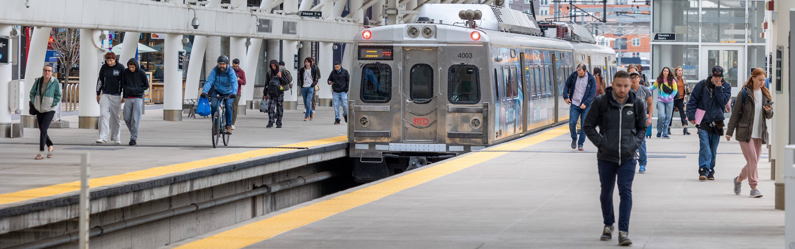
Questions
Customers wishing to ask a question related to the proposed changes orally should “raise” their virtual hand and will be called on one at a time
RTD asks that questions be related to the proposed service changes. Customers with unrelated questions are encouraged to join an upcoming Ask a Service Planner or call Customer Care at 303.299.6000.
Customers who wish to type their questions may do so by inputting them into the Q&A
30
Notes:
I will read the questions submitted into the Q&A function. If you have a question about the proposed changes, please raise your virtual hand or drop your question into the Q&A.
RTD staff ask that questions be related to the proposed changes. If you have unrelated questions, please join the Ask a Service Planner session tomorrow at noon or call Customer Care at 303.299.6000.
[PR specialist reads the questions. The service planner responds. This process continues until all questions have been addressed.]

Slide 31
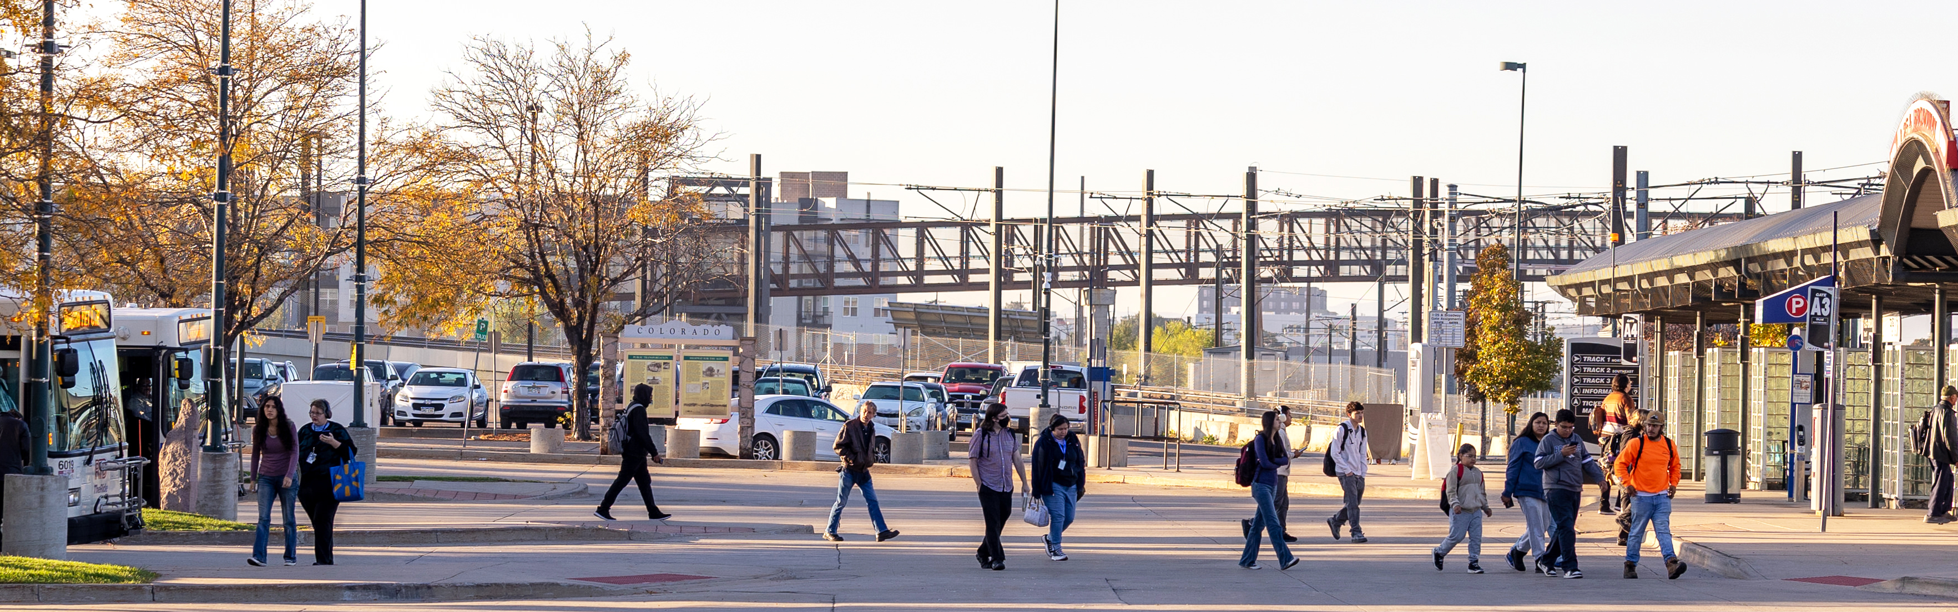
Public Comments
Customers wishing to provide feedback related to the proposed changes orally should “raise” their virtual hand and will be called on one at a time
Customers who wish to type their feedback may do so by inputting it into the Q&A
Customers are asked to be respectful of fellow attendees by limiting their comments to two minutes
31
Notes:
Now that questions have been addressed, we will accept your feedback on the proposed changes. As a reminder, if you wish to provide public comment or ask a question related to the proposed changes, please “raise” your virtual hand and you will be called on one at a time.
Please limit your comments to two minutes to allow your fellow attendees the opportunity to speak.
Alternatively, if you want to type your comments or questions, you may do so by inputting them into the Q&A.
[PR specialist calls on raised hands to speak. This process continues until no additional hands are raised.]

Slide 32
Provide Feedback
Online Survey | Customer Care | Public Comment
Complete the online survey at rtd-denver.com/service-alerts/service-changes | Share feedback with a call center agent at 303.299.6000 | Attend a virtual or in-person meeting of the Board of Directors
Community Events | Email
Visit with RTD staff at a local community event | Send an email to service.change@rtd-denver.com
32
Notes:
Seeing no other hands raised, I want to thank everyone for attending and for providing feedback on the proposed changes. In addition to this public meeting, there are many other ways customers can provide feedback, including by:
Visiting RTD’s proposed service changes webpage for September 2026 on RTD’s website
providing feedback by calling Customer Care at 303.299.6000
attending a meeting of the Board of Directors
finding RTD at a community event or
emailing service.change@rtd-denver.com.

Slide 33
Timeline and Next Steps
Notes:
Timeline and Next Steps
Before we close, I want to share the timeline for the proposed service changes.

Slide 34
Timeline
June 11 – July 8
July 8
July 15
July 28
September 27
Public Meetings and activities to solicit feedback held
Public comment
and feedback
deadline
Proposed Service Changes and public comments shared with the Operations, Safety, and Security Committee
Board of Directors take action on proposed
Service Changes
If approved, the Service Changes take effect
34
Notes:
RTD is hosting public meetings and performing community engagement activities related to the proposed service changes through July 8.
Public comment on the proposed changes ends on July 8.
The Operations, Safety, and Security Committee will vote on the proposed changes on July 15.
The full Board of Directors will take action on July 28.
If approved by the Board of Directors, the proposed service changes will go into effect on Sunday, September 27.

Slide 35
Thank you
Notes:
This concludes our public meeting. Thank you for attending and have a great day / good night.

